Slide 1
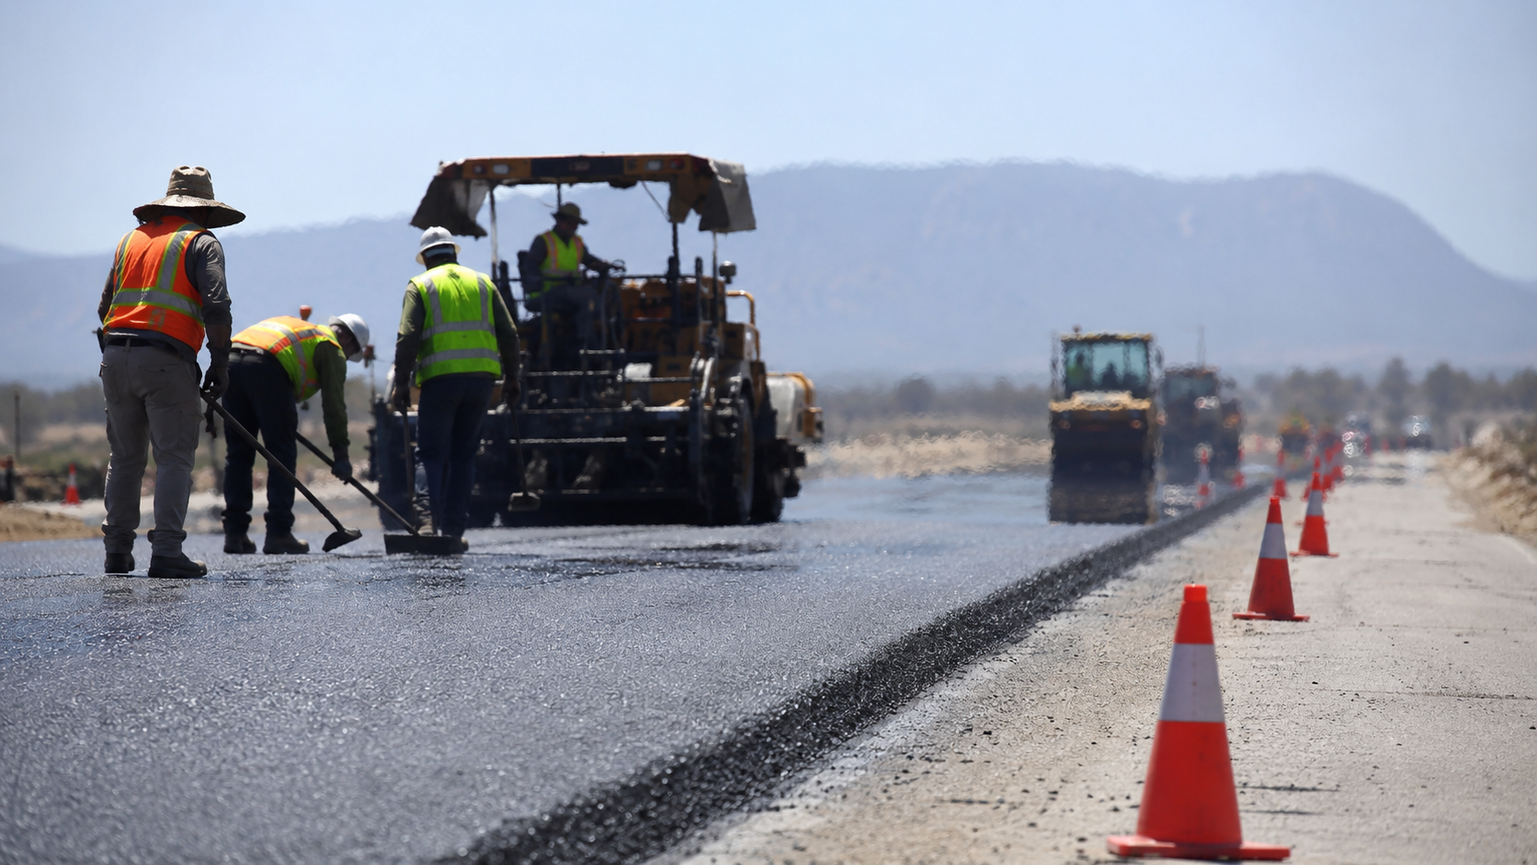
Training Workers
for Heat, Fatigue
and Human Factors
Notes:
Open by making the premise very clear: this is not another heat illness refresher. The audience already knows water, rest, shade. The real problem is whether workers and supervisors can recognize changing risk, interrupt unsafe production pressure, and make a defensible decision in the moment.
Set the expectation: we will cover the changing risk environment, what heat and fatigue do to judgment and performance, how human factors explain “bad decisions,” and how to turn training into field verification and proof.
Suggested pacing: 2 minutes.

Slide 2
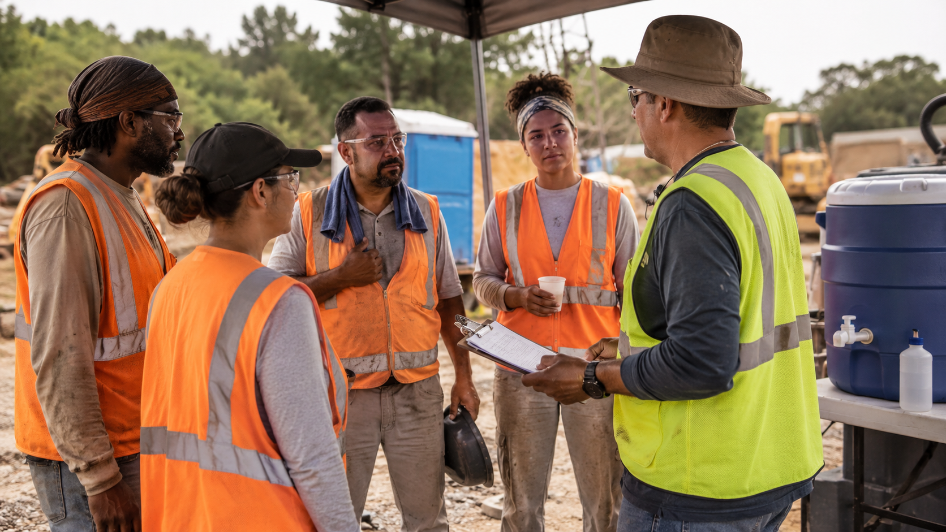
What we’ll prove today
1
Heat risk is changing
2
Fatigue is an exposure
3
Human factors drive decisions
4
Training must survive the field
5
Verification creates due diligence
Notes:
Use this slide as the roadmap. Emphasize that the webinar is not organized around three separate topics. Heat, fatigue, and human factors interact. Heat increases physiological strain. Fatigue reduces attention, reaction time, risk perception, and communication. Human factors explain why people keep working when the safe answer is to stop.
This matters for OHS, HR, and owners because the solution is not just a safety talk. It involves scheduling, staffing, productivity expectations, accommodation issues, supervision, incident response, and training verification.
Suggested pacing: 2 minutes.

Slide 3

The world got hotter
Workplaces are absorbing the risk.
2.41B
22.85M
18,970
workers exposed to excessive heat each year
occupational injuries attributed to heat annually
work-related deaths attributed to heat annually
Source: ILO, Ensuring safety and health at work in a changing climate / Heat at work, 2024.
Notes:
Start broad. The International Labour Organization estimates 2.41 billion workers are exposed to excessive heat annually, with 22.85 million occupational injuries and 18,970 deaths attributable to excessive heat each year.
The point is not to make the audience responsible for global climate change. The point is that employers are inheriting a new operating reality. Work that used to be uncomfortable can now be hazardous. Workplaces that never thought of themselves as “heat workplaces” now need controls.
Bring it back to US and Canada: this is why regulators, insurers, unions, workers, plaintiffs, and customers are looking harder at heat readiness.
Suggested pacing: 3 minutes. Source: ILO 2024.

Slide 4
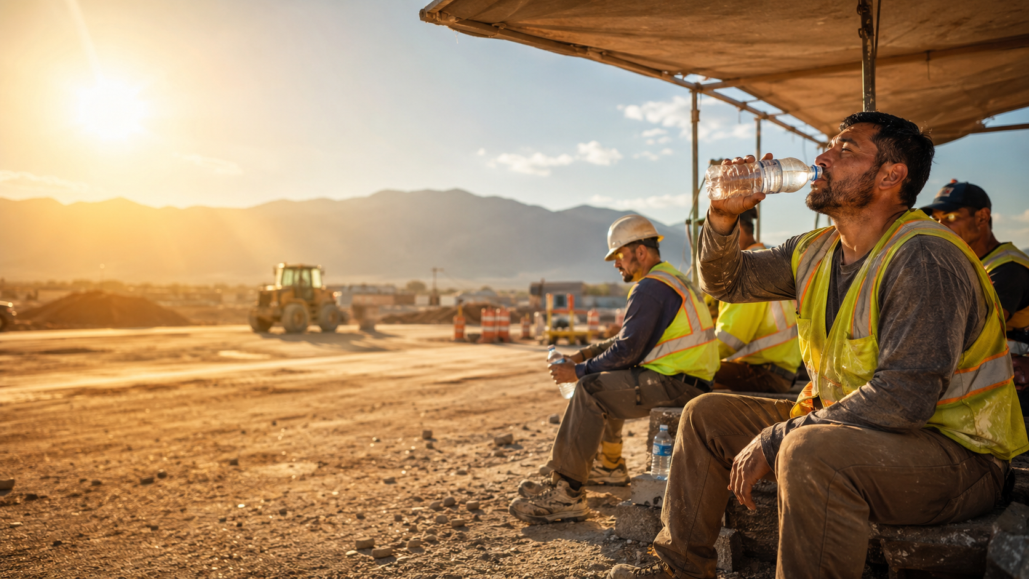
North America is not exempt
US
Canada
48
619
work-related heat deaths in 2024
heat-related deaths during BC’s 2021 heat dome
7,100
DART cases tied to environmental heat in 2023–2024
49.6°C
Canada’s all-time high, recorded in Lytton, BC
Sources: NSC Injury Facts; Science.gc.ca / Health Canada summary of 2021 western heat dome.
Notes:
This slide localizes the risk. In the US, the National Safety Council reports 48 work-related deaths from environmental heat in 2024 and 7,100 DART cases in 2023–2024. In Canada, the 2021 BC heat dome showed how quickly ordinary infrastructure and normal assumptions can fail.
Make the connection to work. The heat dome was a public health event, but the lesson for employers is that heat risk does not stay neatly outside the workplace. Workers arrive already heat-stressed from homes, commutes, smoke exposure, dehydration, poor sleep, medications, and caregiving stress. That changes fitness for work.
Suggested pacing: 3 minutes. Sources: NSC Injury Facts; Government of Canada Science blog.

Slide 5
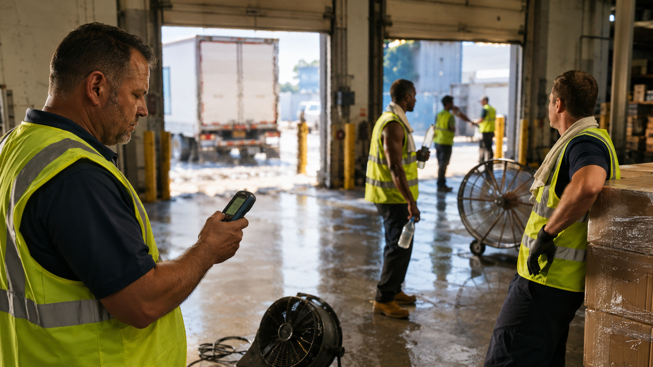
Not just summer
Not just outside.
Heat can be indoor, seasonal, local, hidden.
Source: OSHA, Working in Outdoor and Indoor Heat Environments, 2026.
Notes:
Use the warehouse image to break the audience’s mental model. OSHA expressly says hazardous heat can occur indoors or outdoors and during any season if the conditions are right. That includes kitchens, laundries, warehouses, boiler rooms, foundries, manufacturing spaces, delivery work, construction, utilities, agriculture, and more.
The training implication is important. If employees think heat safety means “summer construction,” they will miss the risk in a hot loading bay, a mechanical room, a delivery truck, a restaurant kitchen, a PPE-intensive clean-up job, or an unexpected early season hot day.
Suggested pacing: 3 minutes. Source: OSHA heat overview, 2026.

Slide 6
Water is not a program
It is one control in a system.
Measure
Modify
Monitor
Stop
WBGT / humidex / task load
pace, schedule, PPE, staffing
new workers, symptoms, recovery
clear authority to pause work
Notes:
This is the first operational pivot. Water matters, but water alone is not a heat program. Training should teach workers and supervisors that controls form a system: measure the risk, modify the job, monitor people, and stop or slow work when needed.
This is especially important for business owners and HR leaders. A heat program touches production schedules, overtime, temporary workers, new hires, job rotation, PPE selection, staffing levels, and emergency response. If those pieces are not aligned, the worker gets a water bottle and a mixed message.
Suggested pacing: 3 minutes.

Slide 7
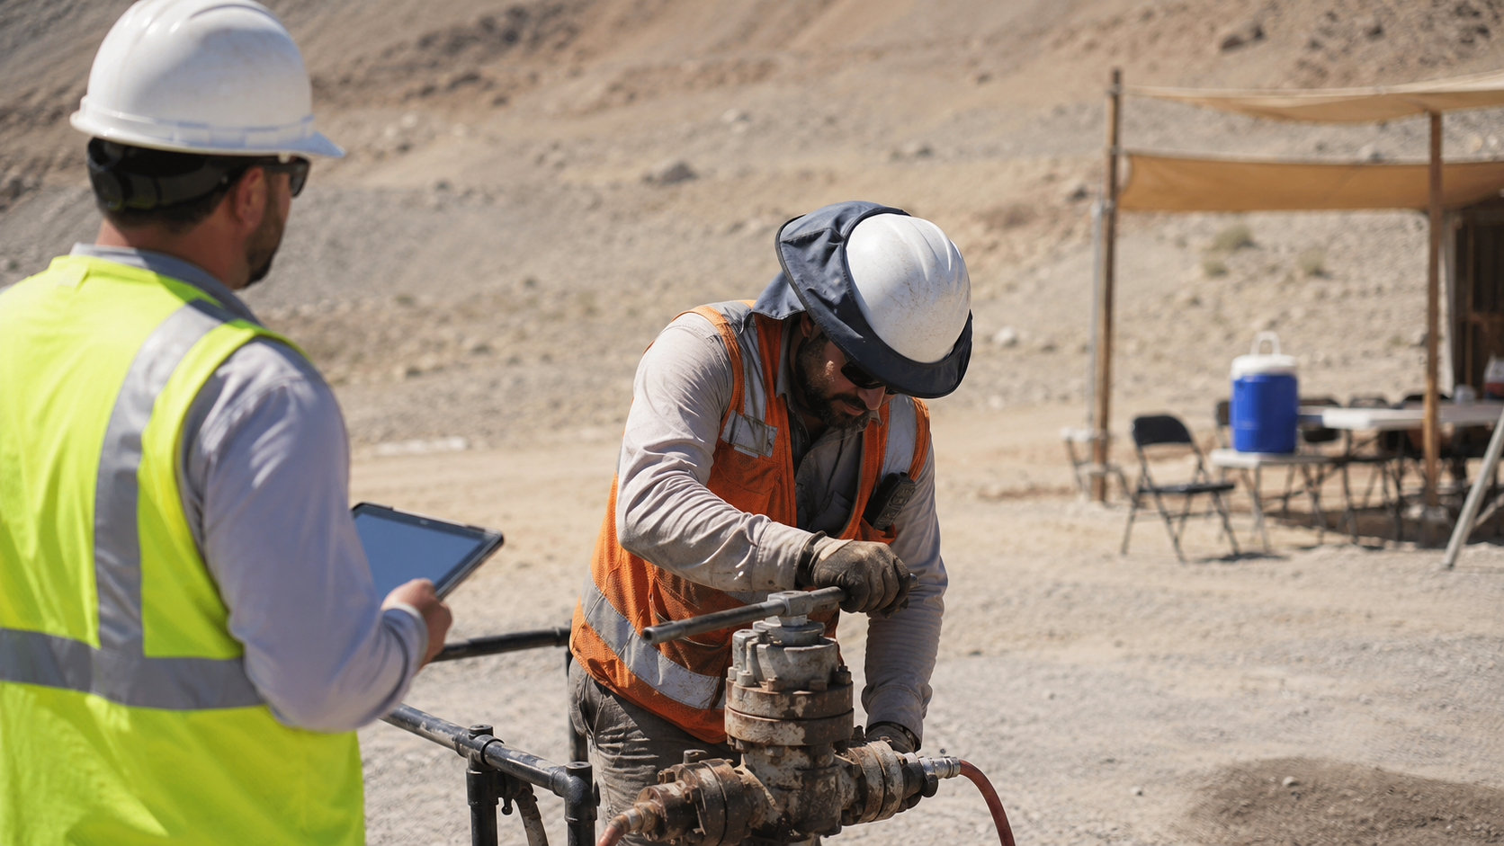
Heat steals capacity
First from the body. Then from the brain.
HOTTER BODY
HEAVIER WORK
MORE PPE
slower thinking
higher strain
less cooling
Notes:
Explain heat strain in practical terms. As core temperature and cardiovascular strain rise, the body is working harder just to stay regulated. Add heavy work, humidity, radiant heat, poor air movement, impermeable PPE, dehydration, or low acclimatization, and the margin shrinks.
Then connect it to cognitive performance. The question is not only whether a worker can collapse from heat stroke. The earlier danger is reduced attention, poorer judgment, slower reaction time, miscommunication, and an increased likelihood of pushing through symptoms.
Suggested pacing: 3 minutes. Source to reference verbally: NIOSH criteria document and OSHA heat guidance.

Slide 8
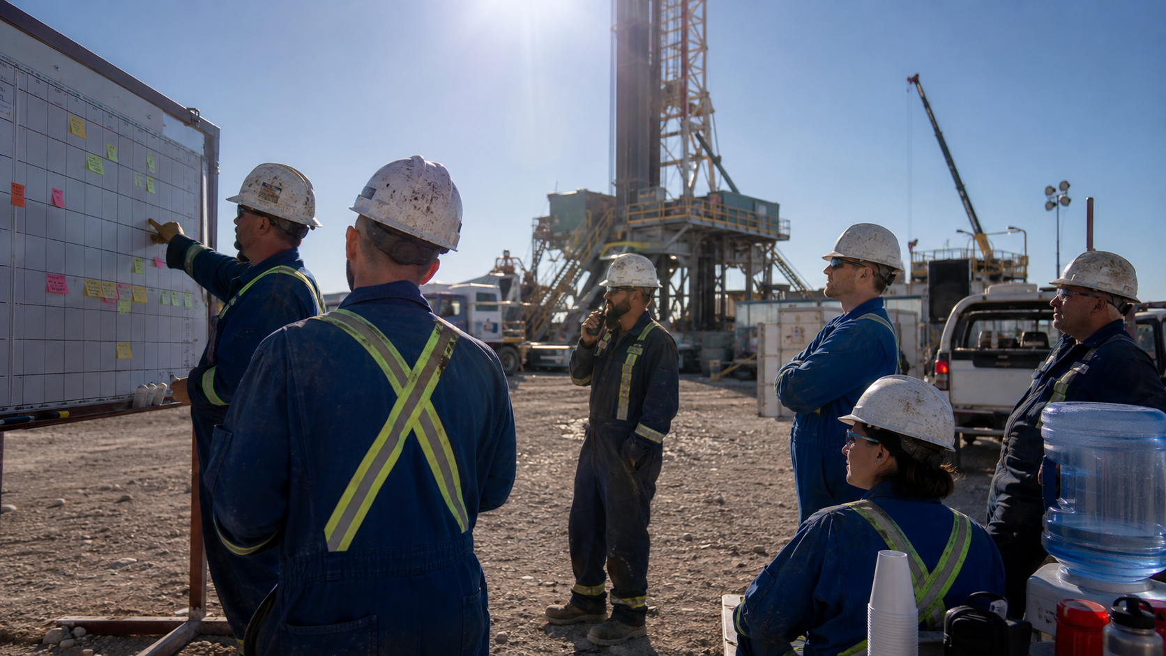
Acclimatization is a control
New, returning, reassigned, or rushed workers need ramp-up.
The first hot days are not practice days.
Source: OSHA Heat, Protecting New Workers / Acclimatization guidance.
Notes:
A common failure is assuming experienced workers are automatically acclimatized. OSHA notes workers who have not recently spent time in hot environments or doing physically active work need time to build tolerance. That includes new workers, seasonal workers, workers returning from vacation or illness, people transferred to hotter tasks, and employees coming off lighter duty.
Training should not just say “acclimatize.” It should make supervisors rehearse the decisions: Who is new to the heat today? Who is coming back? Who got moved from inside to outside? What work-rest schedule applies? What symptoms trigger removal?
Suggested pacing: 3 minutes.

Slide 9

Fatigue is an exposure
It changes what people notice, remember, and risk.
97%
80%+
of workers have at least one fatigue risk factor
have two or more risk factors
Source: National Safety Council Fatigue Reports.
Notes:
Position fatigue as a hazard, not a personal weakness. The National Safety Council reports that 97% of workers have at least one workplace fatigue risk factor and more than 80% have two or more. That means fatigue is normal enough that programs must be designed around it.
Mention common risk factors: long shifts, overtime, night work, early starts, insufficient recovery between shifts, physically demanding work, heat, stress, long commutes, and poor sleep. HR and operations influence many of these risk factors, not just the worker.
Suggested pacing: 3 minutes. Source: NSC Fatigue Reports.

Slide 10
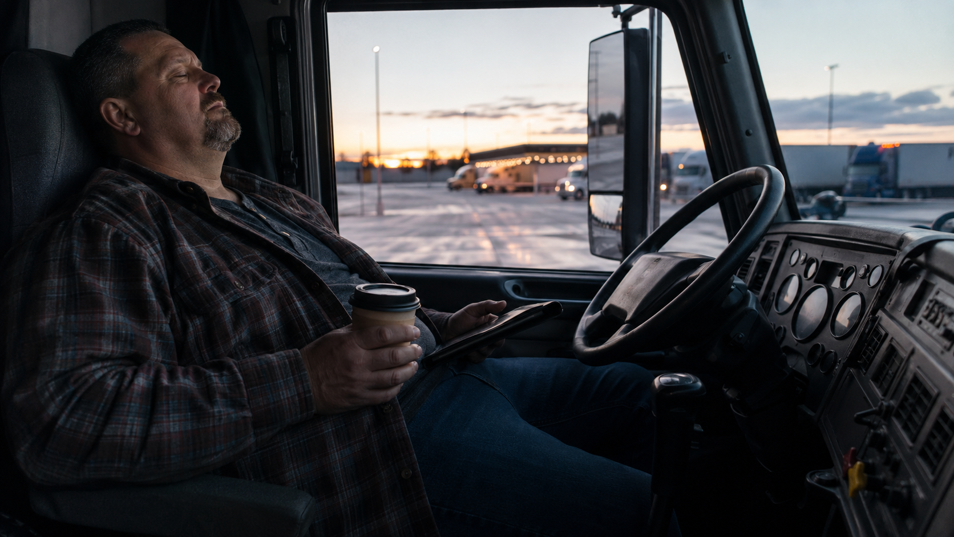
Tired people take longer
To react. To decide. To stop.
$218B+
estimated annual U.S. employer cost from work-related fatigue
1 in 8
workplace injuries may relate to fatigue
Source: CDC/NIOSH Science Bulletin, Working Hours and Fatigue, 2023.
Notes:
Use this slide to bridge worker safety and business impact. NIOSH reports that work-related fatigue costs US employers an estimated $218 billion or more each year through productivity loss and absences, and that close to 1 in 8 workplace injuries may relate to fatigue.
Then emphasize driving and commute risk. NIOSH also notes that more than 1 in 5 fatal vehicle crashes may involve a drowsy driver. For employers, this matters for professional drivers, field workers, emergency responders, sales/service staff, and anyone driving home after a long hot shift.
Suggested pacing: 3 minutes. Source: CDC/NIOSH Science Bulletin, 2023.

Slide 11
Human error is usually a symptom
Ask why the decision made sense at the time.
People adapt to the system they are given.
Source: WorkSafeBC Human Factors.
Notes:
This is the central human factors argument. WorkSafeBC describes human factors as the study of how people interact with the elements of a workplace system. It also says workers make decisions and take actions that make sense to them at the time given their goals, knowledge, and focus of attention.
Put that into heat and fatigue language: a worker keeps going because the crew is behind, the supervisor is under pressure, the symptom feels minor, the shade is too far away, the cooling area is crowded, the task is almost done, or the worker does not want to look weak.
Training that only tells people what the rule is will miss the conditions that make rule-breaking feel reasonable.
Suggested pacing: 4 minutes. Source: WorkSafeBC Human Factors.

Slide 12

Training fails in the gap
Classroom knowledge → field behaviour.
The test is not completion.
The test is the decision under pressure.
Notes:
This is where you can bring in your training fatigue perspective. A worker can pass a heat module and still fail the field moment. Completion proves exposure to content. It does not prove the worker can recognize deteriorating conditions, challenge production pressure, report symptoms early, or apply controls when the job has changed.
For HR and business owners, the issue is defensibility. After a serious event, the question will not be “Did they take a module?” It will be “Did the employer train, supervise, reinforce, and verify that the worker and supervisor could apply the controls in the real work environment?”
Suggested pacing: 3 minutes.

Slide 13
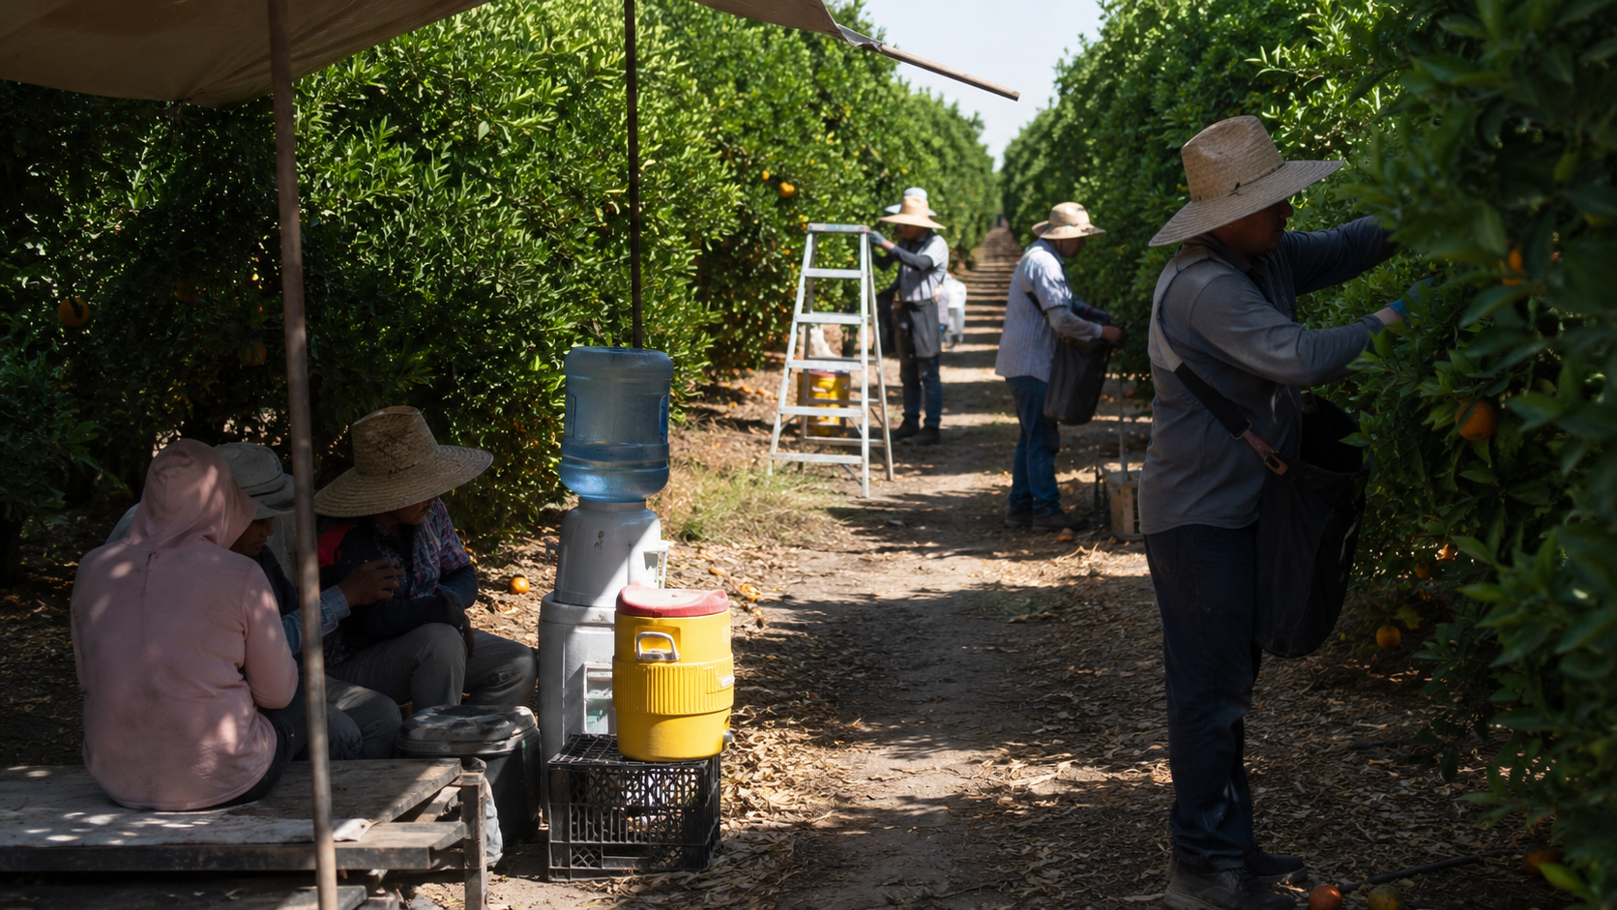
Case lesson: 92°F was enough
A Florida farmworker collapsed and died after heat-stroke symptoms.
Disoriented. Difficulty talking. Unresponsive.
Source: U.S. Department of Labor / OSHA news release, June 26, 2024.
Notes:
Use this as a case, not as a blame exercise. OSHA reported that a 41-year-old farmworker harvesting oranges in Florida became disoriented, had difficulty talking, became unresponsive, and died three days later. OSHA determined the heat index was approximately 92 degrees Fahrenheit that day.
The lesson is powerful because many supervisors might not perceive 92°F as catastrophic, especially in warm climates. The risk is not only the number on the weather app. It is workload, acclimatization, hydration, medical factors, access to shade, early symptom recognition, emergency response, and whether workers feel able to stop.
Ask the audience: would your supervisors have stopped work soon enough? Would workers have reported symptoms early enough? Would your first-aid response have been ready?
Suggested pacing: 4 minutes. Source: DOL/OSHA release, June 26, 2024.

Slide 14
Regulators are closing the gap
Heat is becoming formal, measurable, and enforceable.
US OSHA
2026 revised Heat NEP; federal rulemaking still pending
California
Indoor heat standard effective at 82°F threshold
Canada federal
COHSR thermal stress procedures, controls, training, reporting
BC
2026 heat stress prevention guidance and employer planning expectations
Sources: OSHA Heat NEP/rulemaking pages; Cal/OSHA; ESDC Labour Program; WorkSafeBC.
Notes:
This slide helps executives see the direction of travel. OSHA’s 2026 heat page highlights a revised National Emphasis Program for outdoor and indoor heat hazards dated April 10, 2026. OSHA’s proposed federal heat rule had hearings ending July 2025 and a post-hearing comment period ending October 2025; as of the cited OSHA rulemaking page, final rule status remains pending.
California now has an indoor heat standard applying to most workplaces where the indoor temperature reaches 82°F, effective July 23, 2024. In Canada, federal thermal stress amendments for federally regulated workplaces require procedures for monitoring and controlling thermal stress, including work-rest cycles, acclimatization, engineering controls, training, and internal reporting.
Your message: even where a specific heat standard is not yet in force, due diligence expectations are rising.
Suggested pacing: 4 minutes. Sources: OSHA, Cal/OSHA, ESDC Labour Program, WorkSafeBC.

Slide 15
Train for the moment
Not the memory quiz.
Recognize → Decide → Speak Up → Stop → Recover
Notes:
This is the practical training standard. Teach the sequence, not just the hazard. Workers need to recognize early signs, decide what those signs mean, say something in words that supervisors accept, stop or modify work, and recover before returning.
Make training scenario-based. For example: a new worker is trying to prove themselves; a crew is behind schedule; a worker says they are “fine” but is confused; the shade is 300 yards away; the work is almost done; PPE cannot be removed; the supervisor thinks everyone is acclimatized.
The training objective is not recall. It is a competent decision under real constraints.
Suggested pacing: 3 minutes.

Slide 16
Supervisors are the control point
They translate policy into work pace.
Ask
Observe
Adjust
Escalate
Notes:
Supervisors need more than awareness training. They need practiced authority. They must know how to ask direct symptom questions, observe changes in coordination or communication, adjust task pace and crew assignment, and escalate when symptoms or conditions warrant it.
Give examples of supervisor scripts: “You’re not in trouble. I need a real answer. Are you dizzy, confused, cramping, nauseated, or unusually weak?” Or: “We’re changing the plan because the risk changed.” Or: “Production pressure does not override heat illness symptoms.”
This is where HR policies matter. Supervisors must not punish early reporting, and workers must not lose pay, status, or future shifts for using heat controls.
Suggested pacing: 4 minutes.

Slide 17
Verification beats hope
Watch the work. Confirm the control.
Proof is built in the field.
Notes:
Make the due diligence point. The program becomes defensible when the employer can show more than a training record. Evidence should show that the employer identified heat and fatigue risk, assigned relevant training, checked understanding, reinforced expectations, verified controls in the field, and corrected failures.
Examples of field verification: pre-job heat/fatigue check, documented WBGT or humidex review, supervisor observation, worker symptom check, acclimatization roster, rest/water/shade availability check, high-heat escalation record, and post-incident learning loop.
Suggested pacing: 3 minutes.

Slide 18
This is not just safety
OHS, HR, and operations all own a piece.
Policy without staffing is fiction.
Training without supervision is hope.
Records without verification are fragile.
Notes:
This slide is aimed at the mixed audience. OHS owns hazard assessment, controls, training content, and verification. HR owns onboarding, accommodation, scheduling policies, discipline practices, communication, temporary worker processes, and return-to-work. Operations owns job planning, pace, crew size, break logistics, equipment, and supervisor authority.
If any one group is missing, the program becomes performative. Safety writes the policy, HR onboards people into risk, operations schedules work as if heat and fatigue do not exist, and the supervisor is left to improvise.
Suggested pacing: 3 minutes.

Slide 19
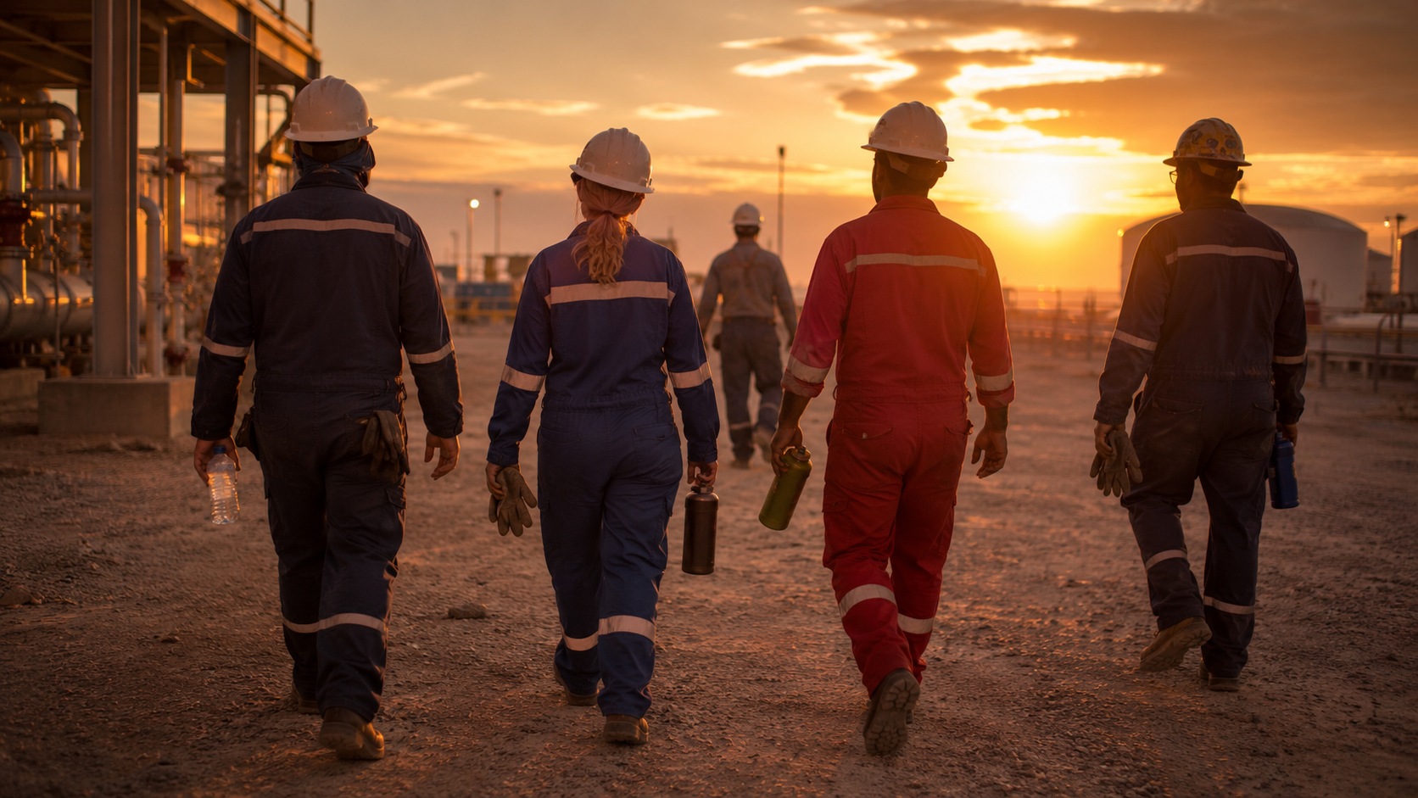
A 90-day reset
Make the program real before the next hot week.
30 days
60 days
90 days
Find the gaps
Train the moments
Verify the field
heat/fatigue exposure map, high-risk roles, supervisor authority
scenario training, supervisor scripts, emergency drills
spot checks, acclimatization proof, KPI review, corrective actions
Notes:
Close with action. For the next 30 days, map exposures and decide where heat, fatigue, and human factors are likely to collide. For the next 60 days, rebuild training around scenarios, supervisor decisions, and emergency response. For 90 days, verify field behaviour and use data to improve.
KPI examples: high-heat days with completed pre-job checks, percentage of new/returning workers on acclimatization schedule, supervisor spot checks completed, early symptom reports, work modifications made, emergency drills conducted, and corrective actions closed.
Suggested pacing: 4 minutes.

Slide 20
The safest worker is not the toughest
It is the one trained to stop before failure.
Build the habit. Verify the control. Protect the person.
Notes:
End with the human point. Old-school safety culture sometimes rewards toughness and silence. Real heat and fatigue prevention rewards early reporting, adaptation, and stopping before the body or the system fails.
The final line: a training record is useful. A worker who can recognize risk, speak up, and get backed by a supervisor is better. A field-verified system is best.
Suggested pacing: 2 minutes.

Slide 21
Key sources used
Add your house sources, cases, and jurisdiction-specific guidance as needed.
• International Labour Organization, Ensuring safety and health at work in a changing climate; Heat at work: Implications for safety and health, 2024.
• OSHA, Working in Outdoor and Indoor Heat Environments, Heat NEP CPL 03-00-024, April 10, 2026; OSHA heat rulemaking status page.
• National Safety Council, Injury Facts: Exposure to Environmental Heat and Work-related Fatigue.
• CDC/NIOSH, Working Hours and Fatigue: Meeting the Needs of American Workers and Employers, 2023.
• U.S. Department of Labor / OSHA, Guerrero Ag LLC heat illness fatality citation release, June 26, 2024.
• Science.gc.ca / Health Canada, Surviving the heat: impacts of the 2021 western heat dome in Canada.
• Employment and Social Development Canada, Thermal stress in the work place, 2026.
• WorkSafeBC, Heat stress resources and Human factors topic page.
• Cal/OSHA, Heat Illness Prevention Guidance and Resources, Indoor Heat Requirements.
Notes:
This source slide is not meant to be presented in full. It supports the deck’s data points and can be retained at the end for credibility.
If presenting to a jurisdiction-specific audience, add local regulatory pages and any internal incident, claim, audit, or training completion data available.

