Slide 1

Click anywhere to get started…

Slide 2

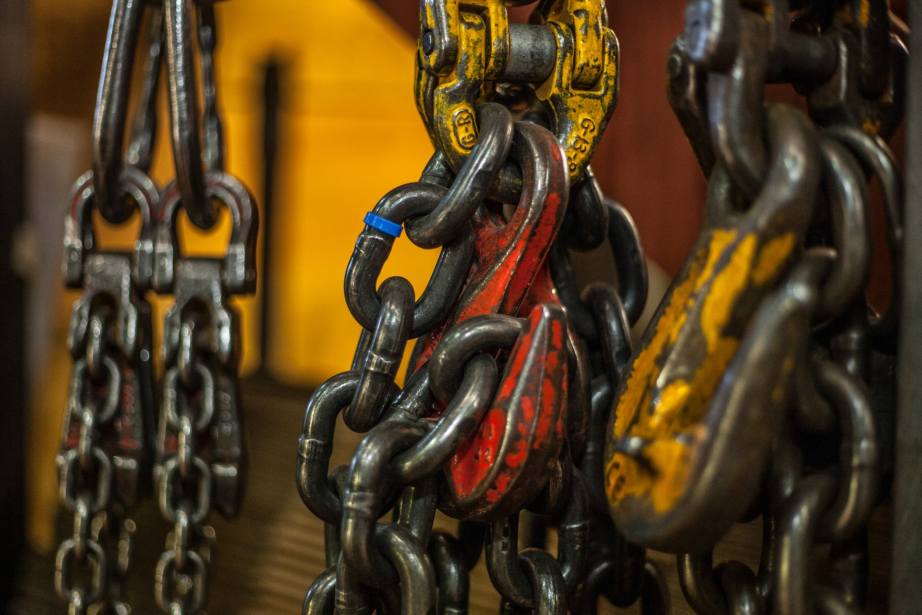

LIFT CHAIN RECERTIFICATION
Notes:
LIFT CHAIN RECERTIFICATION

Slide 3
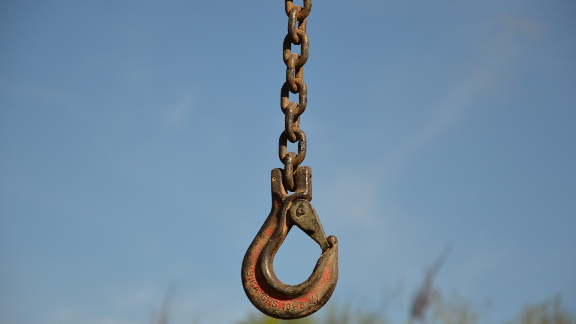
What’s at Stake?
The breaking of lifting chains, causing sudden falling of goods may result in material or personal harm.
Notes:
WHAT’S AT STAKE?
In lifting applications, chains are classed as safety components. It is assumed that the chain delivered by the manufacturer is free from defects and matches the requirements. The breaking of lifting chains, causing sudden falling of goods, may result in material or personal harm.

Slide 4
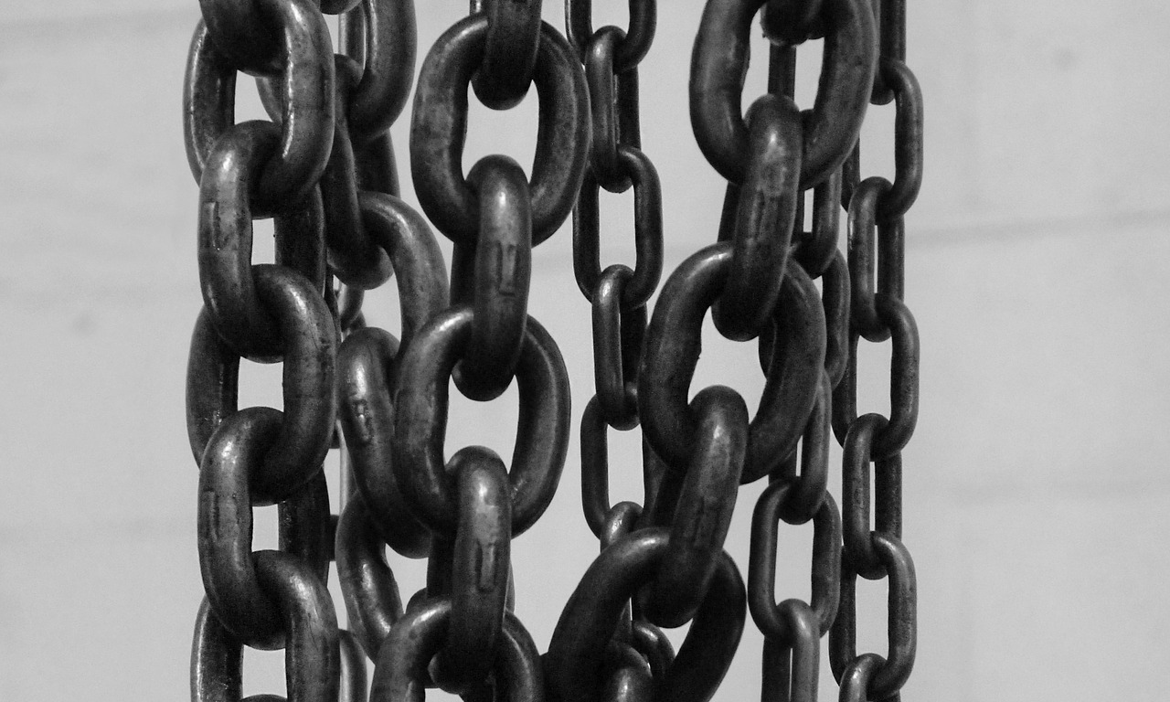
What’s the Danger?
RISK FROM INSTALLATION ERRORS
Notes:
WHAT’S THE DANGER?
RISKS FROM INSTALLATION ERRORS
- If The chain fittings and pulleys are not aligned, Uneven load distribution occurs within the chain links. This may cause grinding of parts in the guide or the pulley causing loss of material, thus leading to a reduction in tensile strength.
- Many chains are attached with pins which are not delivered by the chain manufacturer. If the wrong connecting pin is selected, there may be an incorrect material, heat treatment or dimension tolerance.
- If there is damage to the chain by external forces (shock, media, twist, etc.) the operational safety is no longer guaranteed.
- If the chain is not inspected regularly, there is a risk that potential hazards will not be noticed at an early stage.
- When chains corrode, the following issues can occur: Reduction of breaking load, loosening of press fits or chain pins, and Stiff joints, thereby increasing the frictional forces.
- If the chain vibrates or shakes, non-uniform velocities may cause the lifted load to fall.
- Insufficient lubrication can cause increased chain wear, which gives a change in the load distribution and/or a reduction of the material cross sections. The result would be a reduction in tensile strength.
- Stiff chain joints can result in a lack of proper positioning. The lift can drop at the bent location at any time.
- Twisted or loose pins may be an indication of overload or insufficient lubrication. The load capability of the chain is no longer guaranteed.
- Fatigue cracks may arise due to overload. If individual plates within the packed plates are cracked without the chain failing, the breaking load is reduced.
- The articulating area of the chain must be shielded against accidental contact by users to protect from pinching or crushing.
- Depending on the manufacturer, different materials, heat treatments and lubricants are provided. Application at high or low temperature conditions may lead to brittleness and/or loss of strength of the components.
Risk During Installation
Crushing of fingers/hands: Incorrect assembly can entangle chain links and injure fingers. Injury can be caused by the hands/fingers being drawn into the chain drive, especially in the areas where the chains run around sheaves or sprockets.
Crushing of the feet: To avoid serious injury from falling chains, safety shoes must be worn in the assembly area. When installing the chains in greater heights, the use of protective headgear is recommended.
Cuts from sharp edges: Although chain plates are deburred, in some cases there can be sharp edges or pressed metal chips on the chain. To avoid injury, protective gloves should be worn.

Slide 5
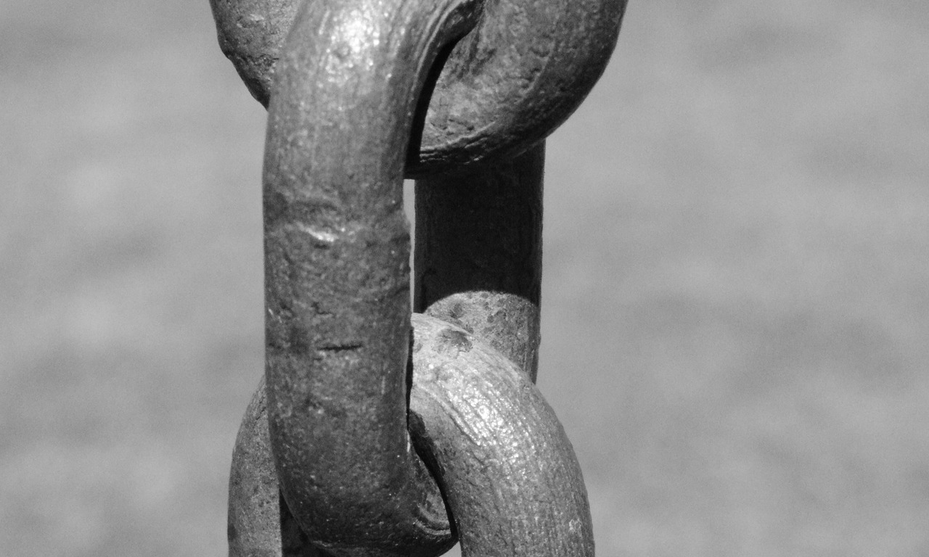
How to Protect Yourself
HOW TO SELECT THE PROPER CHAIN SLING
1. Determine the maximum weight of LOAD.
2. From the working load limit chart above, determine the SIZE of the body chain. Be sure to consider the effect of the angles.
3. Determine the REACH for the selected angle by measuring the distance from the upper bearing surface of the master link to the bearing surface of the lower attachment.
Notes:
HOW TO PROTECT YOURSELF
HOW TO SELECT THE PROPER CHAIN SLING
Determine the maximum weight of LOAD.
From the working load limit chart, determine the SIZE of the body chain. Be sure to consider the effect of the angles.
Determine the REACH for the selected angle by measuring the distance from the upper bearing surface of the master link to the bearing surface of the lower attachment.
Injury and Illness Prevention Program (IIPP), recommends that:
The tools and equipment used are periodically inspected for defects and safety compliance, and are repaired or replaced as needed.
Ensure employees who use cranes to lift loads of varying size and complexity are certified in rigging.

Slide 6
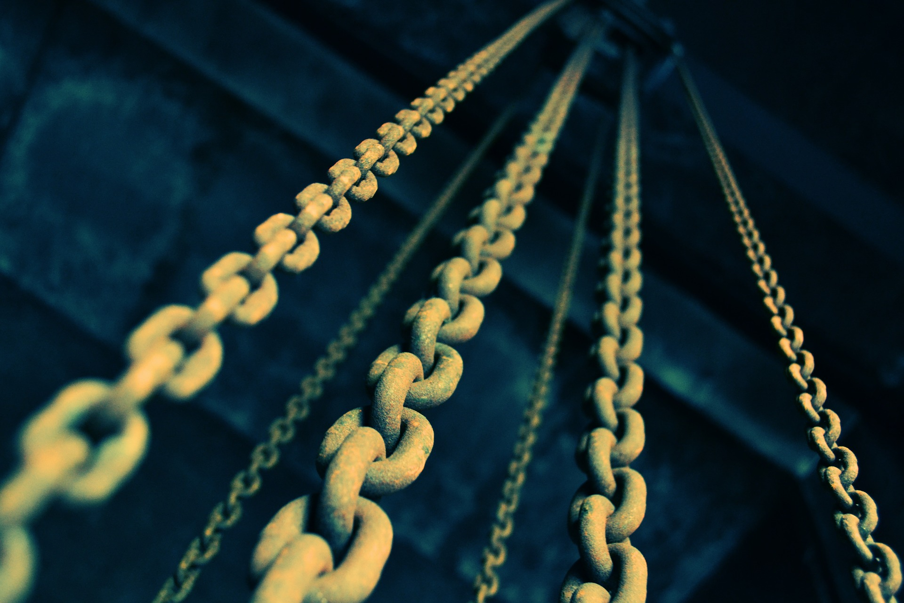
How to Protect Yourself
Using chain slings safely
Always know proper use procedures before attempting the lift.
Inspect the slings and accessories before use for any defects.
Replace broken safety latches.
Do not exceed rated load of the sling.
Notes:
Using chain slings safely
Always know proper use procedures before attempting the lift.
Inspect the slings and accessories before use for any defects.
Replace broken safety latches.
Do not exceed rated load of the sling.
Do not force, hammer or wedge chain slings or fittings into position.
Keep hands and fingers away from potential pinch points when tensioning slings and when landing loads.
Make a trial lift and trial lower to ensure the load is balanced, stable and secure.
Balance the load to avoid overstress on one sling arm or the load slipping free.
Lower the working load limit if severe impact may occur.
Pad sharp corners to prevent bending links and to protect the load.
Position hooks of multi-leg slings facing outward from the load.
Store chain sling arms on racks in assigned areas and not lying on the ground. The storage area should be dry, clean and free of any contaminants which may harm the sling.

Slide 7
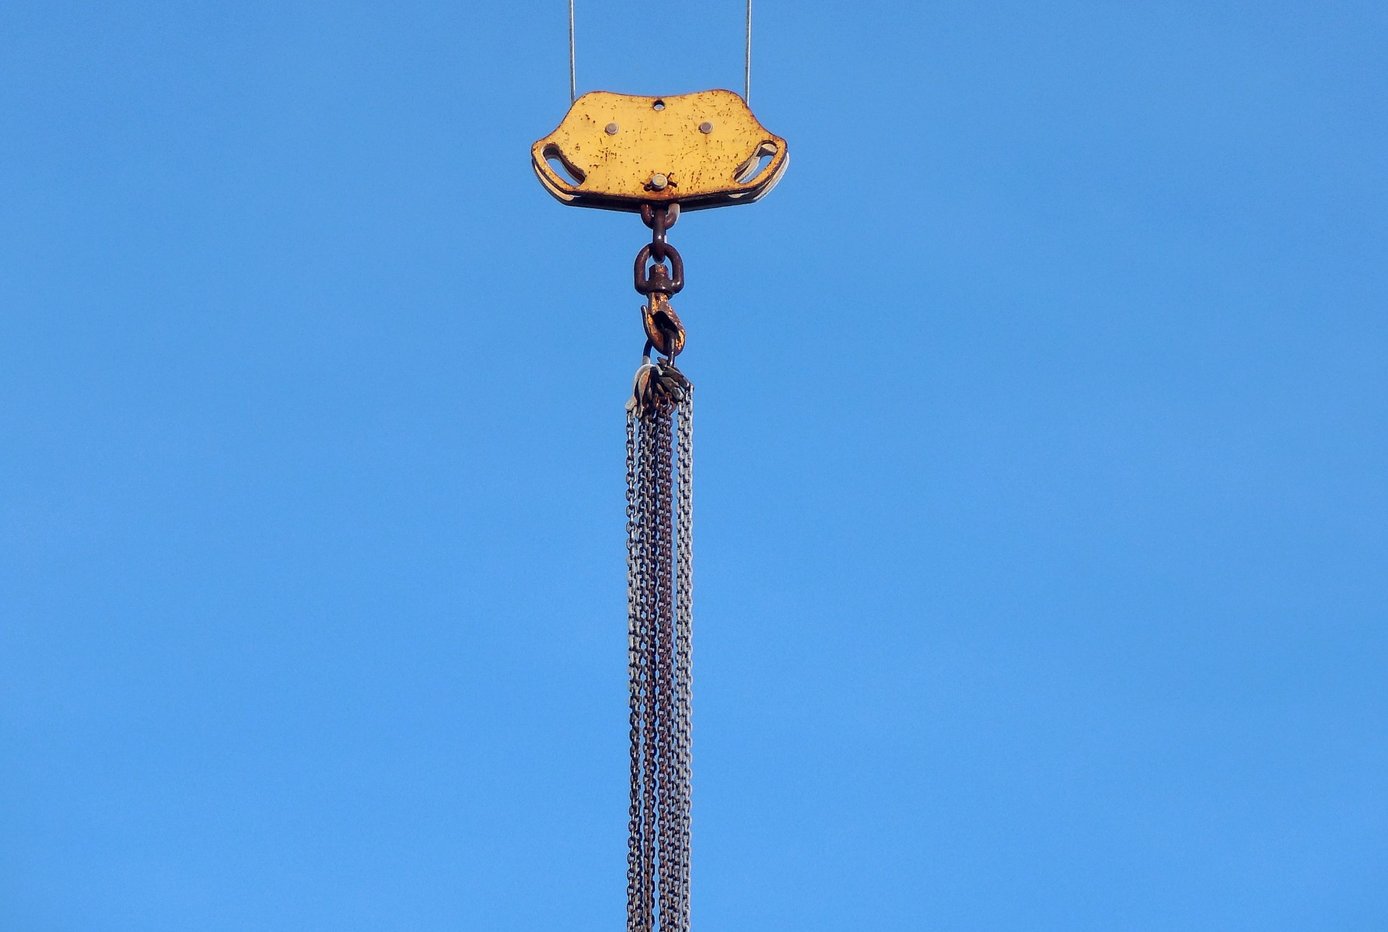
How to Protect Yourself
What should you avoid when using chain slings?
Avoid impact loading: do not jerk the load when lifting or lowering the sling. This motion increases the stress on the sling.
Do not leave suspended loads unattended.
Do not drag chains over floors or attempt to drag a trapped sling from under a load. Do not use a sling to drag a load.
Do not use worn-out or damaged slings.
Do not lift on the point of the hook.
Notes:
How to Protect Yourself
What should you avoid when using chain slings?
Avoid impact loading: do not jerk the load when lifting or lowering the sling. This motion increases the stress on the sling.
Do not leave suspended loads unattended.
Do not drag chains over floors or attempt to drag a trapped sling from under a load. Do not use a sling to drag a load.
Do not use worn-out or damaged slings.
Do not lift on the point of the hook.
Do not trap slings when landing the load.
Do not splice a chain by inserting a bolt between two links.
Do not shorten a chain with knots or by twisting other than by means of an integral chain clutch.
Do not force or hammer hooks into place.
Do not use homemade connections. Use only attachments designed for the chain.
Do not expose chain links to chemicals without the manufacturer's approval.
Do not stand or pass under a suspended load.
Do not ride on sling.

Slide 8
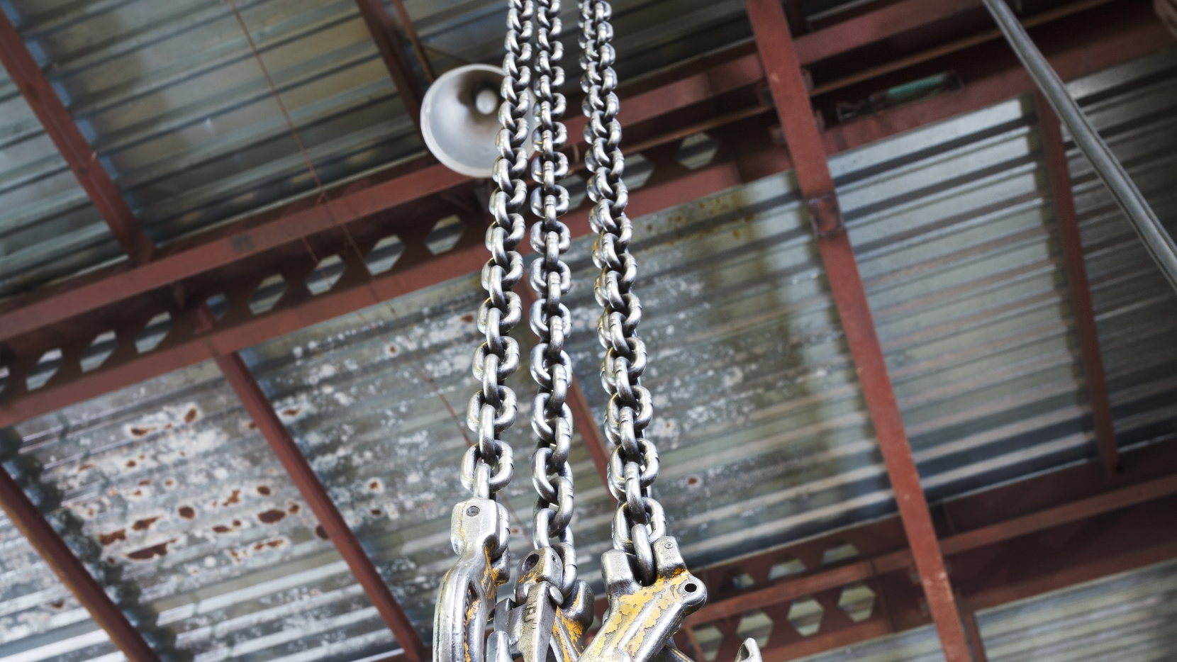
FINAL WORD
The designated person is very important, since they determine if chain slings are safe enough to use in potentially dangerous workplace situations.
Notes:
FINAL WORD
The designated person is very important, since they determine if chain slings are safe enough to use in potentially dangerous workplace situations.

