Slide 1

Click anywhere to get started…

Slide 2
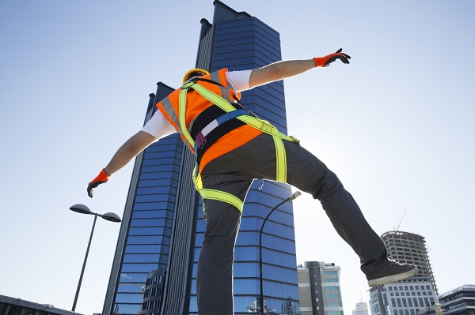


Protecting Against Fall Hazards in Construction
Notes:
Protecting Against Fall Hazards in Construction

Slide 3
What’s at Stake?
Workplace falls cause a significant number of lost workdays, injury, suffering and even death.
Notes:
What’s at Stake?
Workplace falls cause a significant number of lost workdays, injury, suffering and even death.
In Canada, an average of 100 workers suffer fall injuries each day, leading to 60 deaths and over 40,000 work days lost each year. In the US, falls are consistently at or near the top of causes of worker deaths in the construction industry.

Slide 4
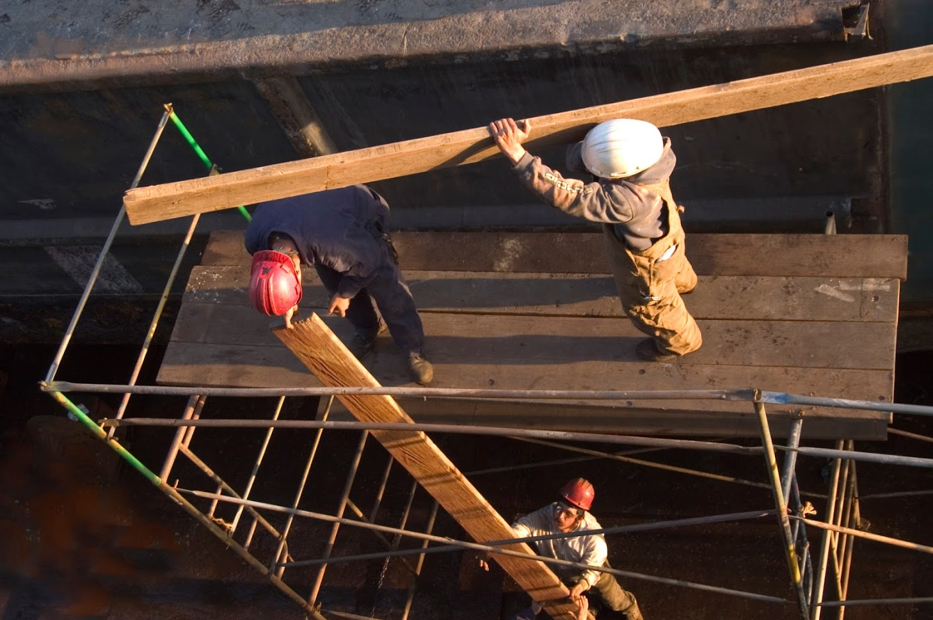
What’s the Danger?
A “vertical fall” is typically something that occurs between two different levels (i.e. falling from a roof to the ground) compared to a “horizontal fall” which occurs on the level upon which a person is standing or moving (i.e. running and tripping).
Notes:
What’s the Danger?
A “vertical fall” is typically something that occurs between two different levels (i.e. falling from a roof to the ground) compared to a “horizontal fall” which occurs on the level upon which a person is standing or moving (i.e. running and tripping). Vertical falls cause most of the significant injuries and fatalities. Falling only a relatively short distance can lead to significant, long-term illness, disability or death. The way a person lands, or the surface they land on, can be the difference between walking away uninjured or permanent paralysis.

Slide 5
What’s the Danger?
Sloping, slippery roof.
Overreaching to carry out work.
Uncovered floor or wall openings.
Falling from, or onto machinery.
Falling into deep water.
Being inadequately trained.
Notes:
On construction sites, hazards include:
Sloping, slippery roof.
Overreaching to carry out work.
Uncovered floor or wall openings.
Falling from, or onto machinery.
Falling into deep water - physical injury hitting the water, drowning.
Being inadequately trained to use specialized fall prevention equipment.

Slide 6
How to Protect Yourself
Know the safety regulations about when fall protection is required.
Check if a site-specific fall protection plan is required and in place.
Notes:
How to Protect Yourself
Know the safety regulations about when fall protection is required, based on:
How high up you will be working - typically 3 meters/6 feet (or higher);
The surface or platform you are working on (e.g., vehicles, scaffolds, sloped roofs);
What you are at risk of falling through, on or into (e.g., machinery, hard surfaces, water).
Check if a site-specific fall protection plan is required and in place.
If there is a plan, know it and follow it.

Slide 7
How to Protect Yourself
Notice physical barriers:
  Guardrails
  Protective coverings over openings
  Safety nets
Take notice of warning signs.
Notes:
Notice physical barriers:
Guardrails - strict guidelines are in place including the minimum heights, gap between rails and materials used.
Protective coverings over openings.
Safety nets.
Take notice of warning signs.

Slide 8
How to Protect Yourself
Use appropriate active fall protection systems correctly.
  Fall restraint system
  Fall arrest system
Use PPE to reduce the risk of injury.
Complete any required courses and attend regular training.
Notes:
5. Use appropriate active fall protection systems correctly.
The fall restraint system is the preferred system as they prevent falling.
Fall arrest systems:
Limit the distance of the fall.
Risk of injury from system when worker comes to an abrupt stop.
Risk of suspension trauma after the fall.
Emergency rescue plan for suspended workers must be in place.
6. Use PPE to reduce the injury risk if a fall happens including hard hats, knee/elbow pads or lifejackets if working over deep water.
7. Complete any required courses to keep you safe when working at heights and attend regular training.

Slide 9
Final Word
Vertical falls on construction sites are a common cause of injury and worker deaths. Procedures, processes and equipment must be in place on all construction sites to prevent falls. And, workers must wear and use fall protection equipment consistently and correctly to protect themselves if they do fall.
Notes:
Final Word
Vertical falls on construction sites are a common cause of injury and worker deaths. Procedures, processes and equipment must be in place on all construction sites to prevent falls. And, workers must wear and use fall protection equipment consistently and correctly to protect themselves if they do fall.

