Slide 1

Click anywhere to get started…

Slide 2

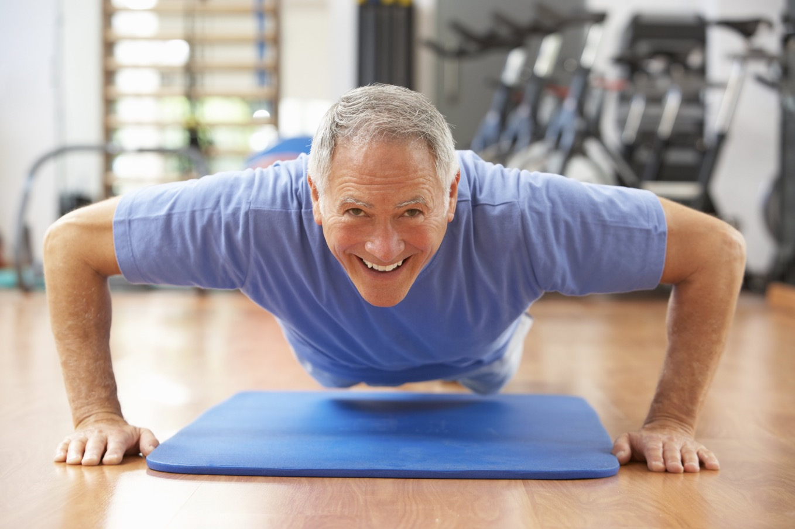

Shape Up For Safety
Notes:
Shape Up For Safety

Slide 3
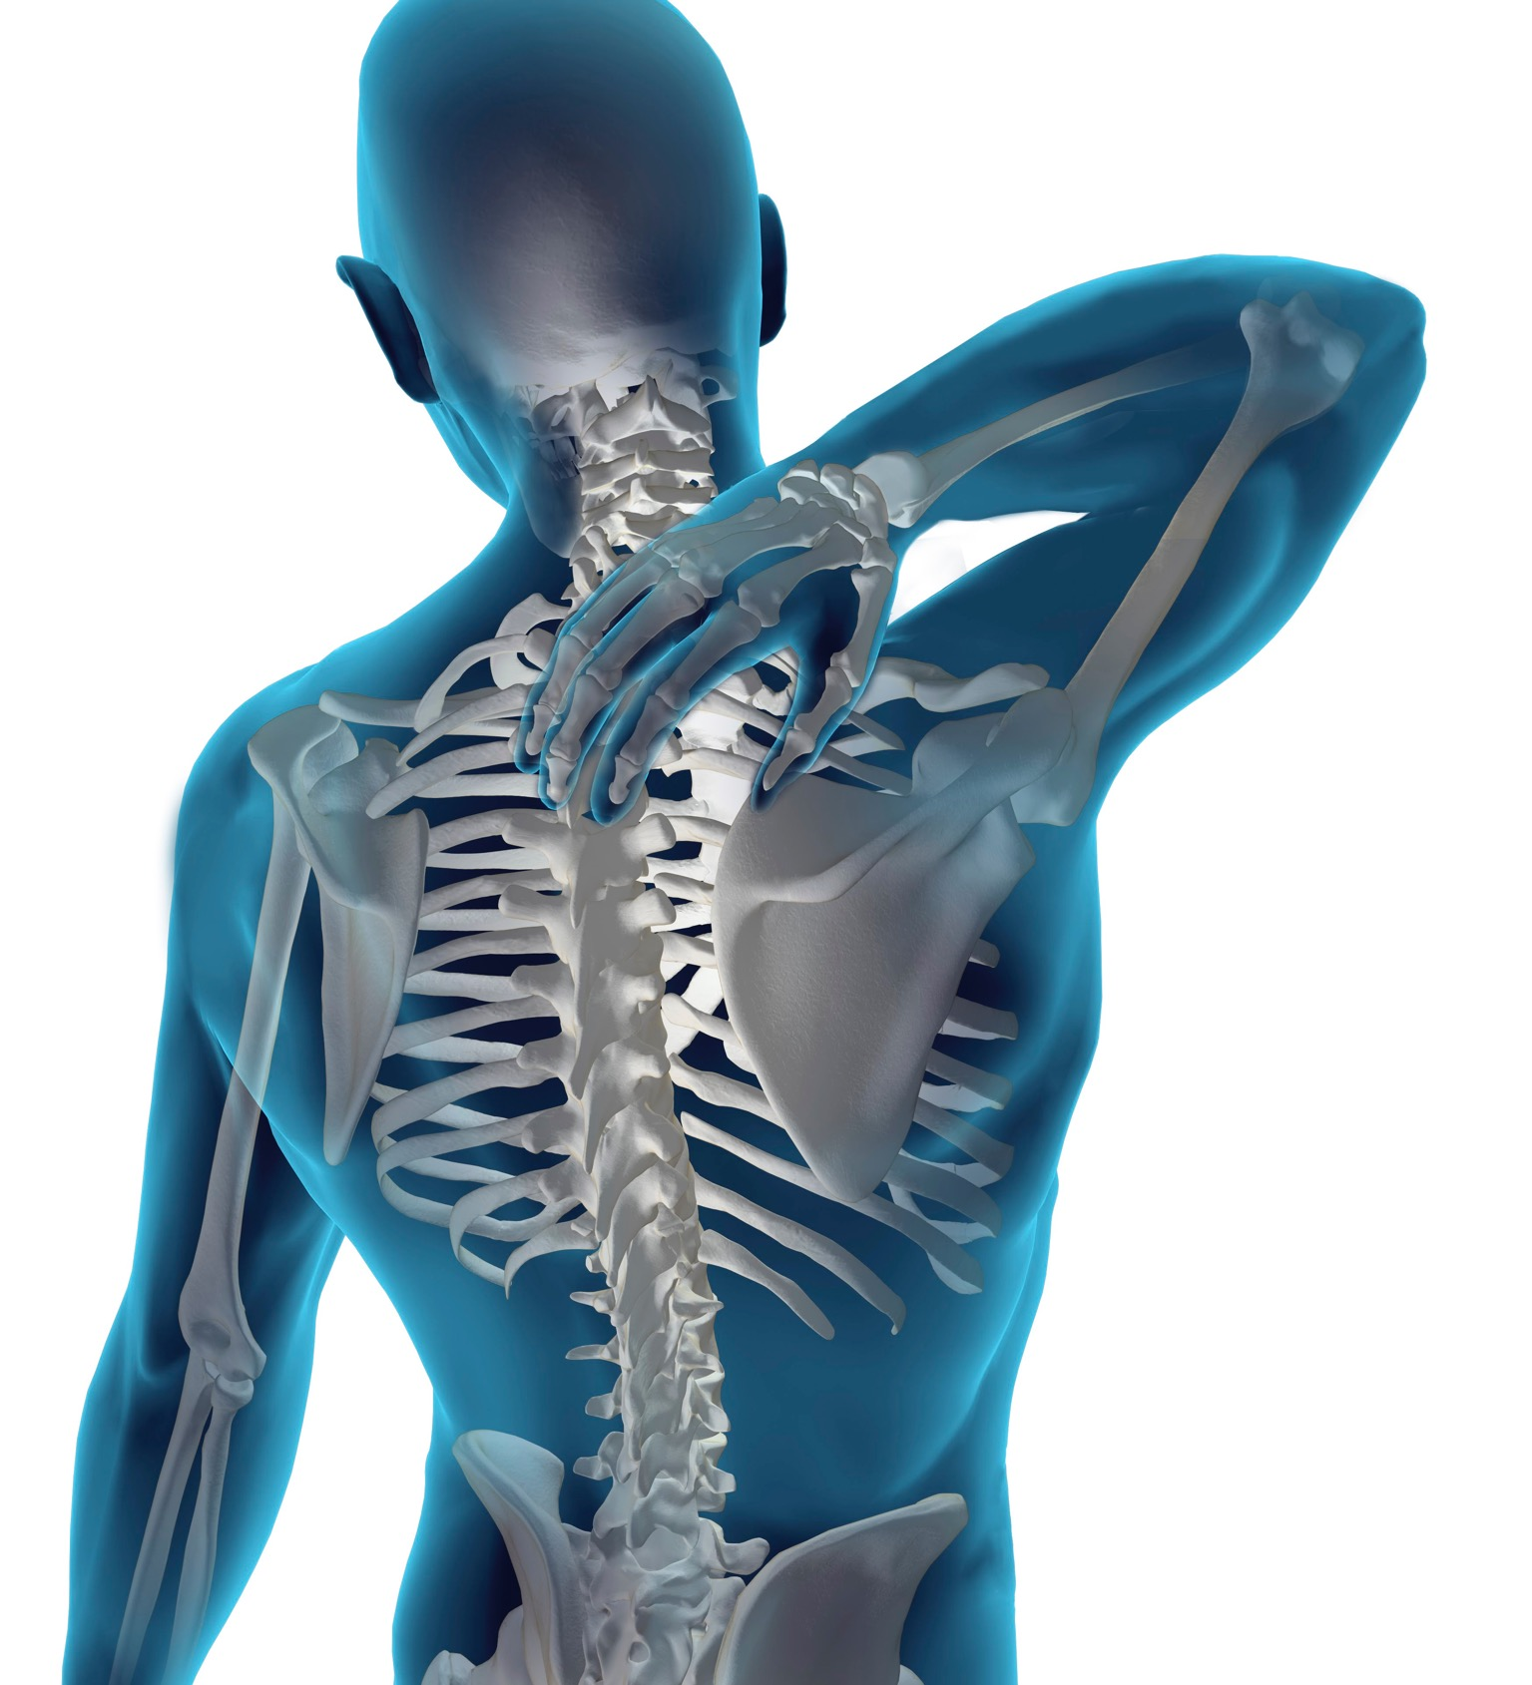
What’s at Stake?
Did you know your mental, physical, and emotional fitness is part of a safe work
environment?
Your overall health can
also reduce the possibility of muscle strains, back problems and other injuries.
Notes:
What’s at Stake?
Did you know your mental, physical, and emotional fitness is part of a safe work
environment? If you are fit and healthy, you are likely to have more energy and stamina.
This can mean you are able to stay alert throughout your shift. Your overall health can
also reduce the possibility of muscle strains, back problems and other injuries.

Slide 4
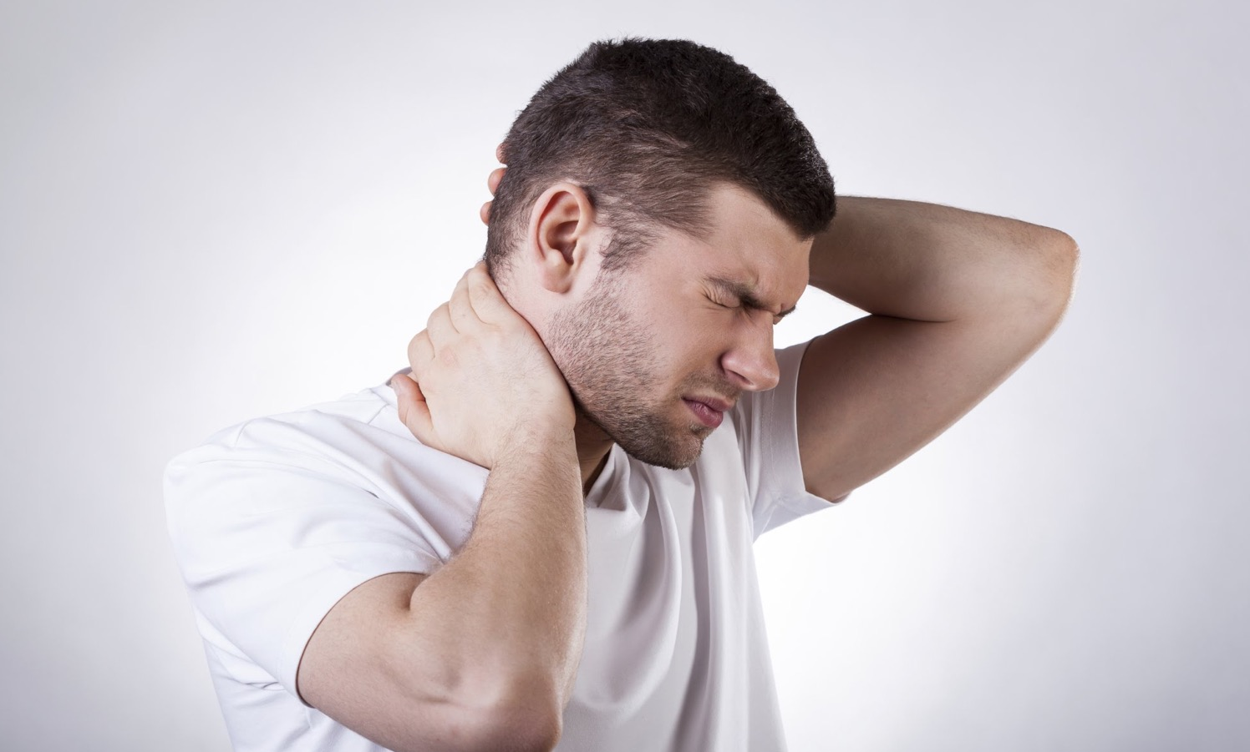
What’s the Danger?
When you’re not physically, mentally, and emotionally healthy your work and your safety
suffer.
Stress can contribute directly to injuries.
Muscle tension caused by stress can contribute directly to problems such as back injuries.
Notes:
What’s the Danger?
When you’re not physically, mentally, and emotionally healthy your work and your safety
suffer.
Examples
Stress can contribute directly to injuries. Worrying about personal problems instead of concentrating on the task can cause serious accidents.
Muscle tension caused by stress can contribute directly to problems such as back injuries.

Slide 5
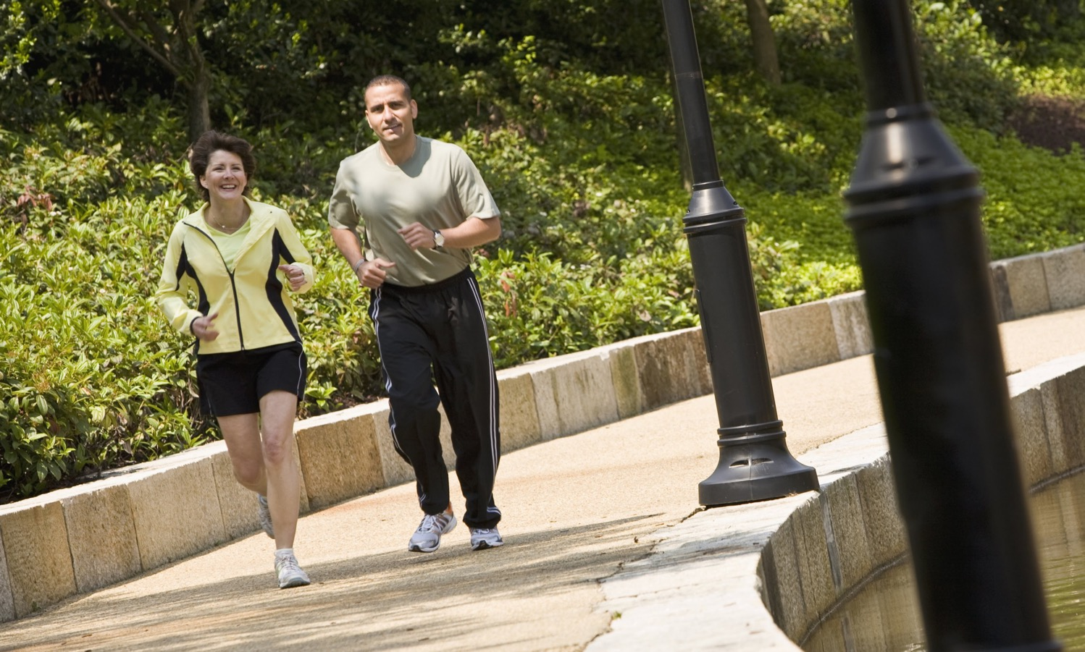
How to Protect Yourself
Improve Physical Health
Get regular exercise
Strengthen your muscles
Notes:
How to Protect Yourself
Improve Physical Health
Get regular exercise to strengthen your heart and lungs. A brisk walk for a half-
hour each day or two is highly recommended. Activities such as running,
swimming, dancing and aerobics are other ways to get your heartbeat up and
improve heart and lung function.
Strengthen your muscles. A program of exercises at home, or a weight-training
program at a gym are two ways to accomplish this. Be sure to include routines to
strengthen the muscles in your abdomen and back to help prevent back injuries.

Slide 6
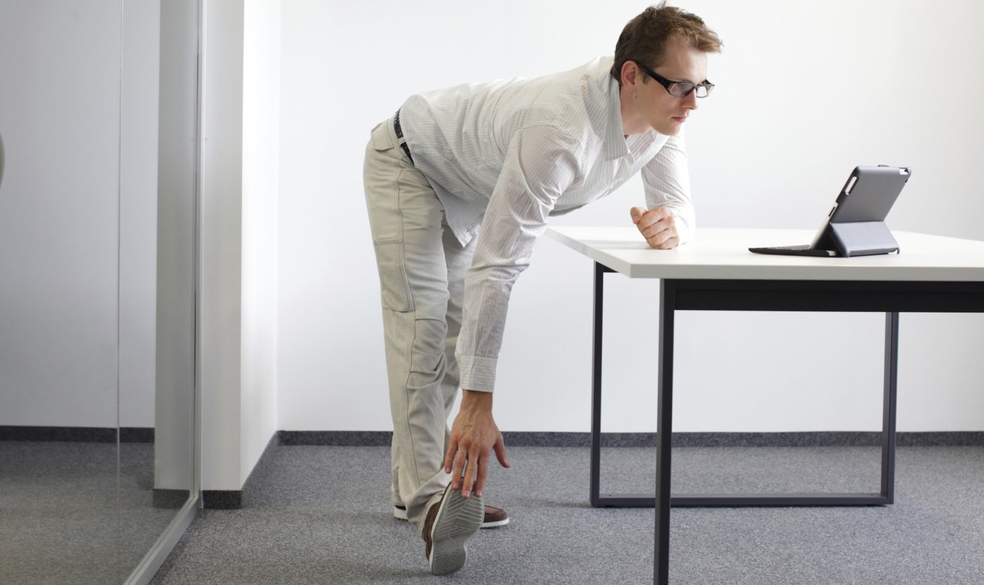
How to Protect Yourself
Improve Physical Health
Increase your flexibility
Quit smoking
Get regular medical and dental checkups
Notes:
How to Protect Yourself
Increase your flexibility. Include stretches in your exercise routines to help your
muscles and joints stay limber.
Quit smoking. This one lifestyle change will pay you big bonuses in health and
fitness. Avoid excessive consumption of alcohol, caffeine and other drugs.
Get regular medical and dental checkups. Follow the advice of health
professionals.

Slide 7

How to Protect Yourself
Improve Mental and Emotional Health
Get enough sleep
Learn to manage stress before it’s a problem
Notes:
How to Protect Yourself
Improve Mental and Emotional Health
Get enough sleep. The body needs sleep to repair the body and refresh the mind. Studies show North Americans are chronically short of sleep. Fatigue has been a factor in many serious accidents - vehicle collisions, train wrecks, plane crashes, chemical spills and even nuclear disasters.
Learn to manage stress before it causes emotional or physical problems. If you have a problem, find a trusted person with whom you can talk it out. Some situations need to be tackled head on; others must be simply accepted as having no solution.

Slide 8
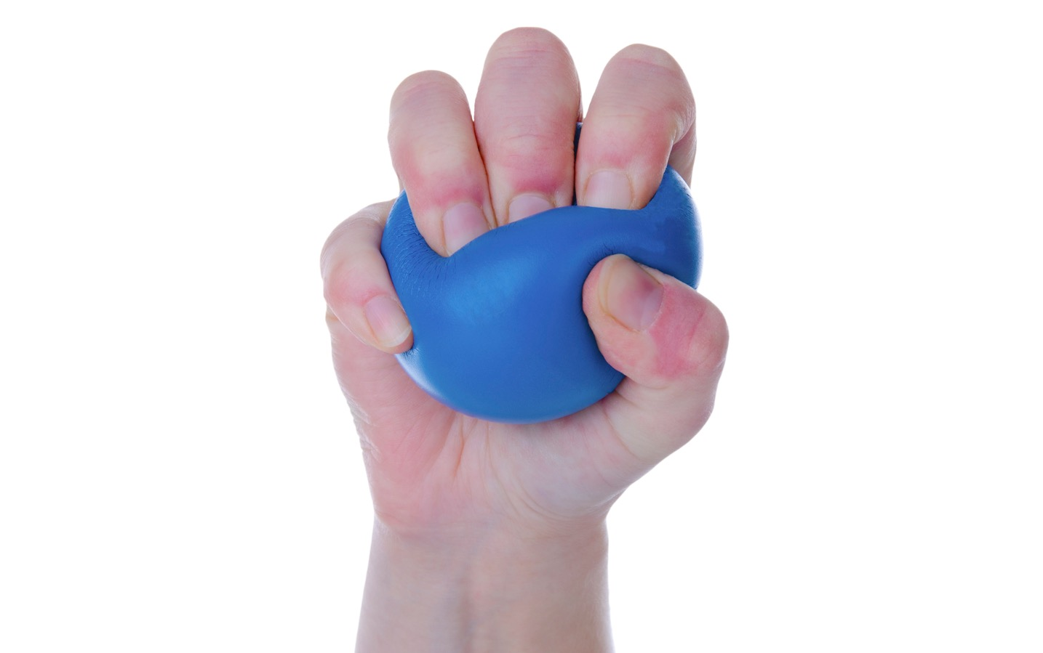
How to Protect Yourself
Improve Mental and Emotional Health
Learn relaxation techniques
Maintain a well-balanced diet
Notes:
How to Protect Yourself
Learn some deliberate relaxation techniques to help you deal with stress. Don’t be afraid to talk to your doctor or do some research on your own to find techniques that work for you.
A well-balanced diet can improve your physical, mental, and emotional health. It can increase your energy level, help you stay alert, reduce your body weight, and prevent illness and diseases.

Slide 9
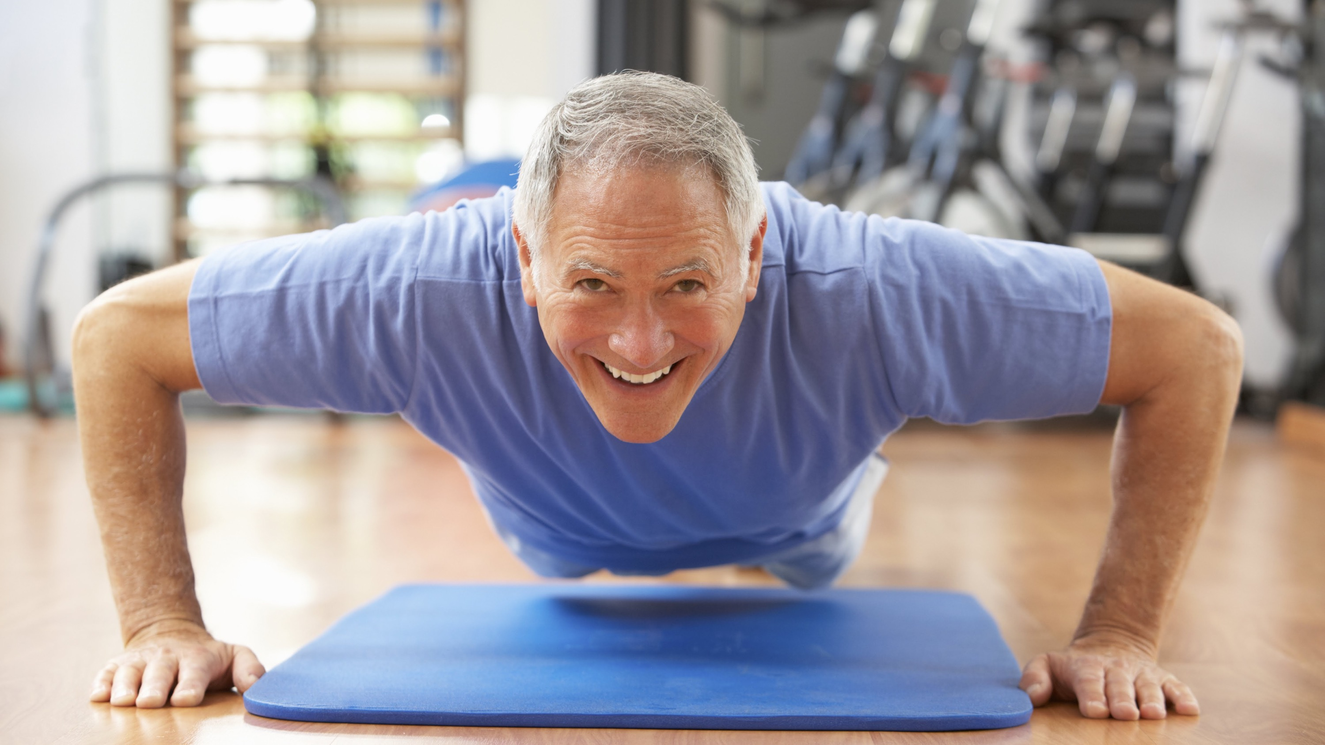
Final Word
When you pay attention to your physical, mental, and emotional health you improve
your chances of working safely. This helps reduce your chances of being in an accident
or being injured. Follow these tips to stay strong and healthy.
Notes:
Final Word
When you pay attention to your physical, mental, and emotional health you improve
your chances of working safely. This helps reduce your chances of being in an accident
or being injured. Follow these tips to stay strong and healthy.

