Slide 1

Click anywhere to get started…

Slide 2

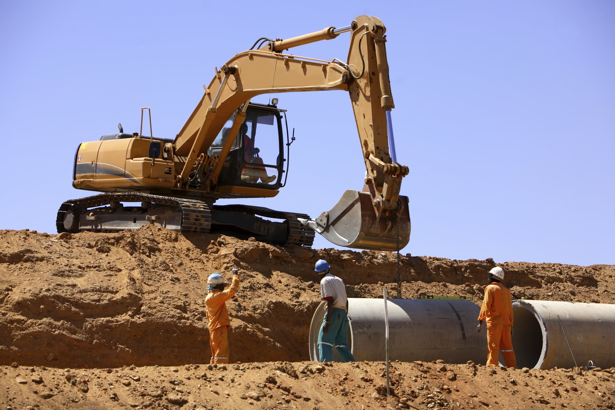

Five Factors of Excavation Safety
Notes:
Five Factors of Excavation Safety

Slide 3
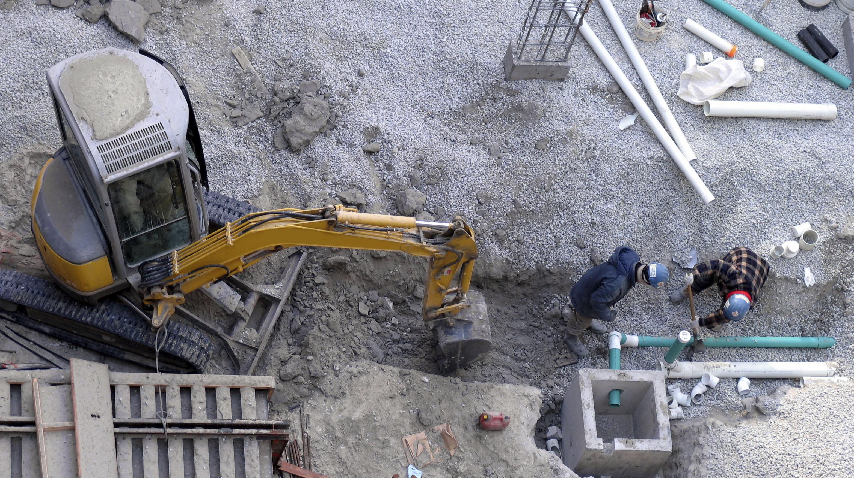
What’s at Stake?
What’s at stake is your life.
Trenching and excavating involve serious hazards. If you’re in an excavation you need to know how to identify the hazards and how they can be prevented.
Notes:
What’s at Stake?
What’s at stake is your life. Trenching and excavating involve serious hazards. If you’re in an excavation you need to know how to identify the hazards and how they can be prevented.

Slide 4
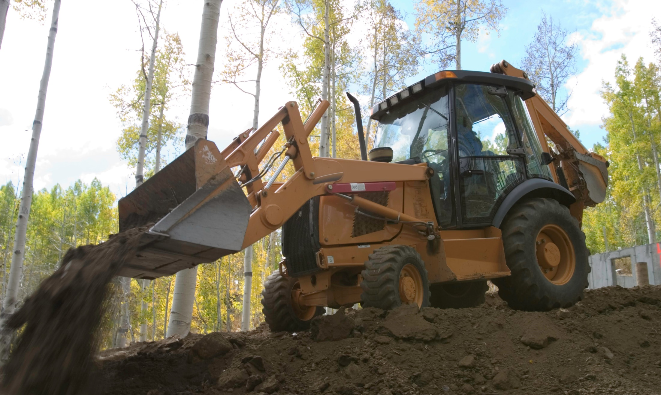
What’s the Danger?
Each year excavation and trenching cave-ins cause thousands of injuries and deaths.
More injuries and fatalities occur from:
  Hazardous atmospheres
  Struck-by equipment
  Falling loads or spoil pile
  Tripping and falling
Notes:
What’s the Danger?
Each year excavation and trenching cave-ins cause thousands of injuries and deaths. More injuries and fatalities occur from hazardous atmospheres in the trench, being struck-by equipment operating in and around the excavation, falling loads or spoil piles, and tripping and falling on materials in the dig. For this talk we are going to focus on what makes a trench or excavation unsafe and ways your employer must protect you.

Slide 5
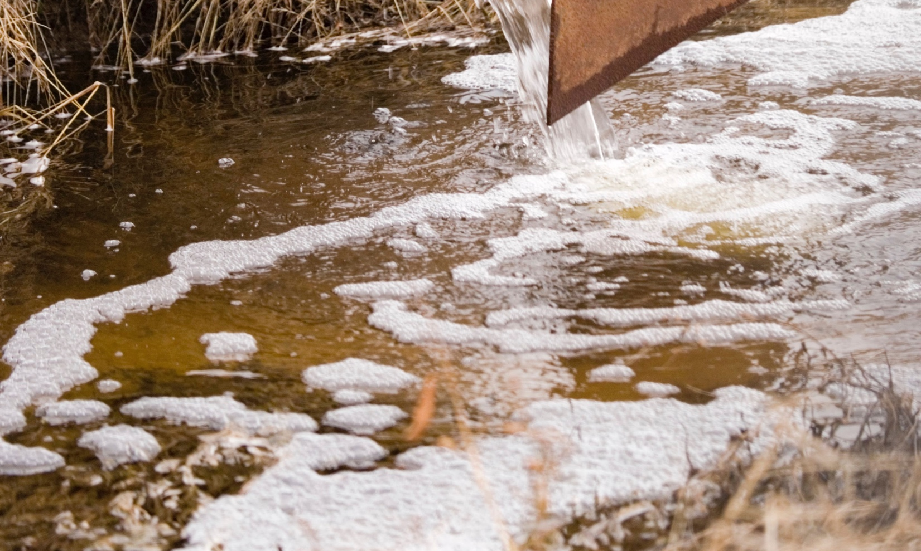
How to Protect Yourself
An excavation is made unsafe by the following factors:
  Soil Type
  Weather and Moisture
  Vibration and Equipment
  Previous Excavation
  Time
Notes:
How to Protect Yourself
There are important things to know and consider when digging and working in an excavation. An experienced excavation crew know that a stable excavation is compromised and made unsafe by the following factors:
Soil Type
Weather and Moisture
Vibration and Equipment
Previous Excavation
Time

Slide 6
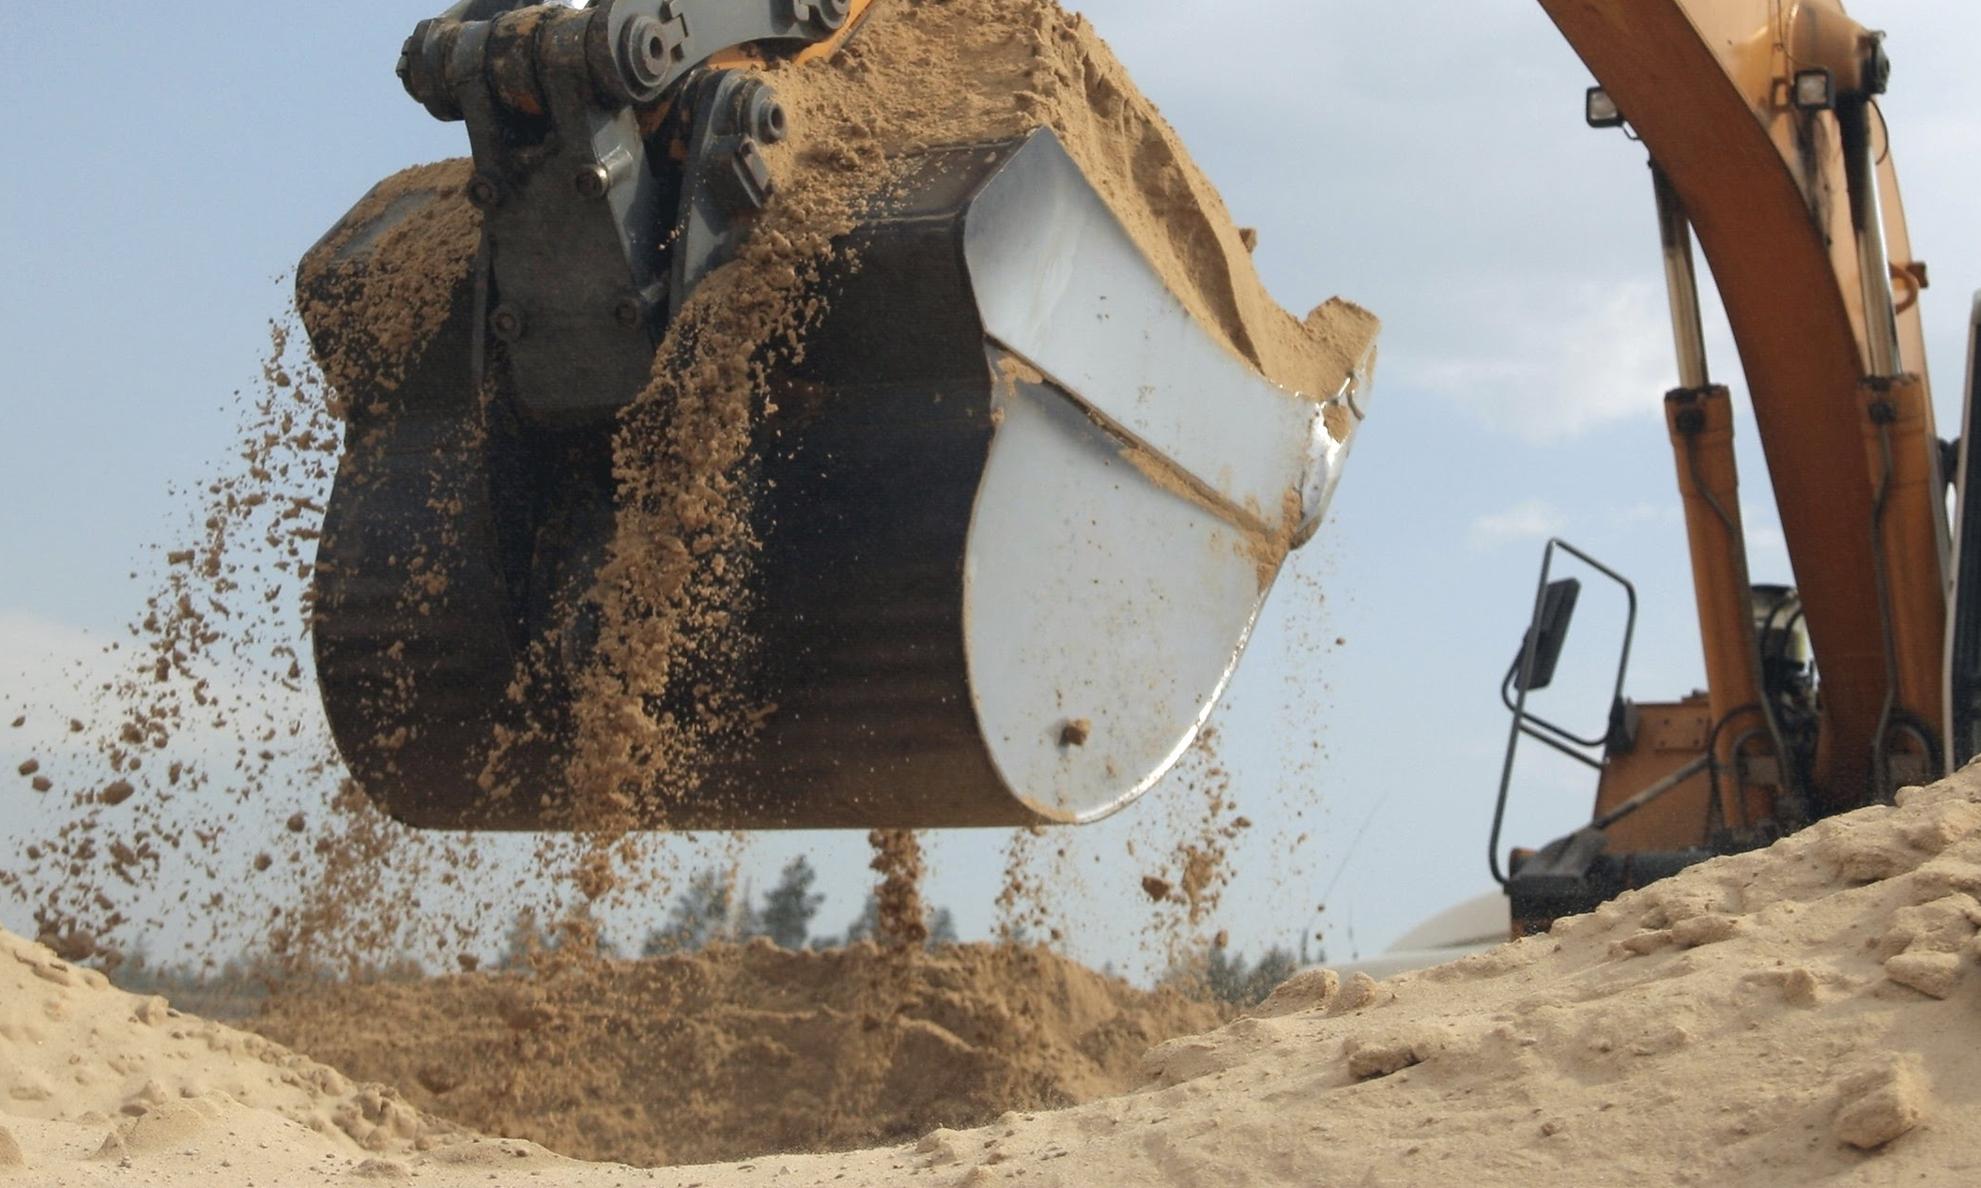
How to Protect Yourself
4 Soil Types
Hard, very dense, - little moisture, high internal strength
Very stiff and dense - low-to-medium moisture content, medium internal strength
Stiff to firm and compact to loose - low degree of internal strength
Soft to very soft and loose, very sensitive to vibration and motion - almost no internal strength - wet or muddy
Notes:
How to Protect Yourself
Soil Type
There are four general types of soil to be aware of:
Hard, very dense, with little natural moisture, high internal strength. Excavation usually requires mechanical equipment.
Very stiff and dense, with low-to-medium moisture content, medium internal strength.
Stiff to firm and compact to loose, with low degree of internal strength.
Soft to very soft and loose, very sensitive to vibration and motion, with almost no internal strength and often wet or muddy.
If you can recognize the different types of soil you can get an idea if protective measures should be in place, i.e. shoring, trench boxes. A competent person or engineer should be on site to perform soil analysis and regular inspections of the excavation.

Slide 7
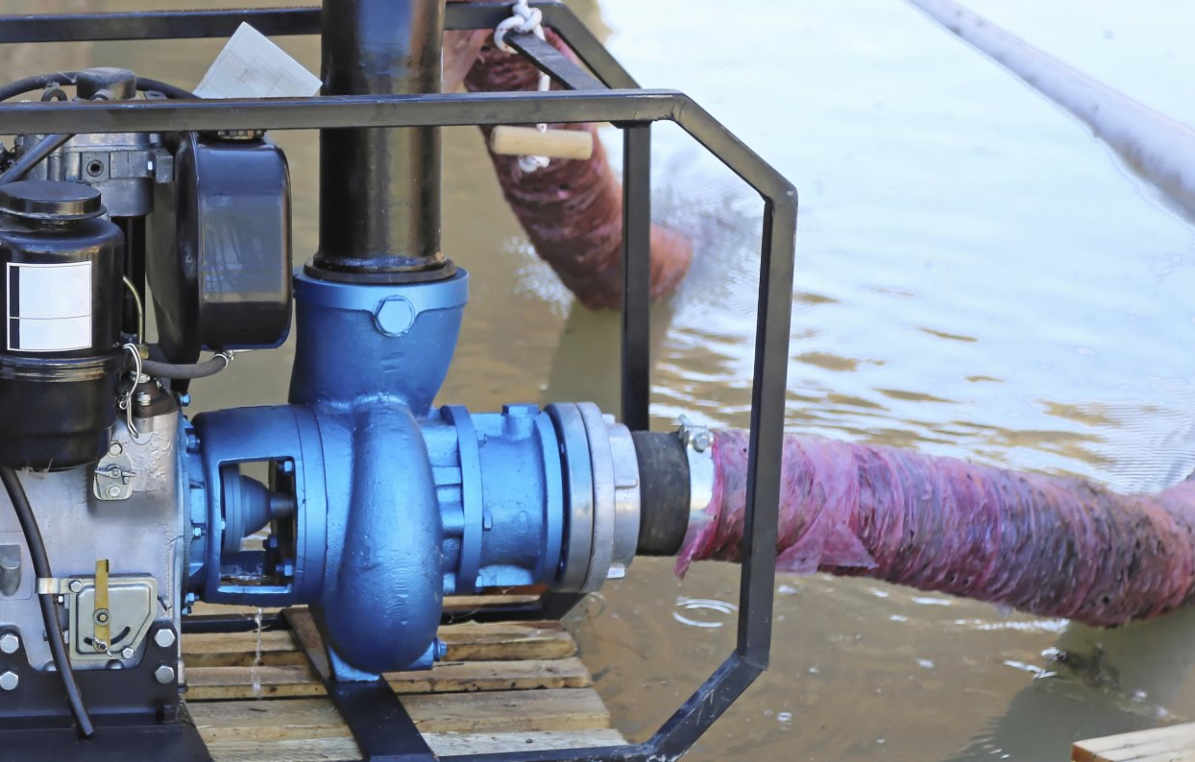
How to Protect Yourself
Weather and Moisture
Water weakens excavation walls
  Special support or shield system
  Water removal
  Safety harness and lifeline
Inspections
  Daily
  Start of shift
  Rain, leaks, etc.
Notes:
How to Protect Yourself
Weather and Moisture
Water in an excavation weakens the walls of the excavation.
You are not safe in an excavation where water is accumulating or has accumulated unless certain precautions are taken to protect you. Some of these precautions include:
Special support or shield system to prevent cave-ins.
Water removal to control the water level.
Safety harness and lifeline.
The competent person on site must inspect excavations every day, before the start of each shift and after rain, leaks and other hazard-increasing events.

Slide 8
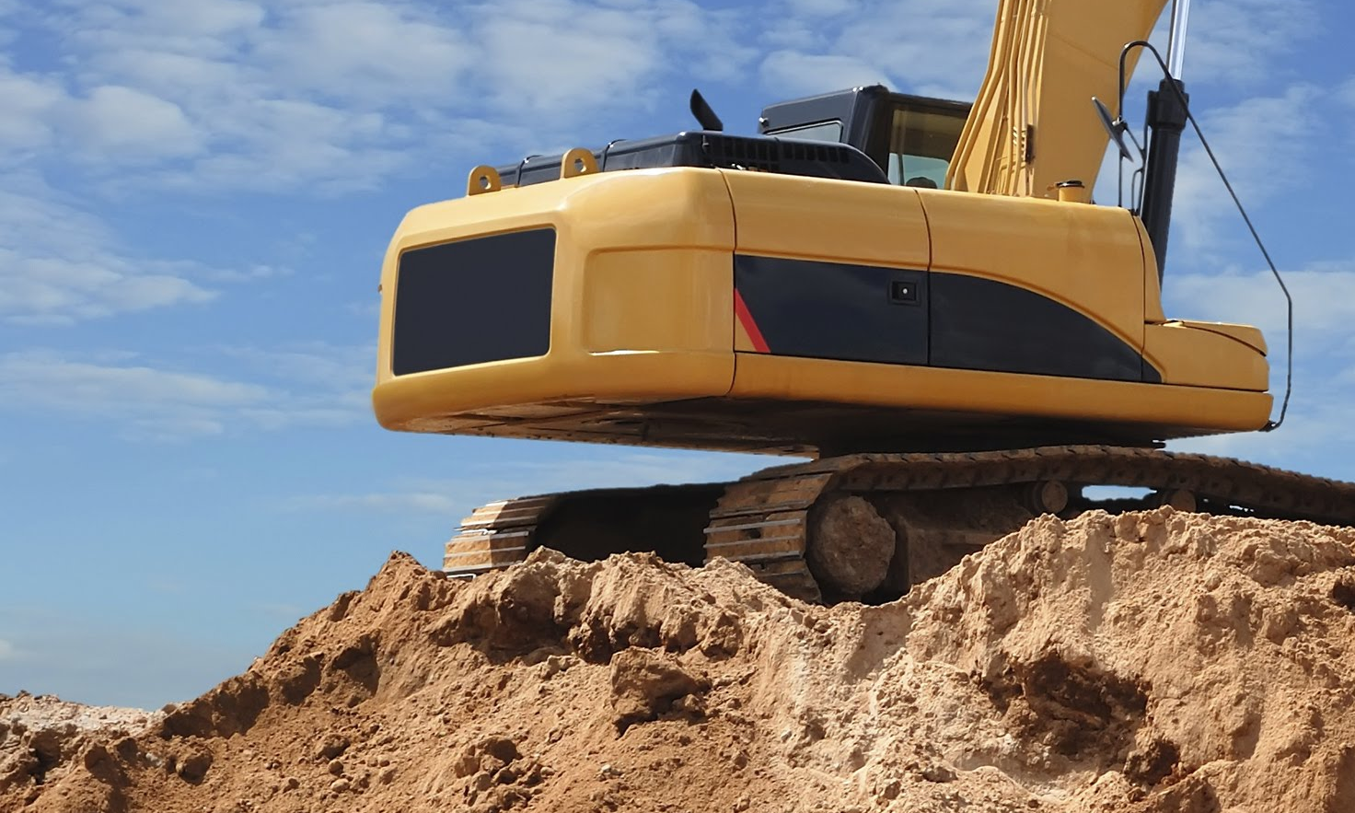
How to Protect Yourself
Vibration and Equipment
Shakes ground/loosens soil
Spoil piles shift/fall
Equipment weight - pressure on excavation walls
Be alert
Speak up
Notes:
How to Protect Yourself
Vibration and Equipment
Vibration from vehicles and equipment can shake the ground and loosen soil which can lead to a cave-in.
Vibration can also cause spoil piles near the excavation to shift and possibly fall into the excavation.
The weight of vehicles and equipment parked close to the edge of a trench puts extra pressure on the excavation walls, making it more likely to collapse.
Be alert to these hazards and speak to your supervisor or competent person if vehicles and equipment are causing a hazardous condition.

Slide 9
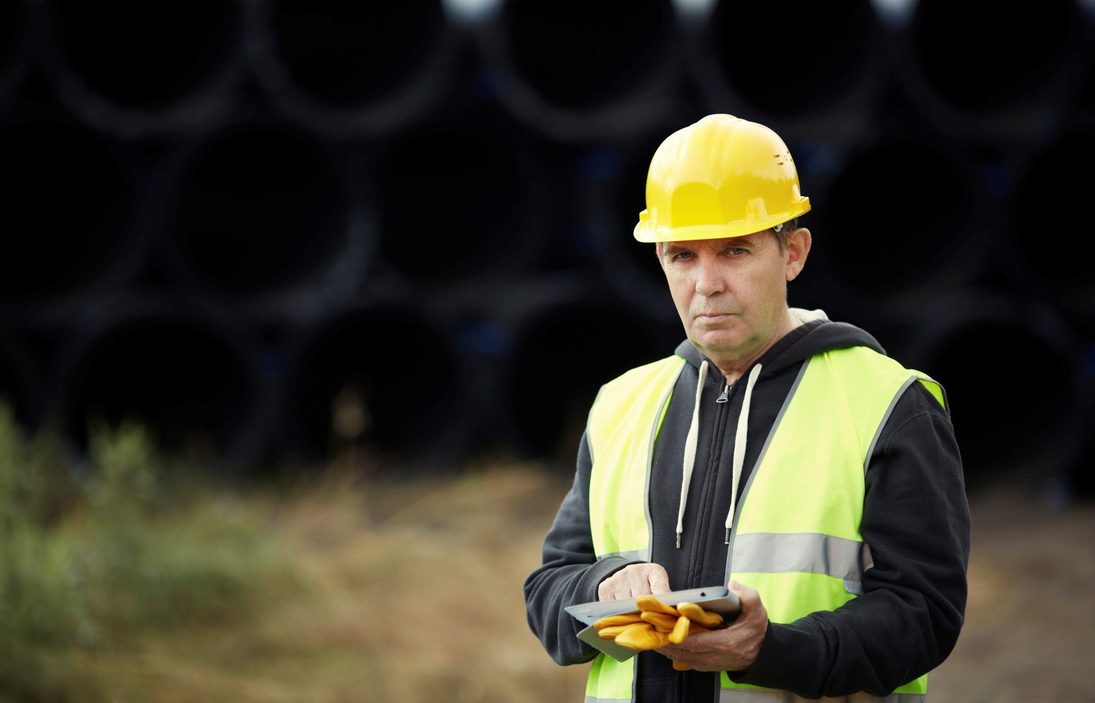
How to Protect Yourself
Previous Excavation
More likely to cave-in
Shoring, shielding, other protective measures in place
Time
Longer excavation is left open - more likely to cave in
A matter WHEN a cave-in will happen – not IF
Notes:
How to Protect Yourself
Previous Excavation
A site that has been excavated before is more likely to cave-in because previous digging weakens the strength and stability of the soil.
The competent person on site must see that these, and all excavations have shoring, shielding, or other protective measures in place before allowing anyone to enter.
Time
The longer an excavation is left open and unprotected the more likely it is to cave in.
In fact, with most unprotected excavations it’s a matter WHEN a cave-in will happen – not IF one will occur.

Slide 10
Final Word
Qualified personnel and a competent person should always be on hand to provide supervision during excavation. You also must look out for your safety and the safety of the excavation. Knowing what causes cave-ins will help you do that.
Notes:
Final Word
Qualified personnel and a competent person should always be on hand to provide supervision during excavation. You also must look out for your safety and the safety of the excavation. Knowing what causes cave-ins will help you do that.

