Slide 1

Click anywhere to get started…

Slide 2
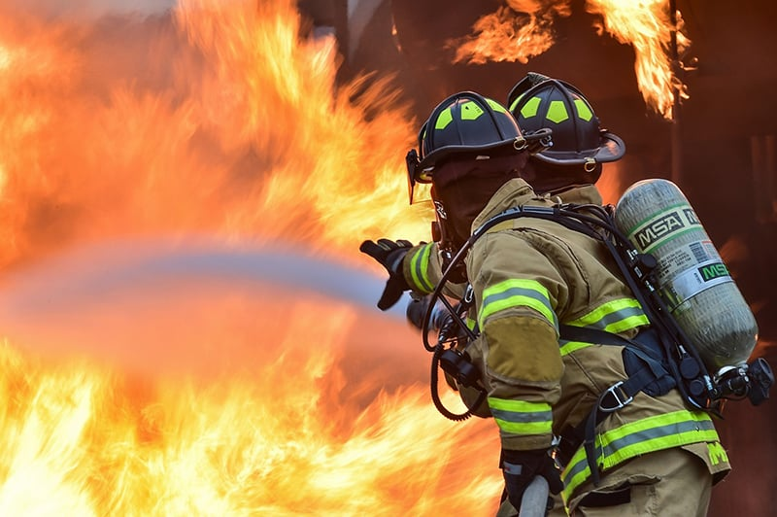

FIRE IS A KILLER
Notes:
The Basics of Forklift Safety

Slide 3
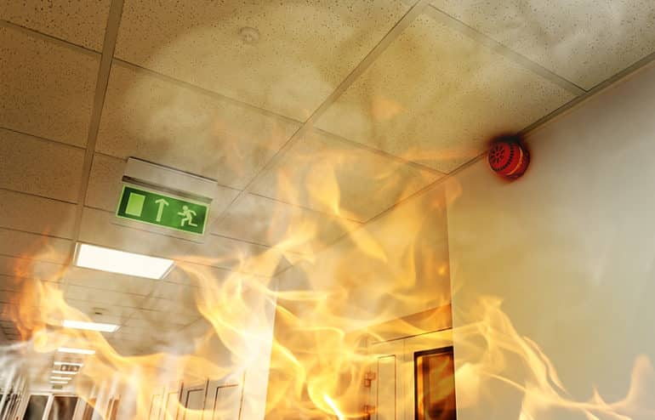
What’s at Stake?
The only way to avoid the perils of fire is practice persistent preparation.
Notes:
What’s at Stake?
Text here

Slide 4
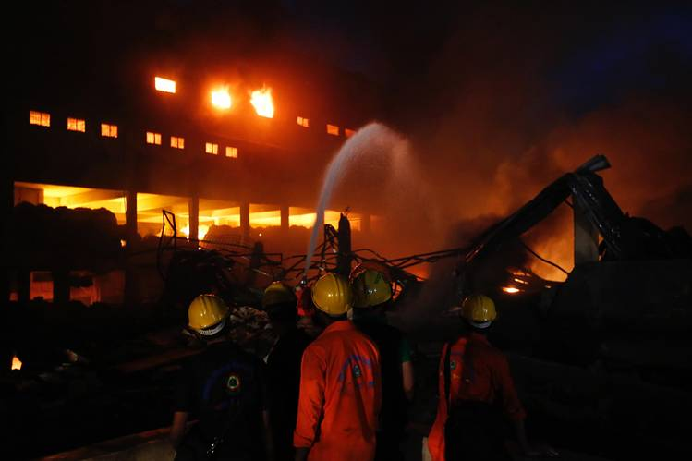
What’s the Danger?
Fire kills more people each year than all-natural disasters combined.
A fire needs three things to start to spread: oxygen, heat and fuel.
Oxygen makes up 21 percent of the air we breathe. That percentage goes higher if an oxygen canister or hose leaks.
Heat can come from smoking, cooking, or a sparking wire.
Fuel is anything that will burn. The workplace is replete with flammable-carpeting, drapes, paper, oil rags, wood, etc.

Slide 5
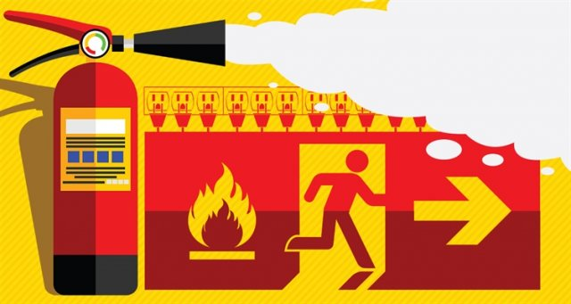
How to Protect Yourself
A Fire Prevention Program includes:
Emergency plans.
Escape routes and exits.
Fire prevention policies.
Emergency plans tell you how to evacuate in case of a fire and how to account for all those evacuated.
Escape routes and exits should be clearly marked and never locked or blocked.
Notes:
How to Protect Yourself
Machines of every description have standard operating procedures which include a “checklist” for its safe operation. Forklifts are no exception. There are procedures and protocols for the safe and effective use of the forklift.
These operating procedures are rooted out of common sense but are too often ignored or forgotten.

Slide 6
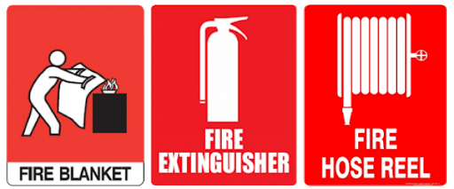
How to Protect Yourself
Fire prevention policies organize all the information about fire safety into one place including the following:
How to store combustible materials.
Location of fire extinguishers.
Disposal methods for flammable materials or chemicals.
Notes:
How to Protect Yourself
Follow safe speed limits – Drive only fast as you can comfortably walk. Forklifts can’t travel safely at high speeds. Without loads, they aren’t weighted and are especially unstable.
Keep the load low – While moving, forks should be low, with the mast tilted slightly back.
Maintain good visibility – If a load blocks forward vision, drive backwards.
Watch the slope – Back down slopes that have an incline greater than10 percent. Make sure your back up alarm is working properly.
Never carry hitchhikers – They are unsecured and can easily fall off and be injured.
Leave aisle room – Allow space for pedestrian and other traffic. Be alert at intersections. Honk your horn before and while you enter an intersection, even if it doesn’t appear to be busy.
Park safely – On a hill, always block the wheels, lower forks and set the parking brake.

Slide 7
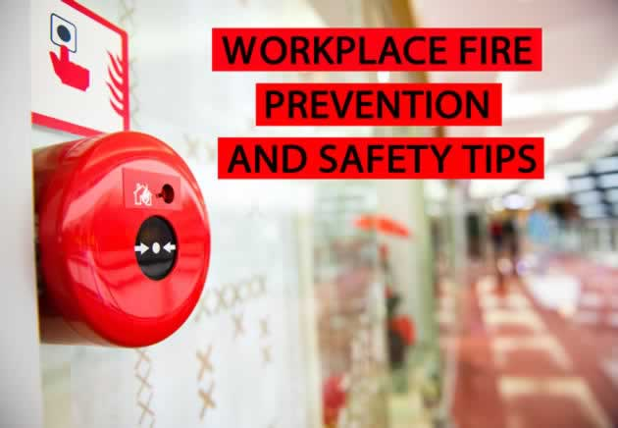
How to Protect Yourself
If a fire does start, here are steps to take:
Alert anyone in the area. Call the local emergency number, the fire department, or your company's fire brigade.
Evacuate the area.
Meet your co-workers in the designated outside area. You don’t want anyone going back into a burning building for you if you've already escaped to safety.
Notes:
How to Protect Yourself

Slide 8
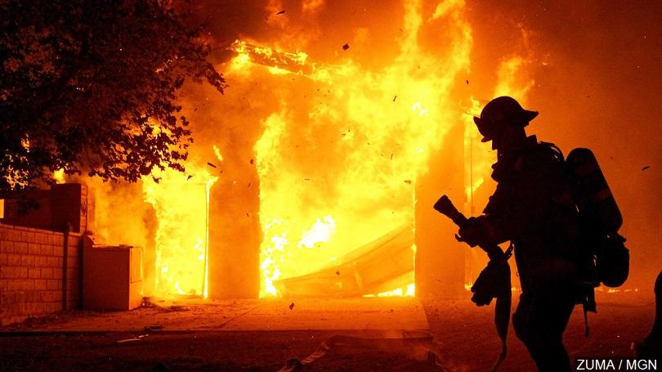
Final Word
Stop fires before they happen. Ensure you have been trained on emergency plans, escape routes, and fire prevention policies to ensure your safety. Fire prevention is all about helping businesses avoid injuries, damages, and potentially, safety fines. Follow the tips suggested in this Safety Talk to prevent fires in your workplace.
Notes:
Final Word

