Slide 1

Click anywhere to get started…

Slide 2

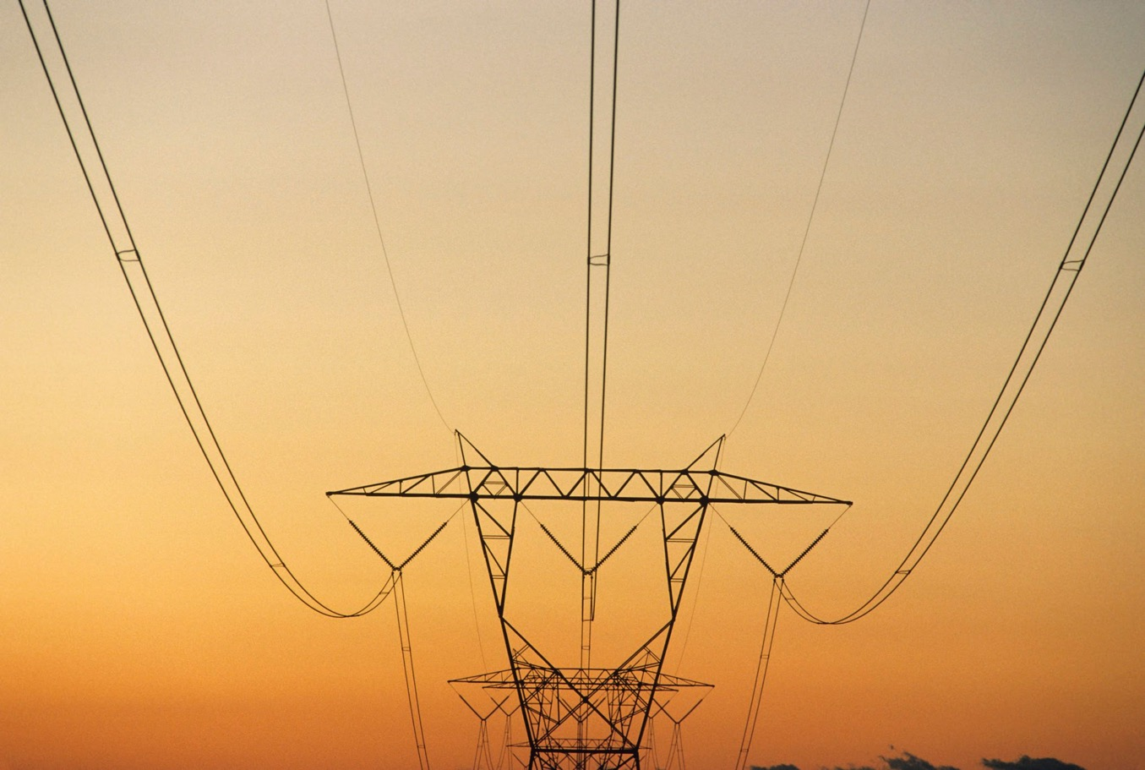

Utilities - Safely Installing and Removing Overhead Power Lines
Notes:
Utilities - Safely Installing and Removing Overhead Power Lines

Slide 3
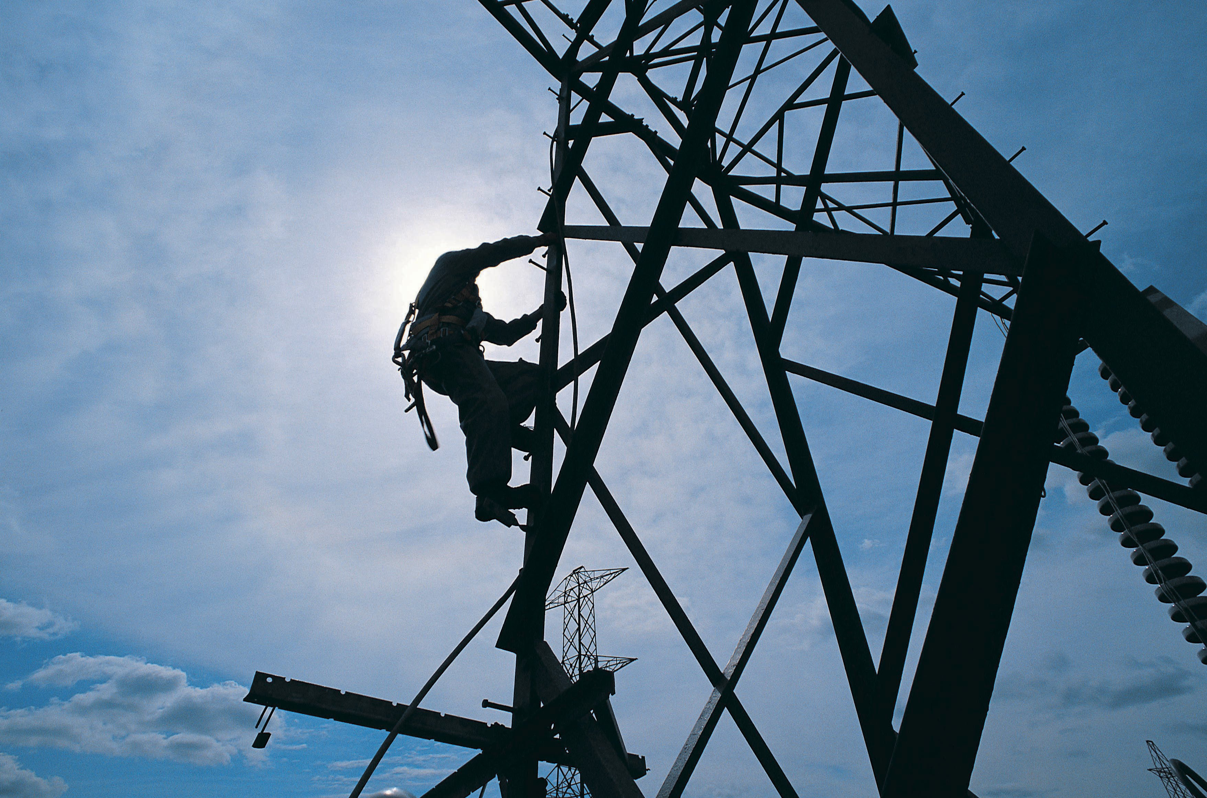
What’s at Stake?
When you install or remove overhead lines, you must protect yourself and others against hazards that could expose you to shock, electrocution, falls, flying and falling objects, and burns.
Notes:
What’s at Stake?
When you install or remove overhead lines, you must protect yourself and others against hazards that could expose you to shock, electrocution, falls, flying and falling objects, and burns.

Slide 4
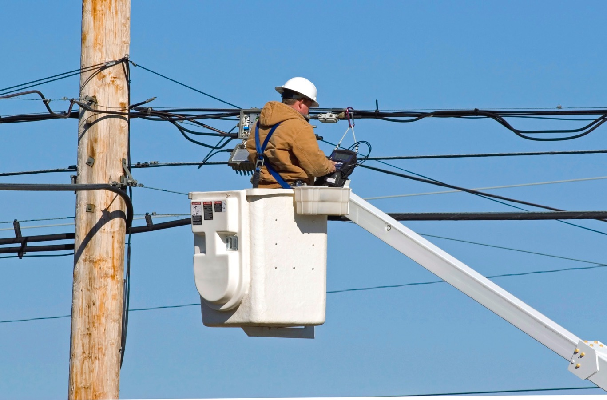
What’s the Danger?
Beware when:
Setting, moving, or removing a power pole near any exposed live conductor
Electricity can arc out from a point of contact and the area around a conduction point
Poles, towers, and other elevated structures that aren’t strong enough to withstand the stresses placed on them
Notes:
What’s the Danger?
Working near high voltage power lines carries considerable risk for anyone in the surrounding area.
When setting, moving, or removing a power pole near any exposed live conductor, the pole could contact the conductor and energize the pole and/or damage the conductor, creating multiple hazards for a work crew.
Electricity can arc out from a point of contact and the area around a conduction point, such as a crane that has touched a live power line, can become electrically charged. This means electrocution can occur even if a worker is not in direct contact with the power line.
Poles, towers, and other elevated structures that aren’t strong enough to withstand the stresses placed on them could collapse.

Slide 5

How to Protect Yourself
5 ways to stay safe when installing or removing overhead power lines
Don’t touch
Have the utility company turn off the electricity if possible.
Wear PPE if working on, or near, live lines.
Use the tension stringing method, barriers, or other physical measures.
Notes:
How to Protect Yourself
5 ways to stay safe when installing or removing overhead power lines
Don’t touch
Have the utility company turn off the electricity if possible.
Wear PPE, including appropriate rubber gloves, footwear and goggles if working on, or near, live lines.
Use the tension stringing method, barriers, or other physical measures to prevent conductors and cables from contacting live lines or equipment.

Slide 6
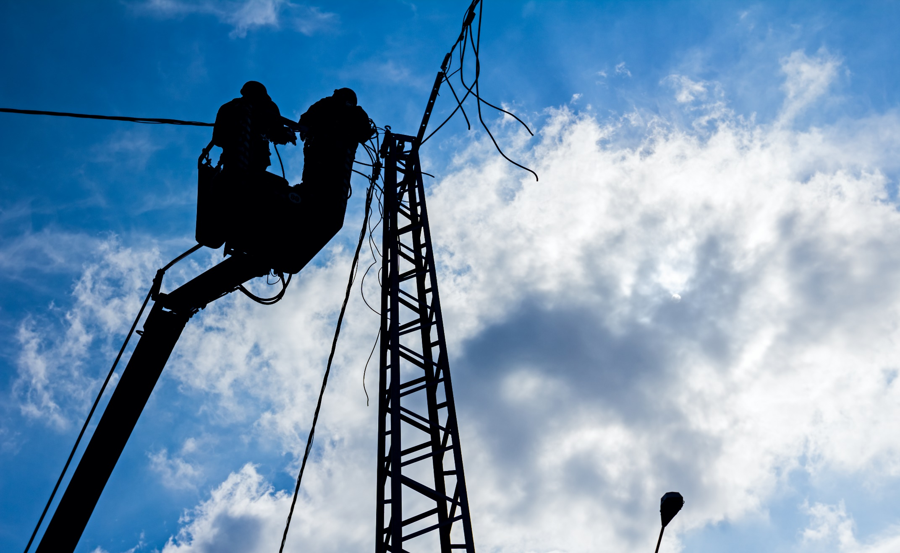
How to Protect Yourself
Loading and load safety
Keep the load line attached
Maintain control of tower sections
Make sure the load stays balanced
Reinforce the pole
Use equipment correctly
Use reel-handling equipment with caution
Level and align equipment
Don’t exceed the ratings of any equipment
Notes:
Loading and load safety
Keep the load line attached to a tower section until it is fully secured.
Use tag lines (or similar devices) to maintain control of tower sections while raising or positioning them.
Make sure the load stays balanced and manageable within crane load limits.
If a pole cannot withstand the load, it must be reinforced using devices like bracing poles and guy wires.
Use equipment correctly
Use reel-handling equipment, including pulling and tensioning devices, with extreme caution to prevent cables from snapping.
Level and align equipment.
Don’t exceed the ratings of any equipment, e.g.includes stringing lines, pulling lines, rigging, hoists, conductor grips, and load-bearing hardware and accessories.

Slide 7
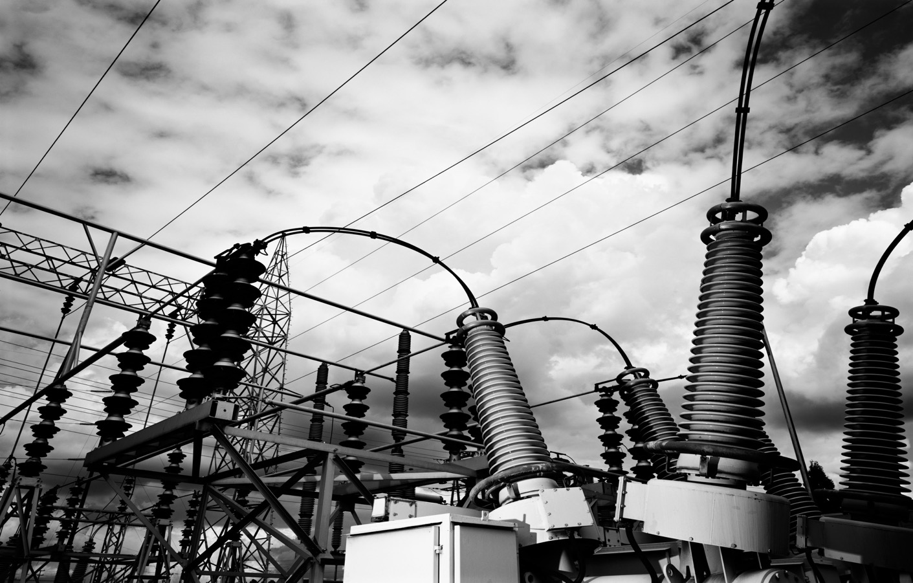
How to Protect Yourself
Keep a look out
Check the “drop zone” is clear of other workers.
Keep an eye on the weather.
Stay alert for failure of wire or cable that’s being pulled.
Watch out for failure of any previously installed lines or equipment.
Notes:
Keep a look out
Check the “drop zone” under any tower or structure that is being moved or worked on, is clear of other workers.
Keep an eye on the weather:
In a thunderstorm, workers must not begin or resume work for at least thirty minutes after hearing the last thunderclap;
In high winds that could reduce minimum approach distances;
Beware of snow, ice and rain storms.
Stay alert for any failure of the wire or cable that’s being pulled.
Watch out for failure of any previously installed lines or equipment.

Slide 8
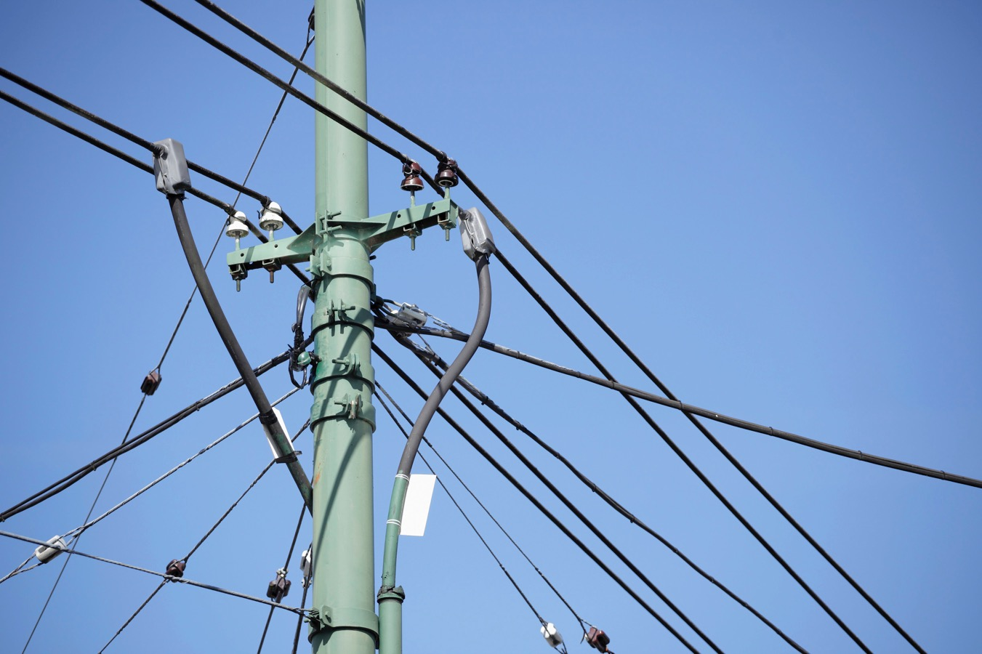
How to Protect Yourself
Conductors
Stop conductors from sagging into energized lines
Turn off energized line with reclosing devices
Activate “one-shot” operation
Newly installed conductors can create a risk of induced voltage
Notes:
Conductors
Stop conductors from sagging into energized lines by using:
tensioning equipment; barriers; and other means.
If the energized lines have reclosing devices, they must be turned off during the pulling operation.
When pulling over energized lines, activate “one-shot” operation to prevent breakers from automatically reclosing after any fault.
Newly installed conductors can create a risk of induced voltage so:
grounds must be installed on the new conductors so that every point is within 2 miles (3km) of a ground;
grounds must remain in place until all other installation work is done; and
Additional working grounds must be installed on the conductors at all terminating ends and at locations where workers are tying in the new conductors.

Slide 9
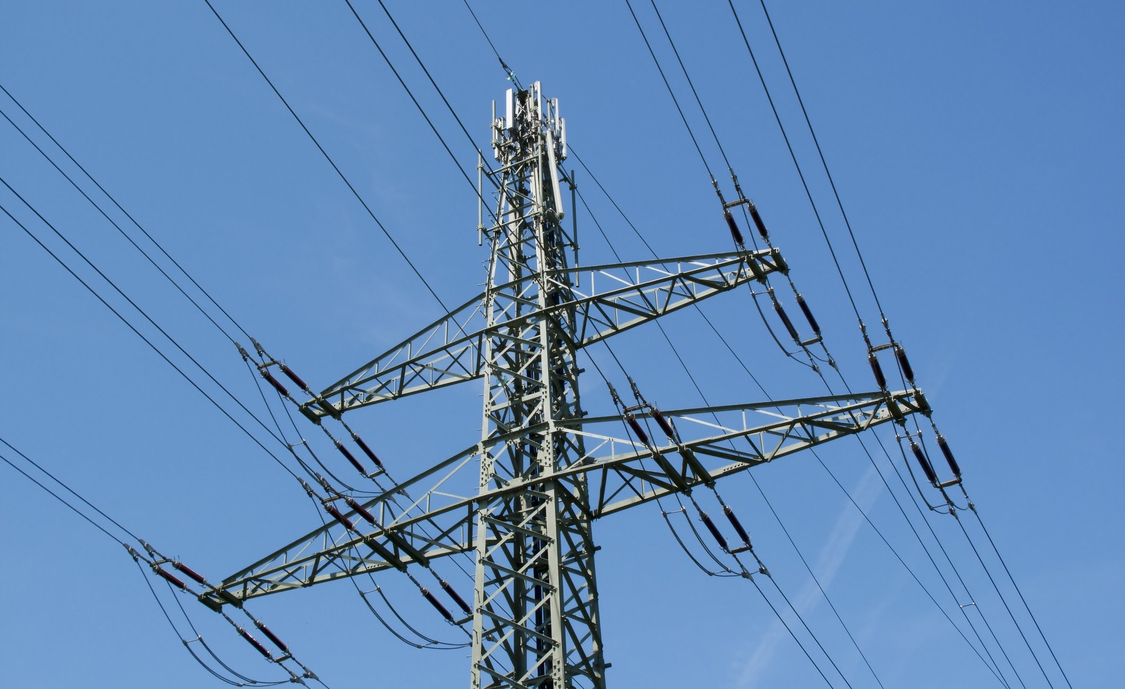
Final Word
Installing and removing overhead power lines requires a high level of concentration. Workers have to be aware of both the risks involved in working with heavy machinery used to move the structures, as well as the risks of working near live power lines.
Notes:
Final Word
Installing and removing overhead power lines requires a high level of concentration. Workers have to be aware of both the risks involved in working with heavy machinery used to move the structures, as well as the risks of working near live power lines.

