Slide 1

Click to get started…
Notes:
Water Safety Tips – Don’t Throw Safety Overboard
(Next Slide)

Slide 2
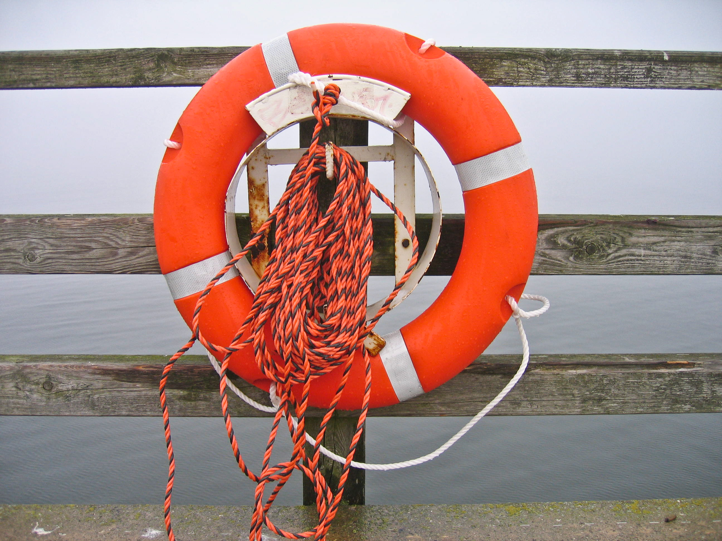

Water Safety Tips
Don’t Throw Safety Overboard
Notes:
Water Safety Tips – Don’t Throw Safety Overboard
(Next Slide)

Slide 3
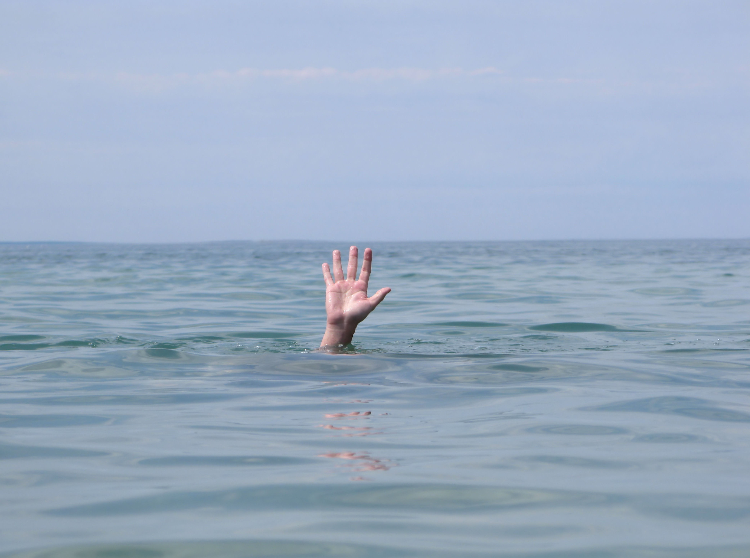
What’s at Stake
What’s at Stake
1,000 people a year die in boating accidents.
3,500 drownings a year not related to boating.
Majority of deaths are preventable.
Notes:
WHAT'S AT STAKE
Swimming and boating are staples of summer fun. The fun can quickly turn to tragedy though, when water and boating safety are thrown overboard. On average, 1,000 people die in boating-related accidents every year in North America and thousands more are injured. Additionally, more than 3,500 unintentional drownings, not related to boating, happen each year. The majority of these deaths are preventable.
(Next Slide)

Slide 4
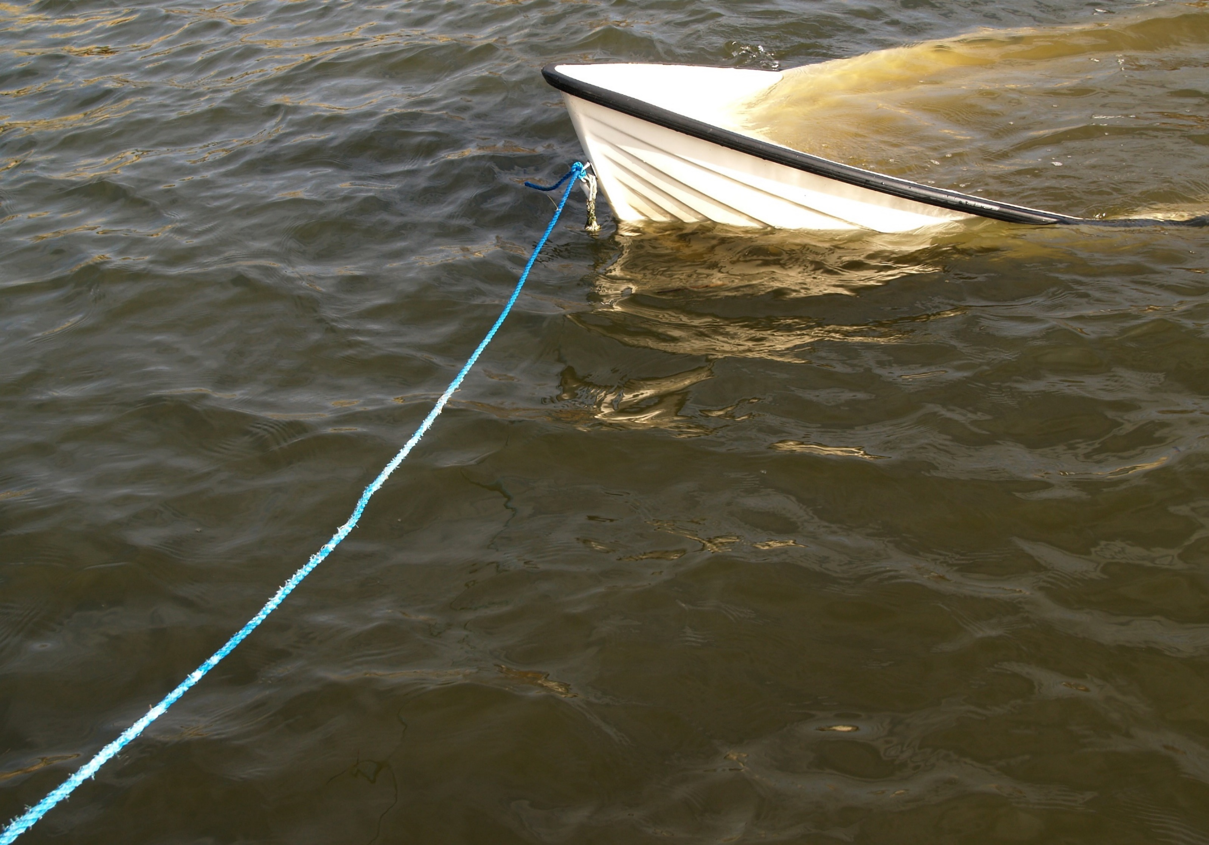
What’s the Danger
What’s at Stake
Most boating deaths involve recreational activities.
Majority of victims are males 15 to 74 years of age.
Almost 90% of boaters were not wearing, or not properly wearing, a lifejacket when they drowned.
In over 21% of deaths, a lifejacket was on board but was not worn.
Notes:
WHAT’S THE DANGER
Most boating deaths involve recreational activities and the vast majority of victims are males 15 to 74 years of age.
Almost 90 percent of boaters were not wearing, or not properly wearing, a lifejacket when they drowned.
In more than 21 percent of boating deaths, a lifejacket was present on board but was not worn.
(Next Slide)

Slide 5
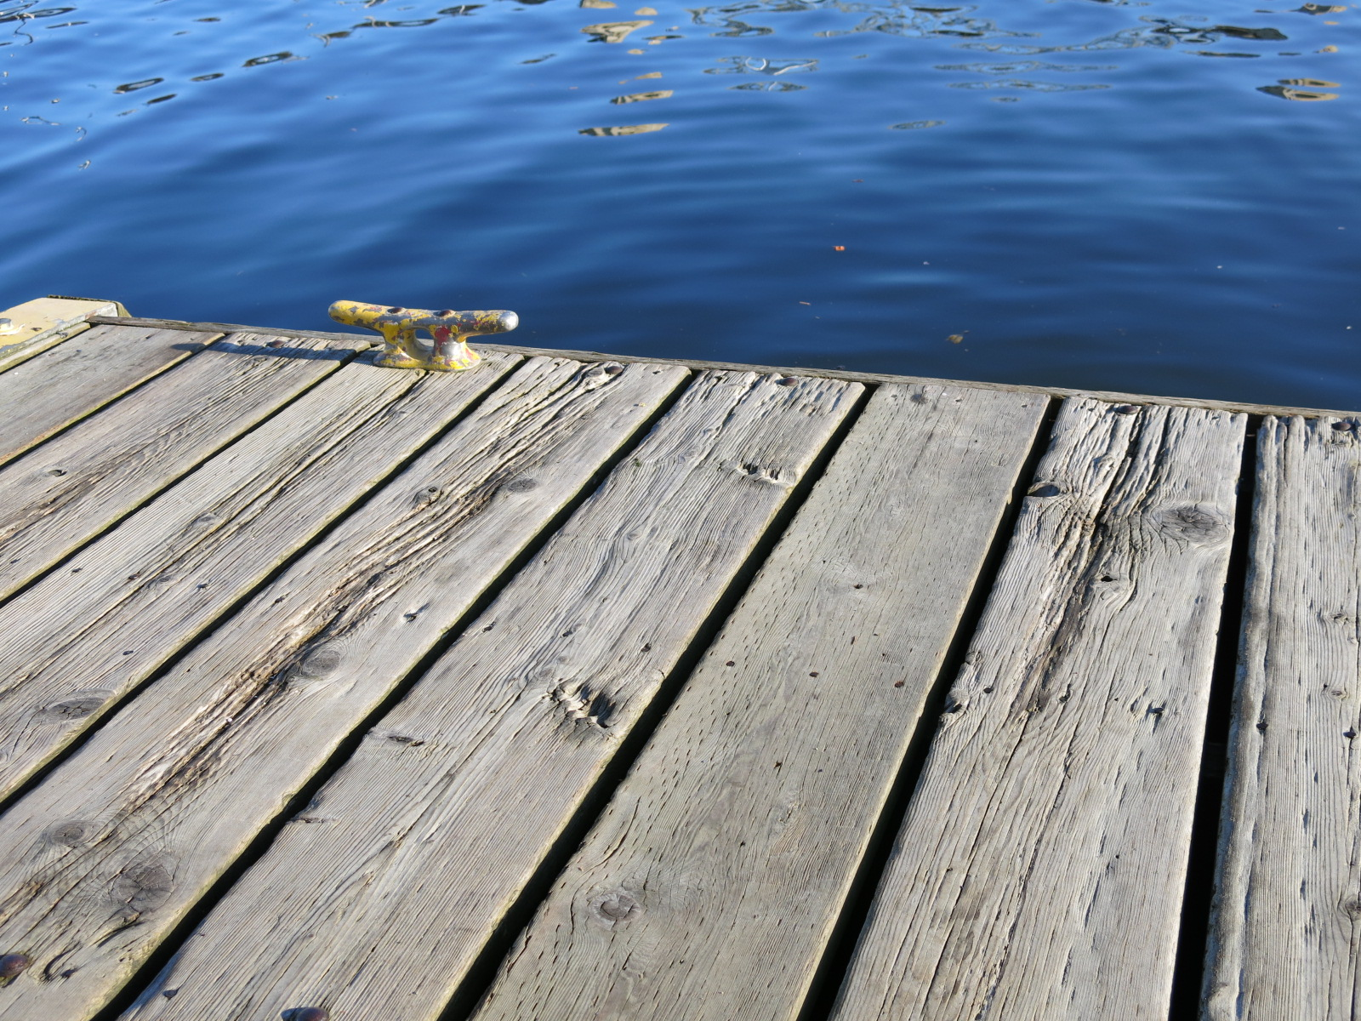
What’s the Danger
What’s at Stake
The NSC cites drowning as 2nd leading cause of death for people between ages of 5-24.
In a recent Canadian study, the average age of drowning victims was 42.
The highest death rates were among those 20 to 34 and 65 and older.
More than 200 children drown in backyard pools every year.
80% of these drownings occur when there is a lack of adult supervision.
Notes:
WHAT’S THE DANGER
Swimming, unexpected falls at waterfronts and pools, or from a dock, account for thousands of drowning deaths each year.
The National Safety Council cites drowning as the second-leading cause of death for people between the ages of 5-24.
In a recent Canadian study, the average age of drowning victims in Canada was 42. The highest death rates were among those 20 to 34 and 65 and older.
More than 200 children drown in backyard pools every year, and 80 percent of these drownings occur when there is a lack of adult supervision.
(Next Slide)

Slide 6
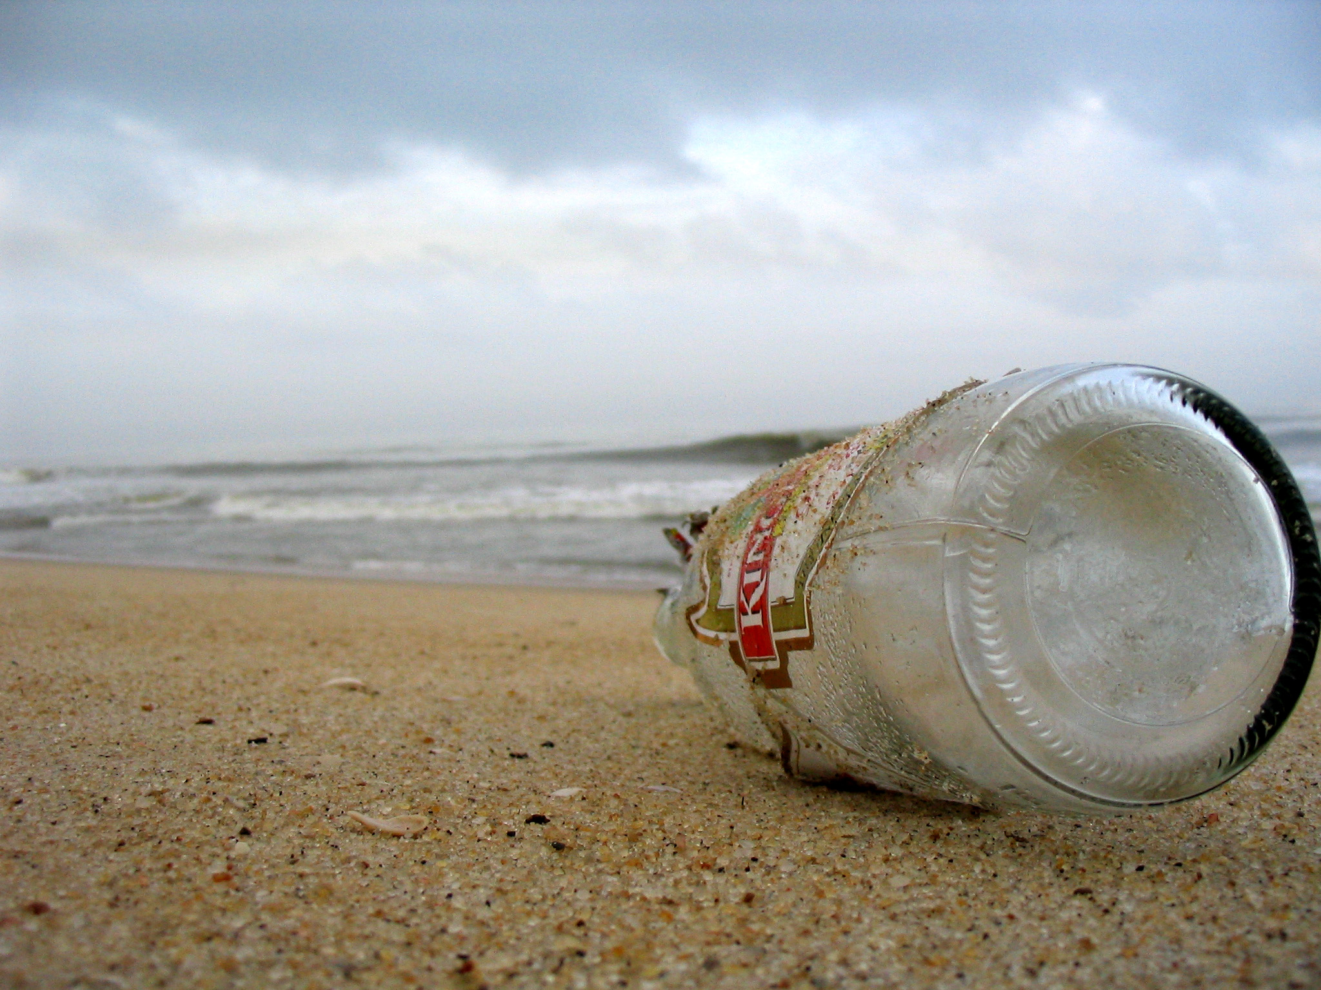
What’s the Danger
What’s at Stake
Alcohol consumption plays a role in many water-related accidents and deaths.
According to Canadian Red Cross, alcohol is a factor in almost 40% of water-related fatalities for people 15 and older.
The CDC cites alcohol use as the leading factor in fatal boating incidents in the U.S.
Notes:
WHAT’S THE DANGER
Alcohol consumption plays a role in many water-related accidents and deaths.
According to the Canadian Red Cross, alcohol is a factor in almost 40 percent of water-related fatalities involving people 15 and older.
The Centers for Disease Control and Prevention (CDC) cites alcohol use as the leading contributing factor in fatal boating incidents in the U.S.
(Next Slide)

Slide 7
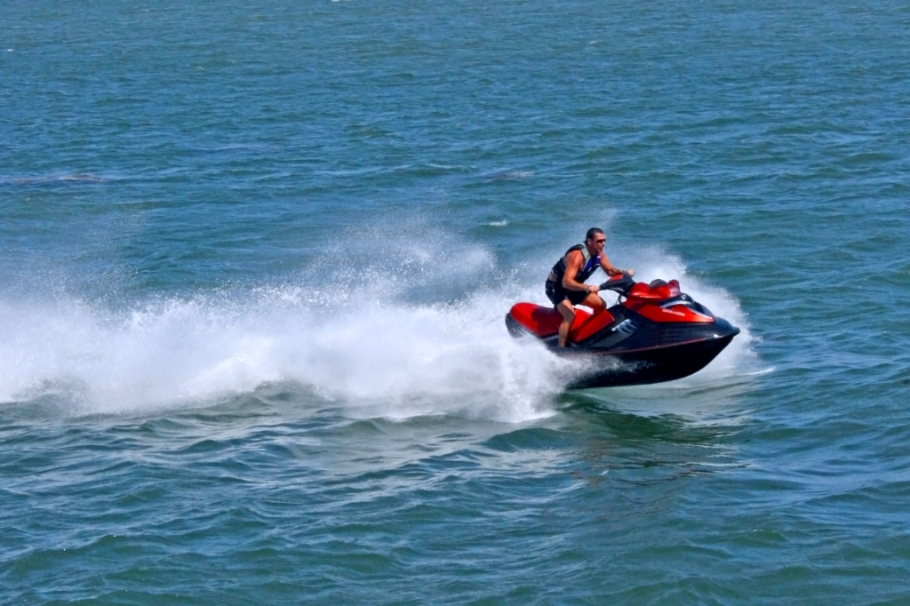
How to Protect Yourself
What’s at Stake
Boating Safety Tips
Lifejackets are required for each person on a boat.
Properly fitted lifejackets can prevent drownings.
Should be worn at all times by everyone on the boat.
If you operate a boat make sure everyone has and is wearing a lifejacket.
Notes:
HOW TO PROTECT YOURSELF
Boating Safety Tips
Wear a lifejacket:
Lifejackets are required by law for each person on board a boat.
Properly fitted lifejackets can prevent drownings and should be worn at all times by everyone on the boat.
If you operate a boat, it is your responsibility to make sure everyone has and is wearing a properly fitting lifejacket.
(Next Slide)

Slide 8
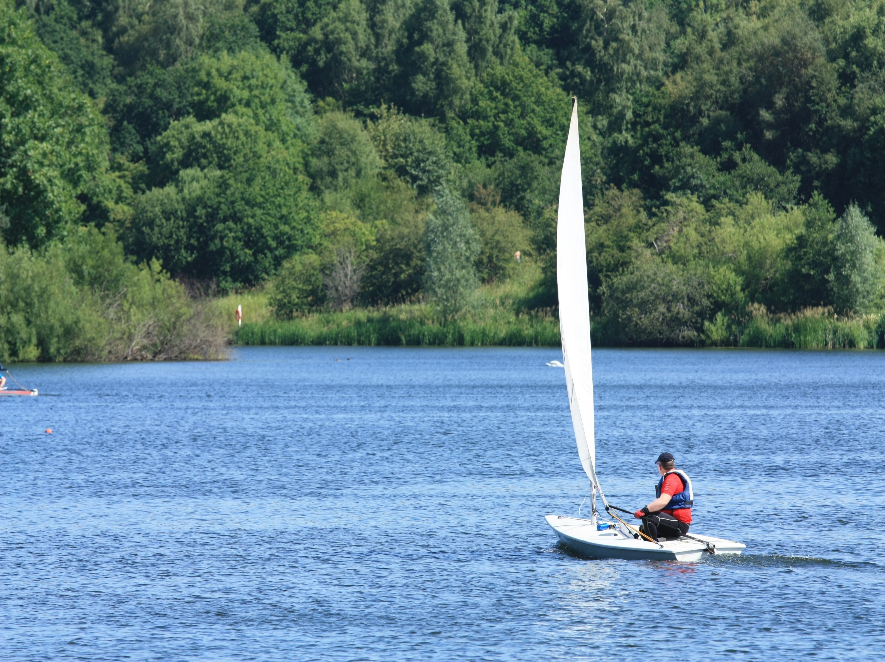
How to Protect Yourself
How to Protect Yourself
What’s at Stake
Boating Safety Tips
Don't drink alcohol and operate a boat.
Boating under the influence of alcohol is just as deadly as drinking and driving.
Drinking and boating is illegal in all U.S. states and all provinces in Canada.
Notes:
HOW TO PROTECT YOURSELF
Boating Safety Tips
Don't drink alcohol and operate a boat:
Alcohol use affects judgment, vision, balance, and coordination.
Boating under the influence of alcohol is just as deadly as drinking and driving.
Drinking and boating is illegal in all U.S. states and all provinces in Canada.
(Next Slide)

Slide 9
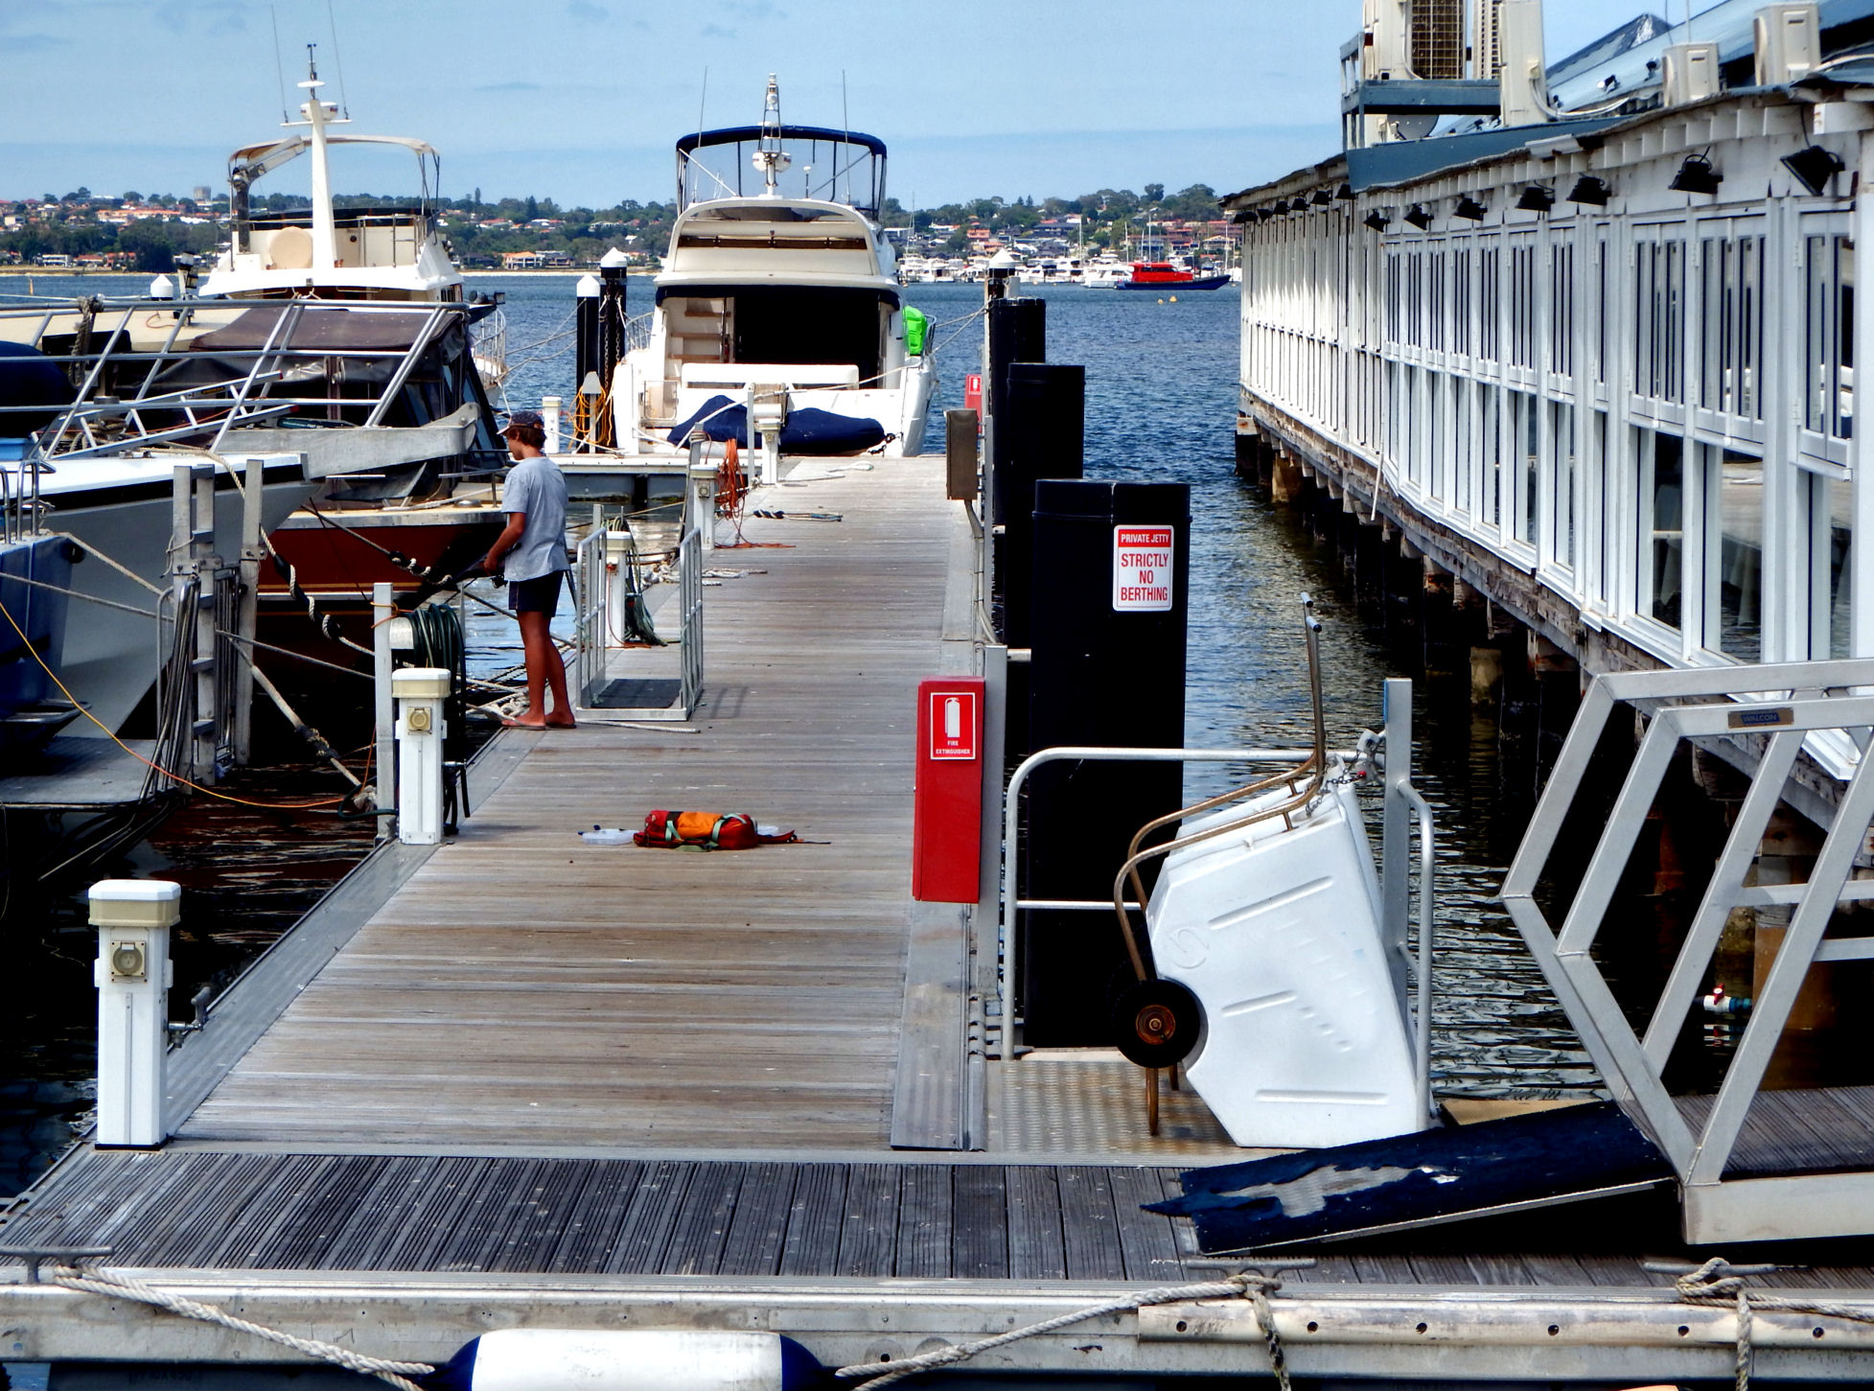
How to Protect Yourself
What’s at Stake
Boating Safety Tips
Take a course on boating safety.
Make sure your boat is in good operational order.
Check gasoline and fluid levels.
Check the weather forecast.
If you see lightning or hear thunder get off the water immediately.
Notes:
HOW TO PROTECT YOURSELF
Boating Safety Tips
Be prepared:
Take a course on boating safety.
Make sure your boat is in good operational order before each outing.
Check gasoline and fluid levels.
Check the weather forecast. Don’t go out on the water if stormy weather is expected. If you see lightning or hear thunder, get to a safe place off the water immediately.
(Next Slide)

Slide 10
How to Protect Yourself
What’s at Stake
Swimming Safety Tips
If you don’t know how to swim, take swimming lessons.
Always swim with a buddy.
Only swim in designated areas and obey all warning flags, signs and lifeguard instructions.
If you get caught in a current:
Don’t try to fight it.
Stay calm and float with it.
Swim parallel to the shore until you can swim free.
Notes:
HOW TO PROTECT YOURSELF
Swimming Safety Tips
If you don’t know how to swim, take swimming lessons.
Always swim with a buddy.
Only swim in designated areas and obey all warning flags, signs and lifeguard instructions.
Make sure your skill level matches the water you’re swimming in. Swimming in a river, lake or ocean requires more strength to handle strong currents and waves.
If you get caught in a current:
Don’t try to fight it.
Stay calm and float with it.
Swim parallel to the shore until you can swim free.
(Next Slide)

Slide 11
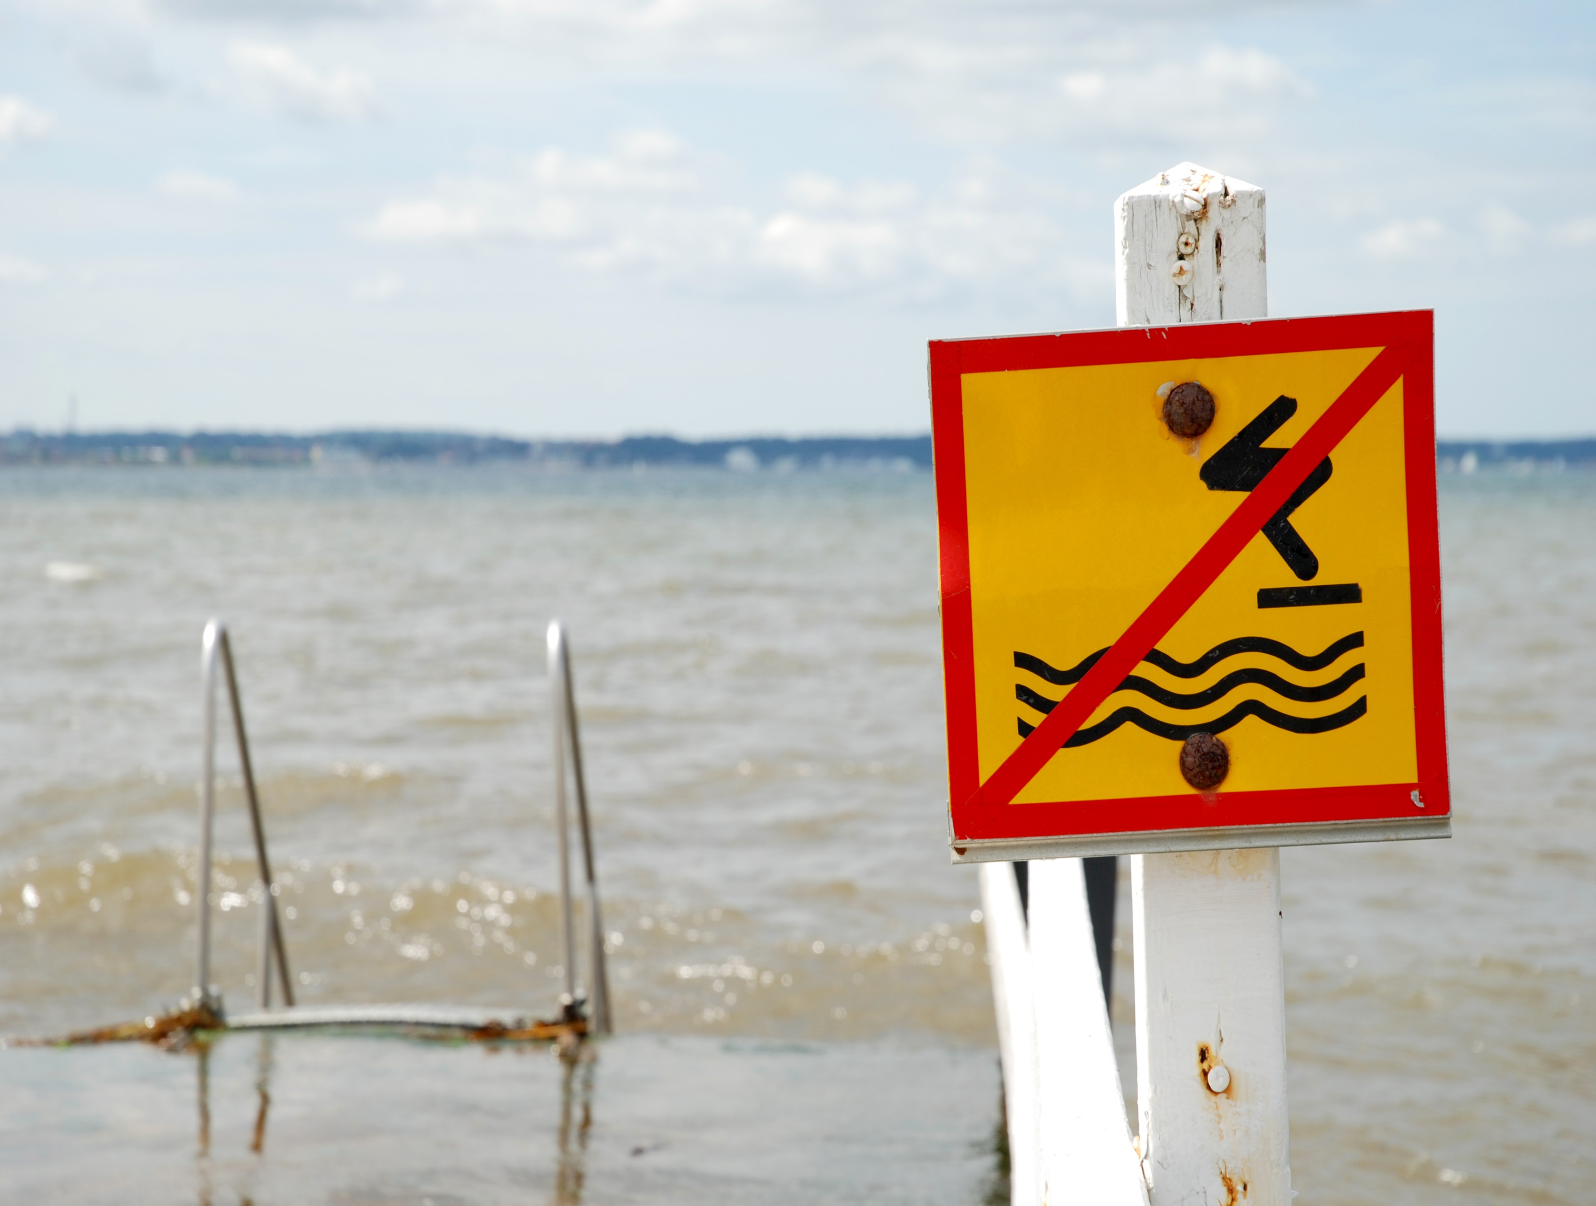
How to Protect Yourself
What’s at Stake
Swimming Safety Tips
Never dive in shallow water or unfamiliar areas.
Never drink alcohol when swimming.
Get out of and away from the water immediately if you see lightning or hear thunder.
Notes:
HOW TO PROTECT YOURSELF
Swimming Safety Tips
Never dive in shallow water or unfamiliar areas.
Never drink alcohol when swimming. Just as when boating, alcohol affects your judgment, vision, balance, and coordination.
Get out of and away from the water immediately if you see lightning or hear thunder.
(Next Slide)

Slide 12
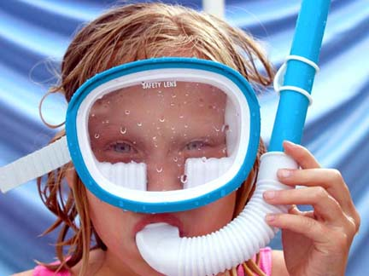
How to Protect Yourself
What’s at Stake
Swimming Safety Tips
Teach children to swim at an early age.
NEVER leave them alone, even for a minute.
Put up proper gates and fencing around backyard pools.
Empty kiddie pools after each use.
Learn CPR and rescue techniques.
Notes:
HOW TO PROTECT YOURSELF
Swimming Safety Tips
Teach children to swim at an early age.
Actively supervise children near any water. NEVER leave them alone, even for a minute. A child can drown in the time it takes to run inside and grab a drink or answer a phone call.
Put up proper gates and fencing around backyard pools.
Empty kiddie pools after each use. A child can drown in just a few inches or centimetres of water.
Learn cardiopulmonary resuscitation (CPR) and rescue techniques.
(Next Slide)

Slide 13
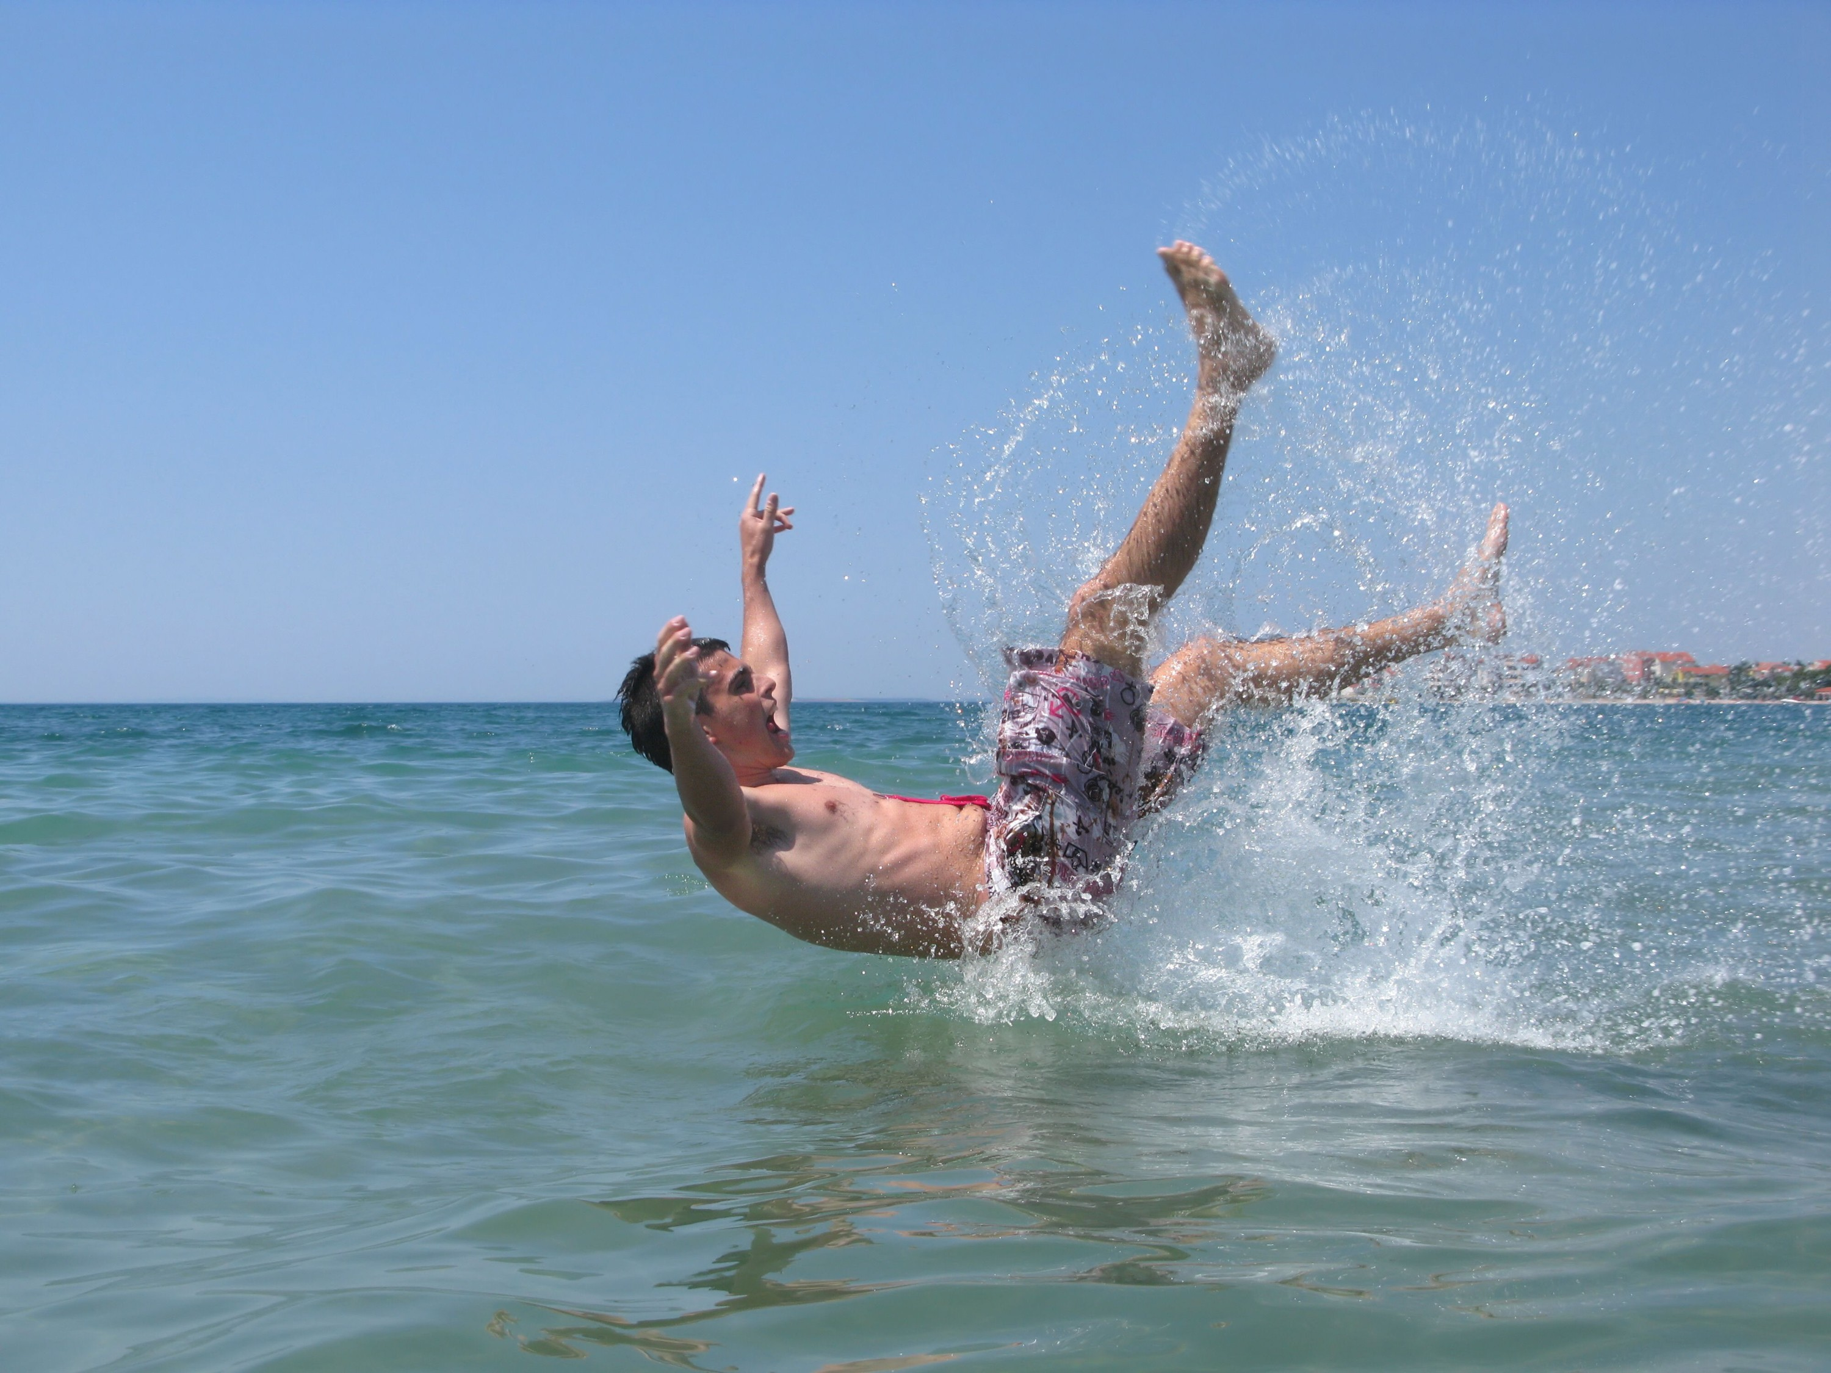
Final Word
What’s at Stake
Swimming and boating are two of the most popular summer activities.
Don’t drown in a sea of regret because you forgot to practice safe boating and swimming.
Notes:
FINAL WORD
Swimming and boating are two of the most popular summer activities. Don’t drown in a sea of regret because you forgot to practice safe boating and swimming.
(Next Slide)

Slide 14
End of Presentation
Notes:
(Next Slide)

