Slide 1

Click to get started…
Notes:
(Next Slide)

Slide 2
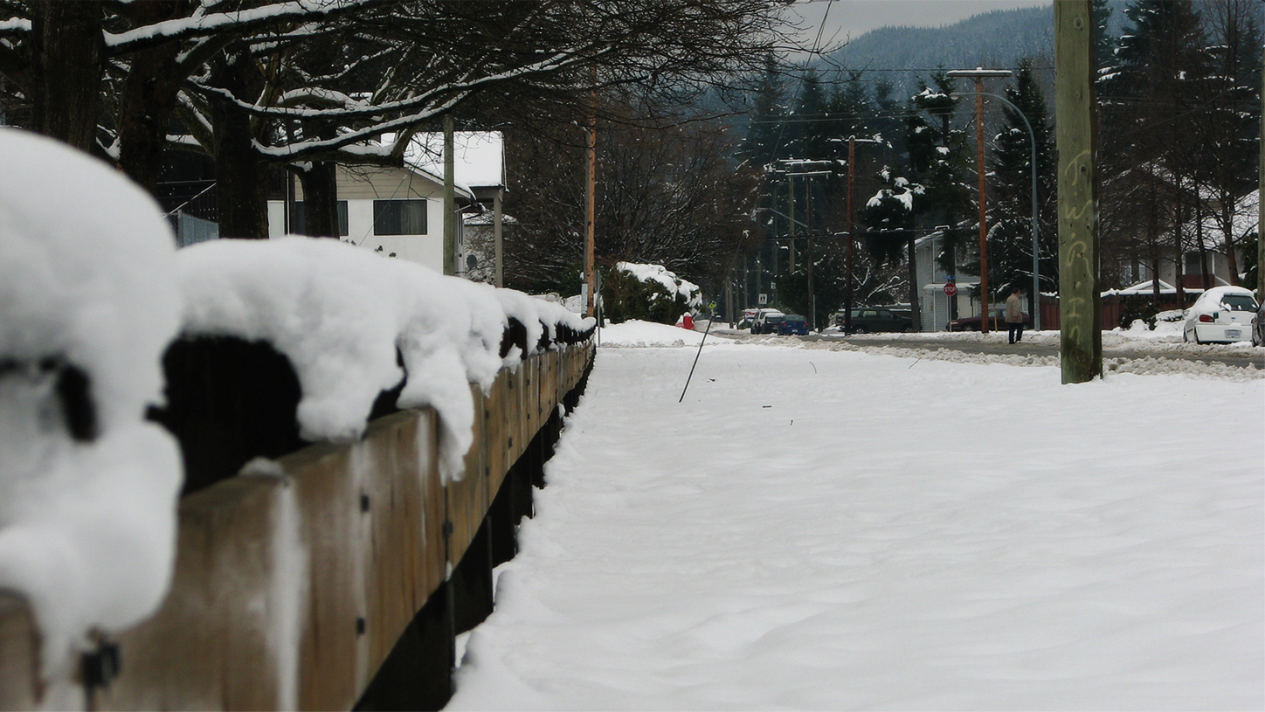

Weathering Winter at Home
Notes:
Weathering Winter at Home
(Next Slide)

Slide 3
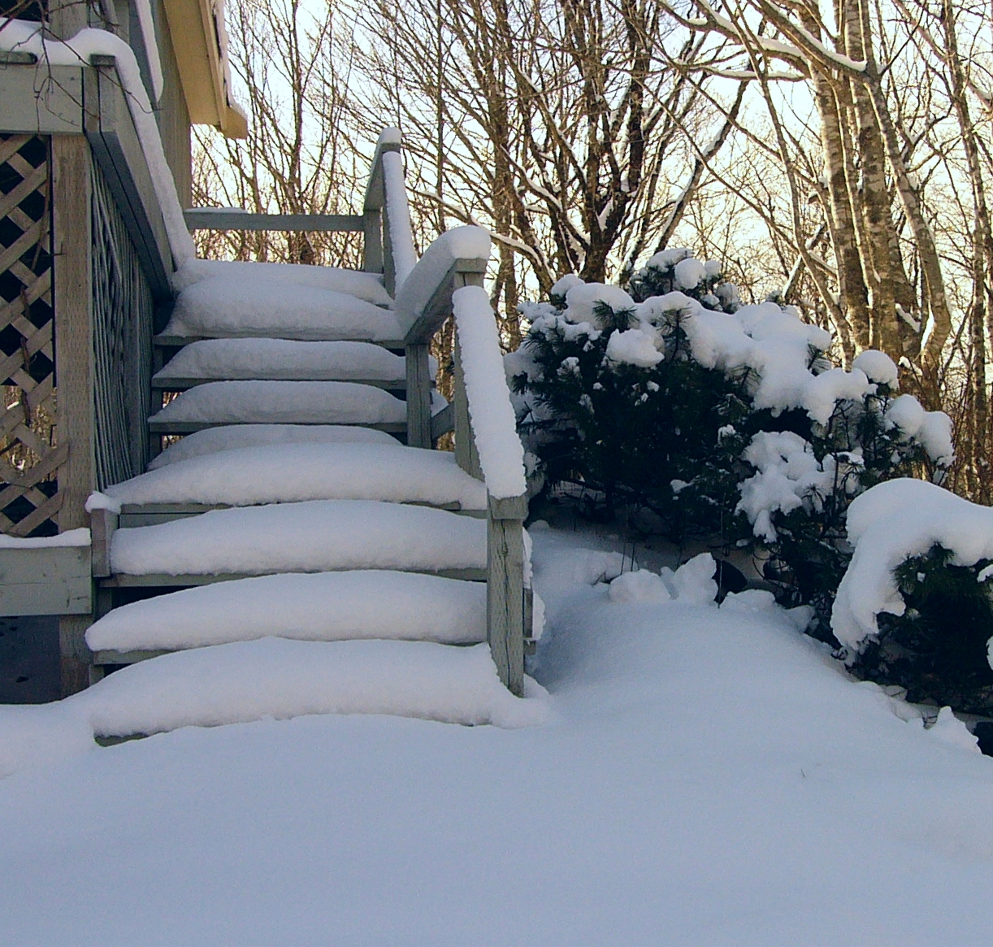
What’s at Stake
What’s at Stake
Most of us are familiar with winter safety tips for our vehicle.
But have you given much thought to prepping your home and family for the long cold winter?
Notes:
WHAT'S AT STAKE
Most of us are familiar with winter safety tips for our vehicle. But have you given much thought to prepping your home and family for the long cold winter?
(Next Slide)

Slide 4
What’s the Danger
What’s at Stake
Frostbite and Hypothermia
Overexertion injuries
Homebound for several days
Slips and Falls
Notes:
WHAT’S THE DANGER
Winter cold, snow and ice can lead to frostbite and hypothermia, slips and falls, overexertion injuries such as back injuries and heart attacks, and the possibility of being stuck in your house for several days without electricity, heat and water.
(Next Slide)

Slide 5
How to Protect Yourself
What’s at Stake
Stock up
Stay Warm
Food
Stay Safe
Blankets and warm clothes
Candles, flashlights and batteries
Install battery-powered or batter back-up carbon monoxide detectors
Water
Wood
Notes:
HOW TO PROTECT YOURSELF
Before Winter Weather Hits
Stock up - have a supply of several days of food and water and dry, seasoned wood for your fireplace or wood-burning stove.
Have plenty of blankets and warm clothes ready and stock up on candles, flashlights and batteries; and
Install battery-powered or battery back-up carbon monoxide detectors.
(Next Slide)

Slide 6
How to Protect Yourself
What’s at Stake
When Using Generators Remember
People can die from carbon monoxide poisoning when using portable generators indoors.
Generators should be used only outdoors.
Including in attached garages, or too close to the house.
Generators should be at least 20 feet or six meters, away from doors, windows, and vents.
Notes:
HOW TO PROTECT YOURSELF
When using generators remember:
People can die from carbon monoxide poisoning when using portable generators indoors, including in attached garages, or too close to the house.
Generators should be used only outdoors and should be located at least 20 feet or six meters, away from doors, windows, and vents.
(Next Slide)

Slide 7
How to Protect Yourself
What’s at Stake
Have snow shovels and other snow removal equipment ready.
Keep your snow blower fueled up and have rock salt or other products on hand to melt ice on walkways.
Don’t forget sand or kitty litter can improve traction if your vehicle is stuck in the driveway.
Notes:
HOW TO PROTECT YOURSELF
Have snow shovels and other snow removal equipment ready.
Waiting until the threat of a storm could leave you searching for a shovel without much chance of finding one.
Keep your snow blower fueled up and have rock salt or other products on hand to melt ice on walkways.
Don’t forget sand or kitty litter can improve traction if your vehicle is stuck in the driveway.
(Next Slide)

Slide 8
How to Protect Yourself
What’s at Stake
Get a weather radio and sign up for alerts and notifications from local emergency services.
Make a Family Communications Plan.
Bring pets inside and move other animals or livestock to sheltered areas with non-frozen drinking water.
Check on elderly or homebound neighbors and relatives.
Notes:
HOW TO PROTECT YOURSELF
Get a weather radio and sign up for alerts and notifications from local emergency services.
Make a Family Communications Plan.
Your family may not be together when disaster strikes, so it is important to know how you will contact one another, how you will get back together and what you will do in case of an emergency.
Check on elderly or homebound neighbors and relatives; and
Bring pets inside during winter weather and move other animals or livestock to sheltered areas with non-frozen drinking water.
(Next Slide)

Slide 9
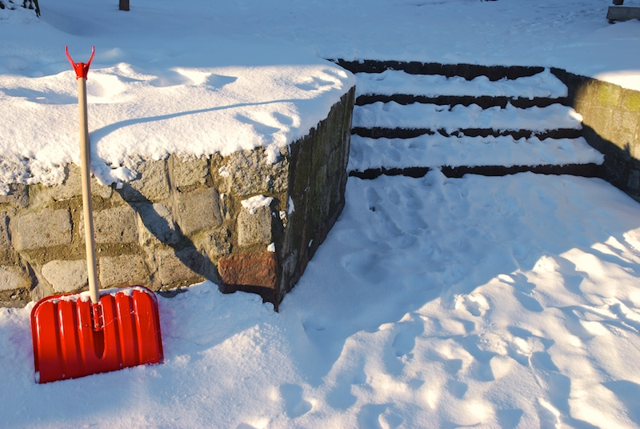
Final Word
What’s at Stake
Winter weather doesn’t have to mean putting yourself or your family in danger.
With a little forethought and planning, you can weather winter successfully!
Notes:
FINAL WORD
Winter weather doesn’t have to mean putting yourself or your family in danger. With a little forethought and planning, you can weather winter successfully!
(Next Slide)

Slide 10
End of Presentation
Notes:
(Next Slide)

