Slide 1

Click anywhere to get started…

Slide 2



Young Worker Safety and Health
Notes:
Young Worker Safety and Health

Slide 3

What’s at Stake?
Over 20 million workers younger than 24 years of age in the workplace.
Young workers have high occupational injury rates:
  High number of hazards in places where they typically work.
  Inexperience and lack of safety training.
For workers in middle and high schools, biologic and psychosocial contributors can increase injury rates.
Notes:
What’s at Stake?
There are over 20 million workers in the U.S. and Canada, younger than 24 years of age in the workplace and these workers represent roughly 15% of the workforce.
Young workers have high occupational injury rates which can in part be explained by the high number of hazards in places where they typically work, such as hazards in restaurant settings associated with slippery floors and the use of knives and cooking equipment.
Inexperience and lack of safety training may also increase injury risks for young workers.
And, for the youngest workers, those in middle school and high school, there may be biologic and psychosocial contributors to increased injury rates, such as inadequate fit, strength, and cognitive abilities needed to operate equipment and machinery.

Slide 4
What’s the Danger?
01
Transportation
Contact with objects/equipment
Assaults and violent acts
Exposure to harmful substances and environments.
03
WHERE?
WHY?
Agriculture
Forestry and fishing
Retail
Construction
Service
HOW?
Lack of safety training
Unsafe equipment
Poor supervision
Performing illegal work
Pressured to work quickly
02
Notes:
What’s the Danger?
Most non-fatal injuries occur in the agriculture, forestry and fishing industries, followed by retail trade, construction and service industries (e.g. nursing homes, amusement parks and swimming pools). The most commonly reported incidents for injury include transportation, contact with objects/equipment, assaults and violent acts and exposure to harmful substances and environments.
Reasons for these incidents include:
Insufficient safety training.
Working with unsafe equipment.
Poor supervision.
Performing work that is illegal for young workers, such as operating certain types of equipment; and
Being pressured to work quickly.

Slide 5

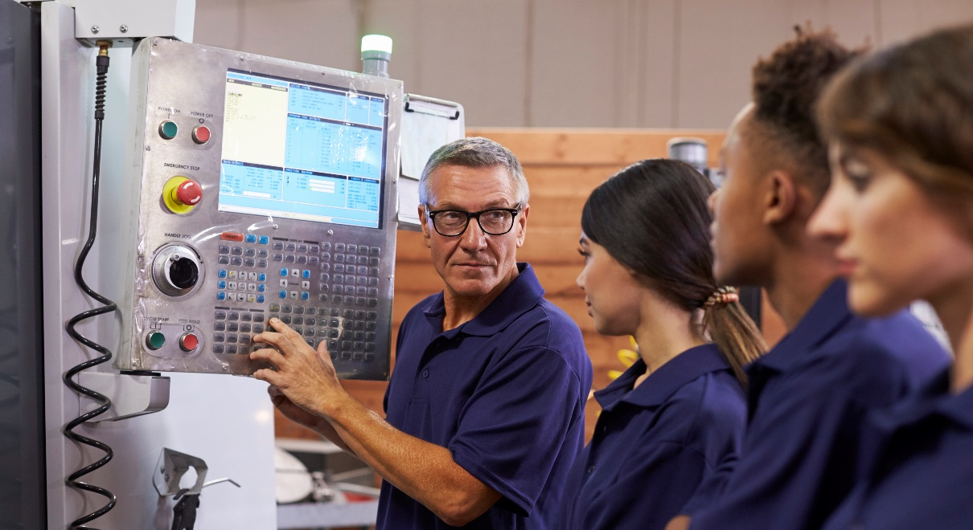

How to Protect Yourself
Comply with the Law
Establish Mentorships
Provide Training
Comply with all federal and state child labor laws.
Follow company policies, rules and requirements.
Have experienced workers available so younger workers can better learn the ins and outs of a new job.
Train young workers on proper work practices and how to spot hazards.
Ensure training is done in an understandable way appropriate for the worker’s age.
Notes:
How to Protect Yourself
To protect young workers from harm:
Be compliant. Comply with all federal and state child labor laws and follow company policies, rules and requirements.
Establish mentorships. Have experienced workers available so younger workers can better learn the ins and outs of a new job.
Train young workers on proper work practices and how to spot hazards. Ensure training is done in an understandable way appropriate for the worker’s age.

Slide 6

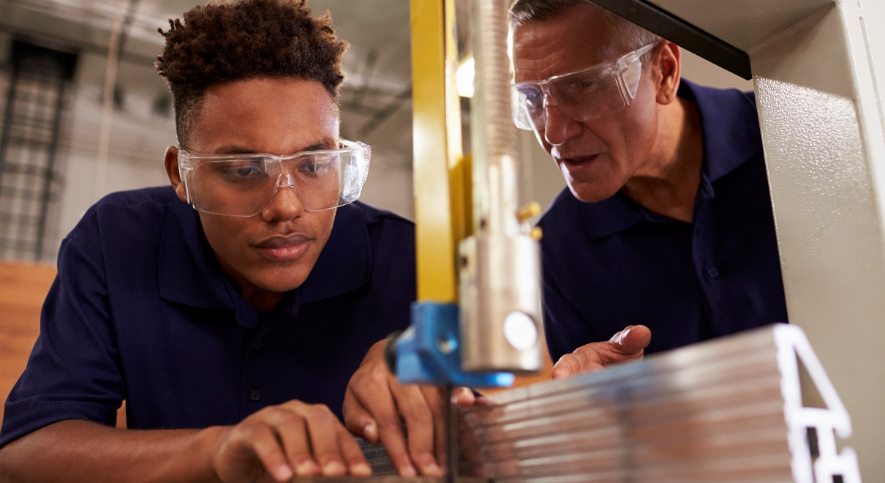

How to Protect Yourself
Culture
Safe Use of Equipment
Injury Follow-up
Create a culture in which young workers are encouraged to ask questions.
Ensure young workers do not operate dangerous equipment.
Teach young workers what they should do if they get injured at work.
Notes:
How to Protect Yourself
Create a culture in which young workers are encouraged to ask questions.
Ensure young workers do not operate dangerous equipment; and
Teach young workers what they should do if they get injured at work.

Slide 7

Final Word
Young workers have a unique role in our workforce.
Help keep them safe by providing training and support that is unique to their needs.
Notes:
Final Word
Young workers have a unique role in our workforce. Help keep them safe by providing training and support that is unique to their needs.

