Slide 1
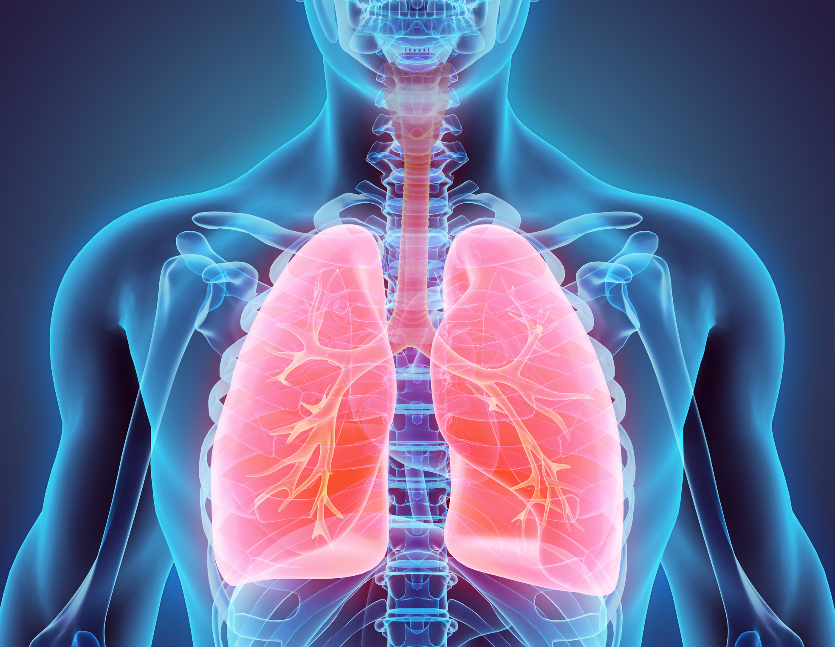

Carcinogens – Cancer Causing Chemicals
Notes:
Carcinogens - Cancer Causing Chemicals
(Next Slide)

Slide 2
What’s at Stake
Carcinogen:
  Any substance that can cause cancer.
  Chronic toxins that cause damage after repeated or long-term exposure.
The workplace can be a source of exposure to carcinogens:
  Asbestos
  Benzene
  Formaldehyde
Notes:
WHAT'S AT STAKE
A carcinogen is any substance that can cause cancer. They are chronic toxins that cause damage after repeated or long-term exposure. For some people, the workplace can be a source of exposure to some carcinogens, such as asbestos, benzene, or formaldehyde.
(Next Slide)

Slide 3
What’s the Danger
Benzene is a colorless, flammable liquid with a sweet odor.
It is among the 20 most widely used chemicals in the United States.
Starting material in making other chemicals, including plastics, lubricants, rubbers, dyes, detergents, drugs, and pesticides.
The main route of exposure is through inhalation.
Can be absorbed through the skin, but liquid benzene evaporates quickly so it’s less common.
Notes:
WHAT’S THE DANGER
Benzene is a colorless, flammable liquid with a sweet odor. It is among the 20 most widely used chemicals in the United States. It is used mainly as a starting material in making other chemicals, including plastics, lubricants, rubbers, dyes, detergents, drugs, and pesticides. The main route of exposure is through inhalation, but it can also be absorbed through the skin, but because liquid benzene evaporates quickly, this is less common.
(Next Slide)

Slide 4
What’s the Danger
Asbestos
Minerals that occur as bundles of fibers.
Two types - both linked to cancer.
Most exposures come from inhaling asbestos fibers:
Mining/processing, making asbestos-containing products, installing insulation.
During demo, when older asbestos-containing materials break down.
Found in soil and rocks.
Notes:
WHAT’S THE DANGER
Asbestos is a group of naturally occurring minerals that occur naturally as bundles of fibers. These fibers are found in soil and rocks in many parts of the world. There are 2 main types of asbestos and both have been linked to cancer. Most exposures come from inhaling asbestos fibers during the mining and processing of asbestos, when making asbestos-containing products, or when installing asbestos insulation. It can also occur when older buildings are demolished or renovated, or when older asbestos-containing materials begin to break down.
(Next Slide)

Slide 5
What’s the Danger
Formaldehyde
Formaldehyde is a colorless, strong-smelling gas
When dissolved in water it is called formalin
Exposure
Building materials
Used as an industrial disinfectant, and as a preservative in funeral homes and medical labs.
Pressed-wood
Glues and adhesives
Permanent-press fabrics
Paper product coatings
Insulation
Other chemicals
Inhalation
Absorption
Notes:
WHAT’S THE DANGER
Formaldehyde is a colorless, strong-smelling gas used in making building materials and many household products, including pressed-wood products; glues and adhesives; permanent-press fabrics; paper product coatings; certain insulation materials; and to make other chemicals. When dissolved in water it is called formalin, which is commonly used as an industrial disinfectant, and as a preservative in funeral homes and medical labs. Exposure occurs mainly through inhalation or by absorbing liquids containing formaldehyde through the skin.
(Next Slide)

Slide 6
How to Protect Yourself
Follow safe work practices, clean-up and disposal.
Talk to safety manager or supervisor.
Wear the right kind of PPE.
Stop smoking.
Notes:
HOW TO PROTECT YOURSELF
Always follow safe work practices, clean-up and disposal procedures.
Wear the right kind of PPE each and every time there is the potential for exposure.
Stop smoking – benzene and formaldehyde are both found in cigarette smoke.
If you are concerned about exposure talk to your safety manager or supervisor.
(Next Slide)

Slide 7
Final Word
  Exposure to carcinogens doesn’t have to be deadly.
    Be informed about the hazards.
    Follow safe work practices.
    Wear your PPE to protect yourself against exposure hazards.
Notes:
FINAL WORD
Exposure to carcinogens doesn’t have to be deadly. Be informed about the hazards, follow safe work practices and wear your PPE to protect yourself against exposure hazards.
(Next Slide)

