Slide 1

Click anywhere to get started…

Slide 2
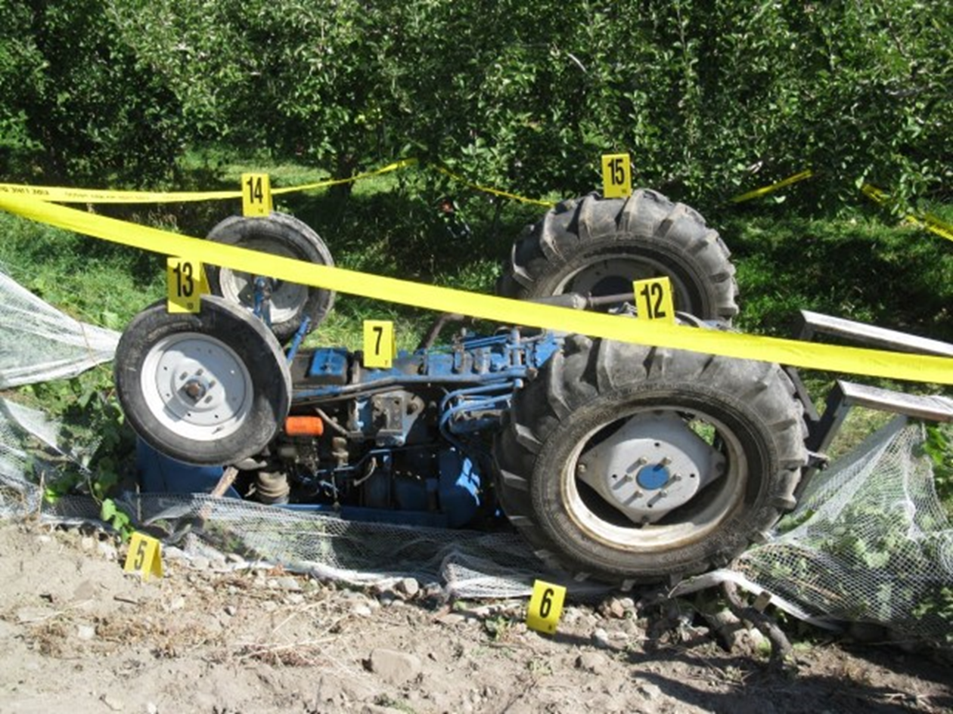


Prevent Tractor Overturns

Slide 3
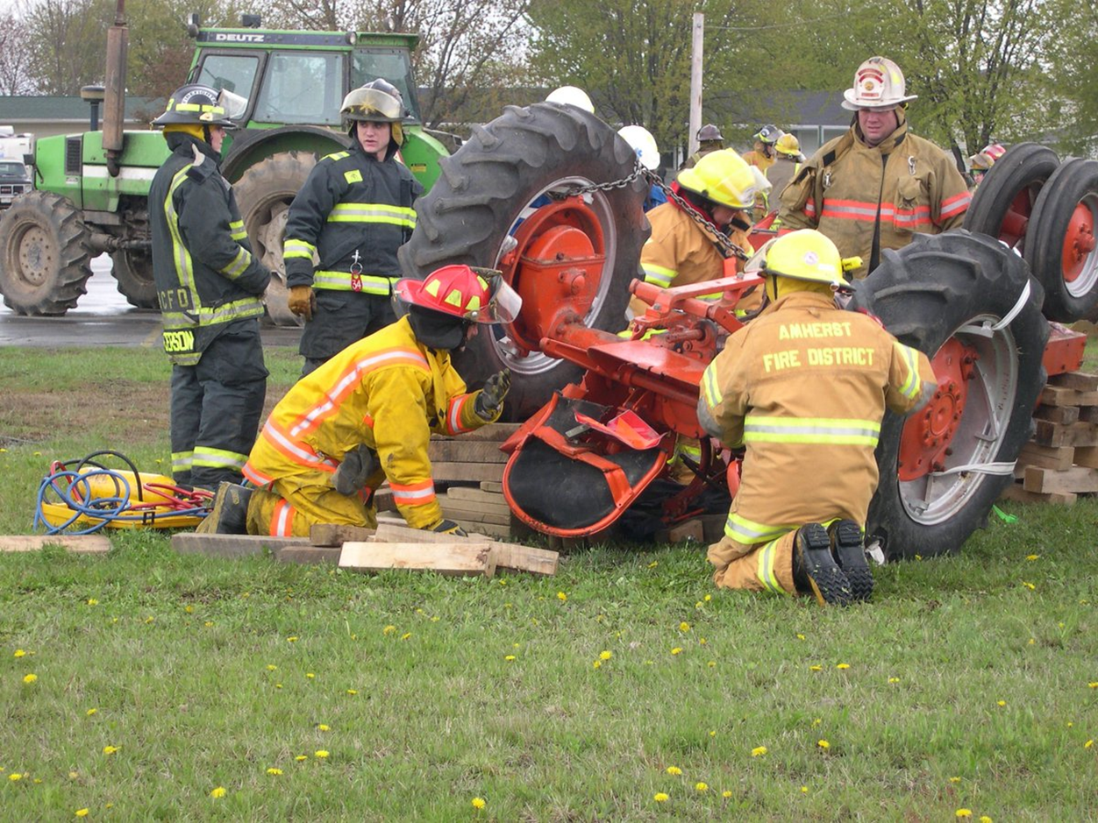
What’s at Stake?
It takes time, and sometimes dangerous experiences, to really understand how unpredictable tractors can be.
Many situations could be the cause of tractor overturns or rollovers, and if you’re not prepared, you may possibly find yourself being pulled down with one.

Slide 4
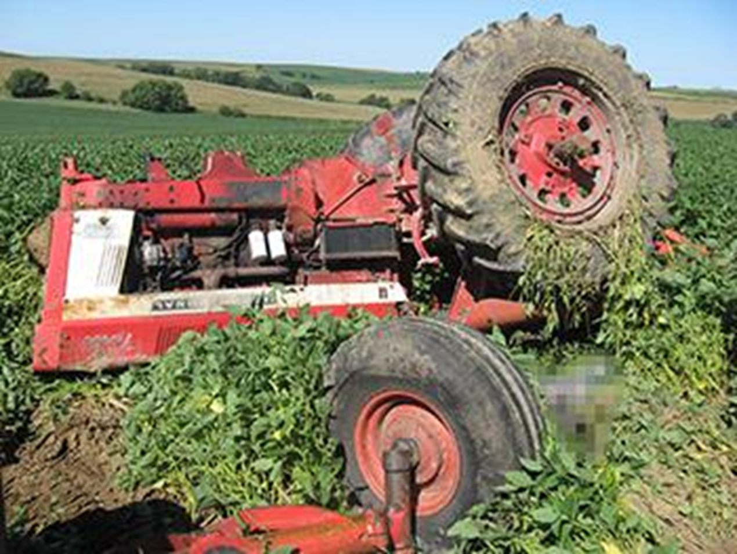
What’s the Danger?
Tractors have come a long way in protecting operators. Many come with rollover protective structures (ROPS) which keep the operator safely enclosed within the cabin. But tractors have a high centre of gravity and are dangerously top-heavy. Steep slopes, potholes, excessive speed and raised loaded buckets are all causes of tractor overturn.
Knowing this, it’s understandable that tractor overturn is one of the biggest causes of fatalities in the agricultural industry. It takes less than a second for the machine to tip-over, so it’s important to get to know what the causes are so you can be better prepared and avoid it from happening.

Slide 5
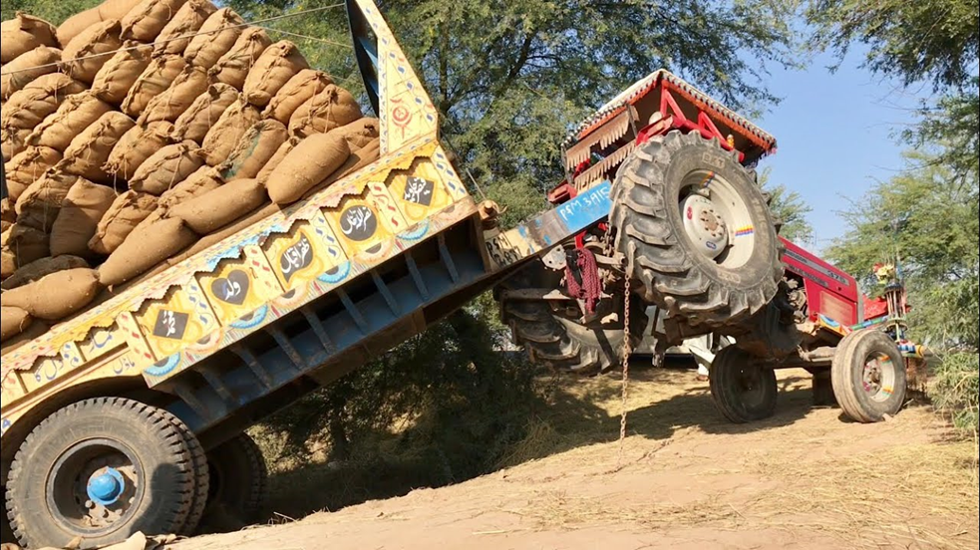
How to Protect Yourself
When taking a turn, go slowly.
Raised front-loading attachments increase the risk of overturns, as the tractor becomes more top-heavy.
Uneven brake pressure can force a rollover, so be sure to lock brake pedals together when traveling at high speed.
Obstructions such as rocks, stumps and potholes can throw your tractor out of control, causing it to overturn. Be mindful of your terrain.
When pulling heavy loads, drive slowly and avoid quick stops.
When going downhill, shift to a lower gear, ensuring you don’t use a speed range that could cause your tractor to “freewheel”.

Slide 6
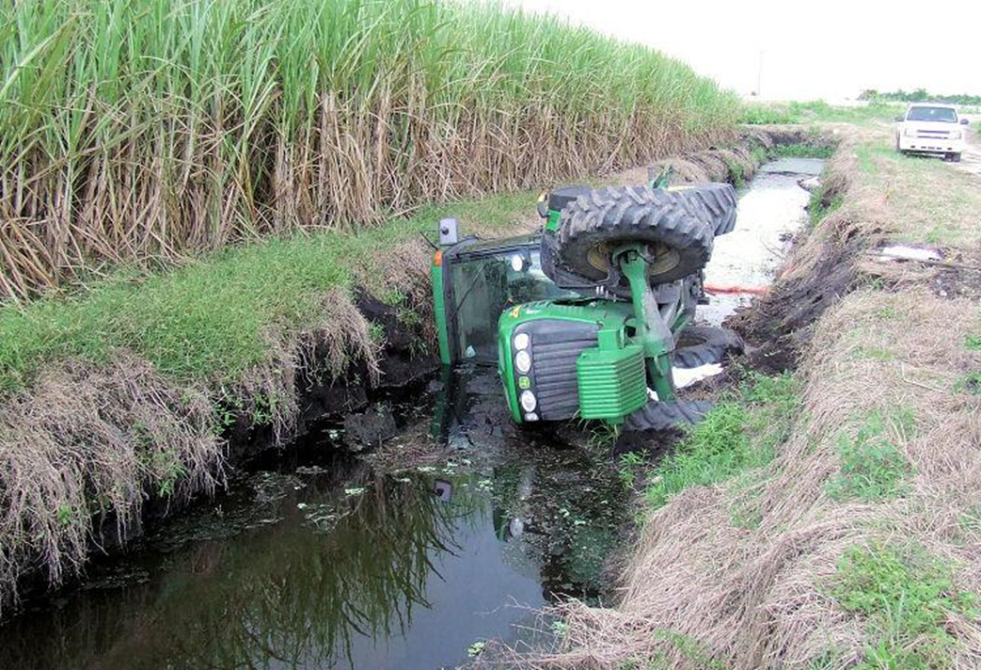
How to Protect Yourself
Avoid crossing slopes. Instead, direct the front-end of your tractor downhill.
Don’t get too close to ditches and streams. Keep the distance between the closest wheels and the edge of the bank the same depth as the bank itself.
Keep a heavily loaded bucket as low as possible while transporting or turning. This will minimize the chances of the tractor being overturned because of an increased centre of gravity.
When towing, be sure the towed load is not higher than the tractor drawbar. When needed, use front chassis weights to counterbalance.
Always start forward slowly.

Slide 7
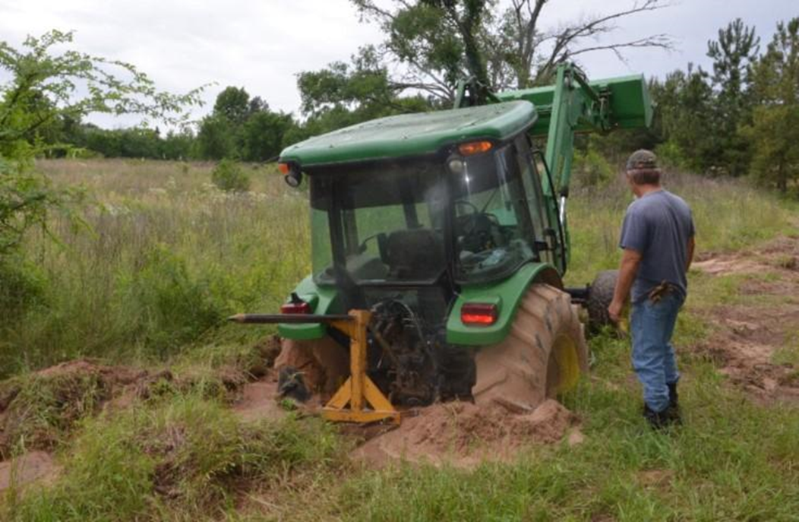
How to Protect Yourself
If possible, travel up a steep grade backwards and travel down forward.
If your tractor begins to roll backward with the clutch disengaged, let it roll naturally without applying the brakes.
Avoid crossing ditches. If possible, go around them.
If your tractor gets stuck in the mud, attempt to back out. Many people have placed boards beneath the drive wheels, which has caused many backward flips.

Slide 8
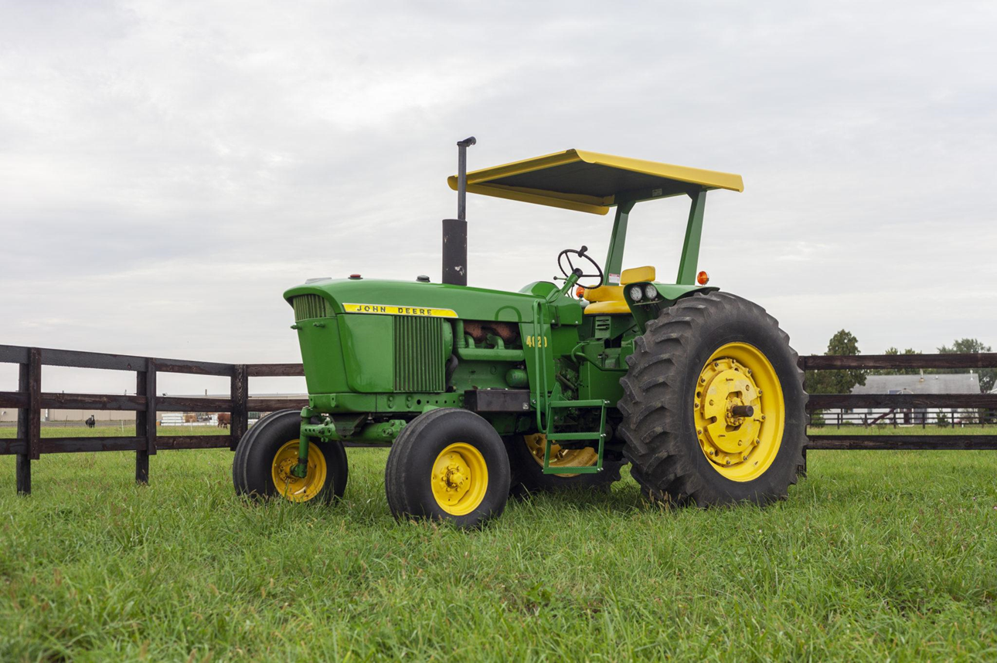
How to Protect Yourself
It is safer to operate a tractor with ROPS. If your tractor is equipped with this feature, be sure to wear your seatbelt. This will keep your body stationary in the event of a rollover. If you don’t have ROPS, it’s very important to keep your belt unfastened. Because there is nothing protecting you, you’ll need the freedom of movement to be thrown clear of the overturning tractor.

Slide 9
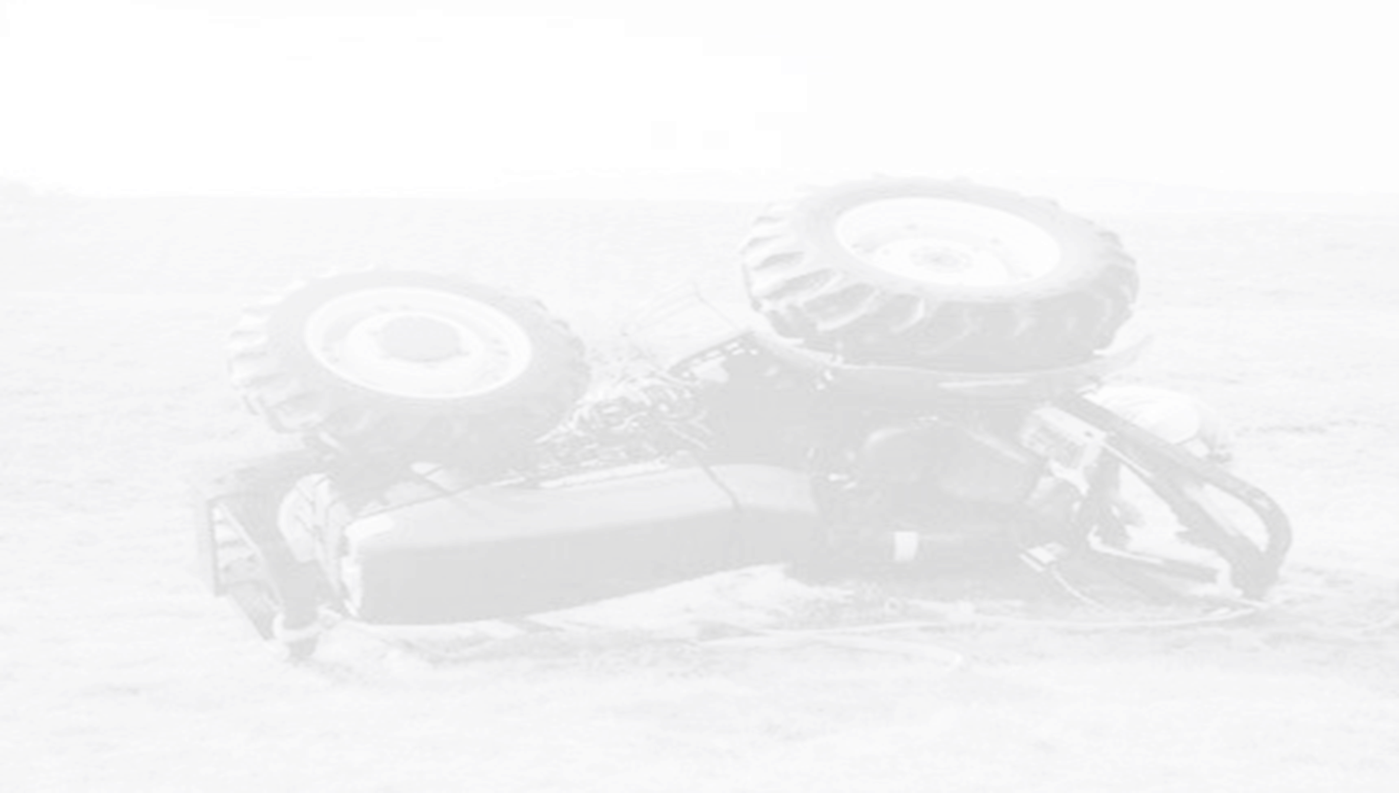
Final Word
Operating a tractor comes with the threat of overturns, which are extremely quick to happen. Being aware of all the risks will protect you and others from injury. Doing the job right doesn’t take more time, it just takes education and practicing the safe techniques you learn.

