Slide 1

Click anywhere to get started…

Slide 2

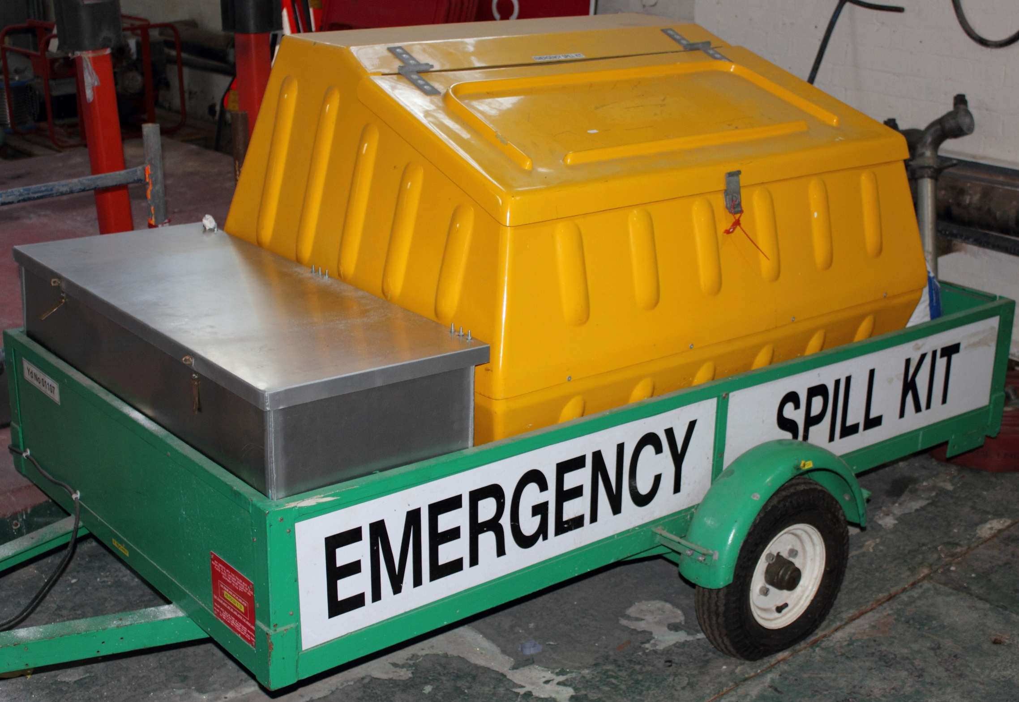

ENVIRONMENTAL - SPILL KITS
Notes:
Environmental: Spill Kits

Slide 3

What’s at Stake?
INTRODUCTION
Probably the most beneficial component of a spill kit is that they are pre-packaged with all the materials that will be needed in the spill clean-up procedure.
Notes:
What’s At Stake?
Probably the most beneficial component of a spill kit is that they are pre-packaged with all the materials that will be needed in the spill clean-up procedure. Once a spill occurs time is of the essence and being able to quickly grab the kit will ensure the spill is addressed immediately and effectively. Not only will the spill be contained and cleaned quickly, the PPE included in the spill kit will keep workers safe while they are handling the spilled materials.

Slide 4
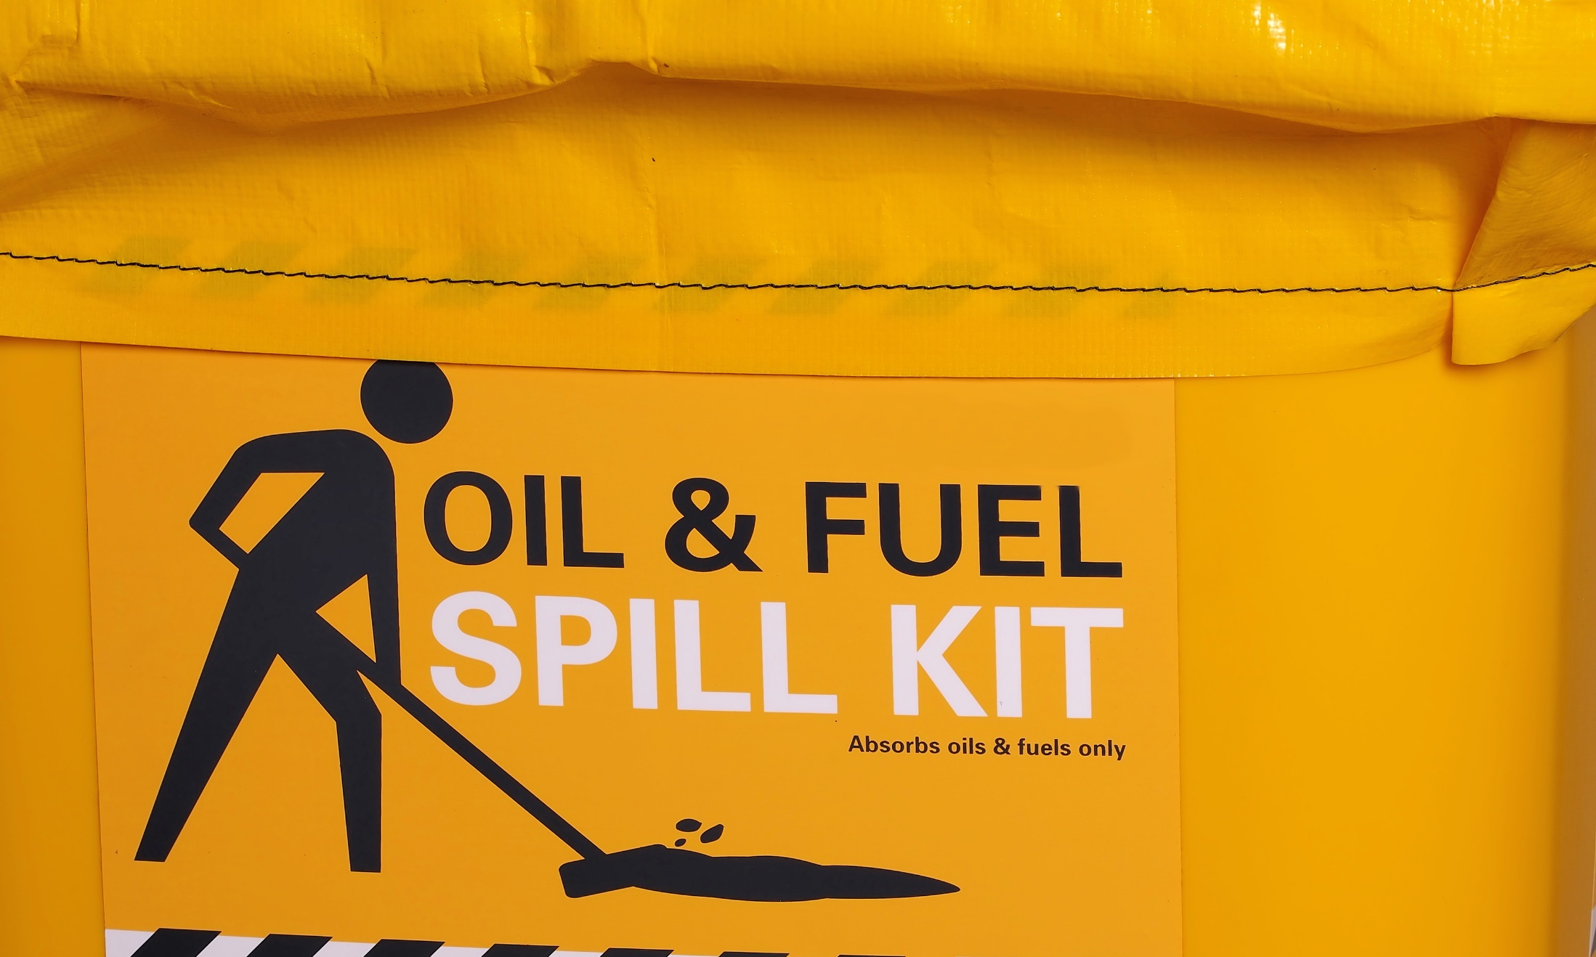
What’s the Danger?
DANGERS
1. Oil based products, water based products and chemicals spills.
2. Corrosive battery acid spills.
3. Mercury spills containing amalgamation powder; indicator powder used in fluorescent light bulbs, thermometers, and lab equipment
4. Bloodborne pathogen spills and any type of bodily fluids.
Notes:
What’s The Danger?
Most facilities have various materials that are dangerous, yet necessary for getting specific jobs done. Most of the time these products are used without any problem, but in the event of a spill it is important to be able to get them contained and cleaned up as quickly and safely as possible. This is why it is so important to have a good spill kit available that can properly clean up the specific solution that is spilled.
Dangers
Oil based products, water based products and chemicals spills.
Corrosive battery acid spills.
Mercury spills containing amalgamation powder; indicator powder used in fluorescent light bulbs, thermometers, and lab equipment
Bloodborne pathogen spills and any type of bodily fluids.

Slide 5
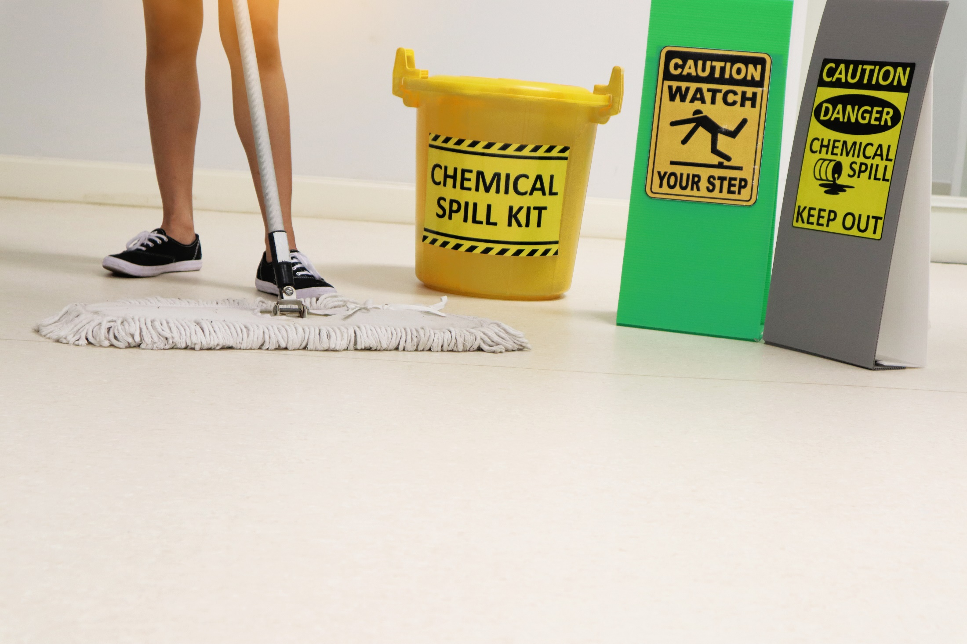
How to Protect Yourself
ENSURE FAST/EFFECTIVE RESPONSE TO SPILLS
1. Assess the risk
2. Select personal protective equipment (PPE)
3. Confine the spill
4. Stop the source
5. Evaluate the incident and implement cleanup
6. Decontaminate
7. Complete required reports
Notes:
How To Protect Yourself
Ensure Fast and Effective Response To Spills
1. Assess the risk
From the moment a spill occurs and throughout response, responders should determine the risks that may affect human health, the environment and property. The spilled material can be identified from the container label or the Safety Data Sheet (SDS).
Next, identify how much has been spilled and the primary dangers posed to the spill responders and the environment. Once the extent of the spill and the risks are understood, appropriate measures may need to be taken to isolate the spill area (e.g. setting up exclusion zones).
2. Select personal protective equipment (PPE)
The spill responder may already be wearing the necessary PPE because they were working with the spilled liquid, but if not, it is crucial that the appropriate PPE is chosen. Consulting the SDS, Chemical Manufacturers literature or the PPE Manufacturers literature can aid in choosing. If the danger is uncertain and the material is unknown, the worst should be assumed and the highest level of protection used.
3. Confine the spill
Confining the spill may be a simple task for spills of a few liters or it could be more difficult for larger spills, so it is important to make sure that the correct absorbents and size of spill kit are available for the liquids that have been spilled.
Responders should limit the spill area by blocking, diverting, or confining the spill. The flow of the liquid should also be stopped before it has a chance to contaminate a water source – minimizing the spill area and protecting drains are the priorities. Make sure the barrier is placed far enough away from the spill to ensure you can complete the setup but also far away from sensitive areas, such as drains and waterways.
4. Stop the source
This step may happen before the spill is even confined depending on the extent or the size of the spill. This could simply involve turning a container upright, or plugging a leak from a damaged drum or container. Once the leak has been stopped the liquids should be transferred from the damaged container to a new one.
5. Evaluate the incident and implement cleanup
Once the spill is confined and the leak has been stopped, it is time to reassess the incident and develop a plan of action for implementing the spill cleanup. First, responders should make sure they have enough spill response supplies to deal with the incident. Once absorbents are saturated, they may be considered hazardous waste and should be disposed of properly.
6. Decontaminate
The site, personnel, and equipment should be decontaminated by removing or neutralising the hazardous materials that have accumulated during the spill. This may involve removing and disposing of contaminated media, such as soil, that was exposed during the spill incident. PPE may be able to be reused after inspection and cleanup. An effective decontamination area should also be created to ensure the health and safety of emergency responders.
7. Complete required reports
As soon as possible after the spill, all spill notifications and reports required by local and national guidelines should be completed. Failure to do so can result in severe penalties. Typical reports include medical reports, local council or district reports, Environment Agency reports and company safety reports.

Slide 6
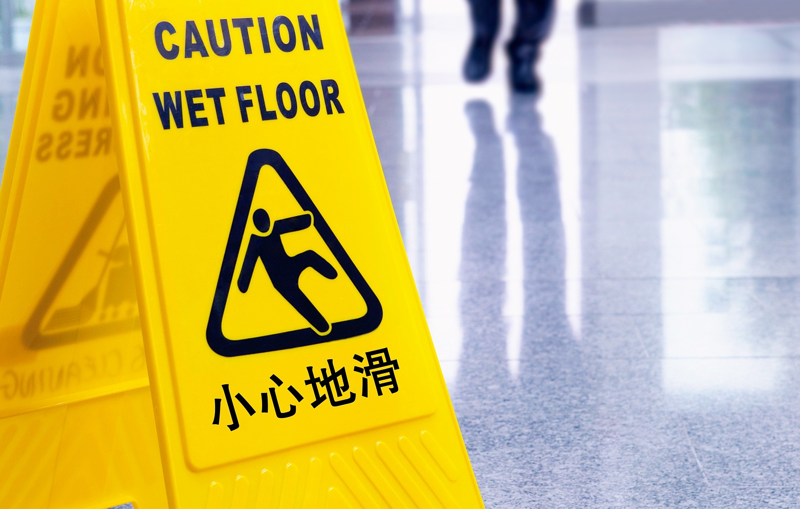
How to Protect Yourself
SPECIFIC PREVENTION STEPS
Oil Based and Water Based Spill
Safety Gloves
Eye Goggles
Shoe Covers
Sorbents
Handbook
Disposal Bag
Notes:
How to Protect Yourself
Oil Based and Water Based Spill
Safety Gloves – Having nitrile safety gloves will provide protection to the person cleaning up a spill. These types of gloves are resistant to corrosion from chemicals.
Eye Goggles – If even a small amount of many chemicals, oils or other things get in the eyes it can cause severe problems. This is why it is so important to keep your eyes protected with these goggles.
Shoe Covers – It is often necessary to step in the spill while cleaning it up and these shoe covers will protect your shoes and your feet.
Sorbents – The absorbent items that will actually clean up the spill need to be able to quickly absorb and hold in a variety of liquids. OSHA spill kits can have any number of types of sorbents. Most will have larger pads to put over the spill, pillows to contain and absorb the spill and smaller sorbent socks.
Handbook – Having the information you need to stay safe during a spill is also important. Most good spill kits will contain a book that helps you determine the potential dangers associated with cleaning up a specific type of spill.
Disposal Bag – Having a large bag or other storage bin that can hold everything after it has been used until it can be properly disposed of is absolutely essential.
Battery Acid Spills
If you work in an area where large, powerful batteries are present it is important to have an OSHA approved battery acid spill kit. These are different than other options because they can clean up the very corrosive battery acid safely. Many things such as the nitrile gloves, eye goggles and storage bags.
In addition to these standard items, the battery acid kids also have a poly apron to help protect your clothes from getting holes in them if the acid comes in contact with them. Having a special polymer that will neutralize the acid is also very important as it can minimize any damage during and after the cleanup process. While not always required, most spill kits of this type will have a scoop to help pick all the acid up.
Mercury Spills
Mercury can be very dangerous but it is a necessary element in things like fluorescent light bulbs, many types of thermometers and some lab equipment. Mercury spill kits need to contain amalgamation powder, indicator powder to make sure it is all cleaned up, a vapor suppressor bottle, an aspirator bottle and a chemical sponge to absorb all the mercury.
Biohazard Spills
If any biological spill occurs, including blood, this type of kit can be very effective. These kits are also known as blood borne pathogen spill kits. It is used to safely absorb just about any type of bodily fluids quickly and sanitarily. The following items should be in any bio-spill kit:
Bio-Hazard Sorbents – These are special sorbents that are made to absorb and secure biological materials. They can come in many shapes and sizes including large mats, thick pillows and more.
Neoprene Gloves – Neoprene gloves will help ensure nothing gets onto your hands. Many kits will have gloves with longer sleeves to help keep all the biological materials off your wrist and arms too.
Sanitizing Surface Wipes – Once you’ve cleaned up all the visible biological materials you’ll want to sanitize all surfaces with these wipes. They are made to kill any bacteria or virus that is left behind.
Sanitizing Hand Wipes – While you should ideally shower as quickly as possible after cleaning up a biological spill, these wipes will sanitize your hands and arms until that is possible.

Slide 7
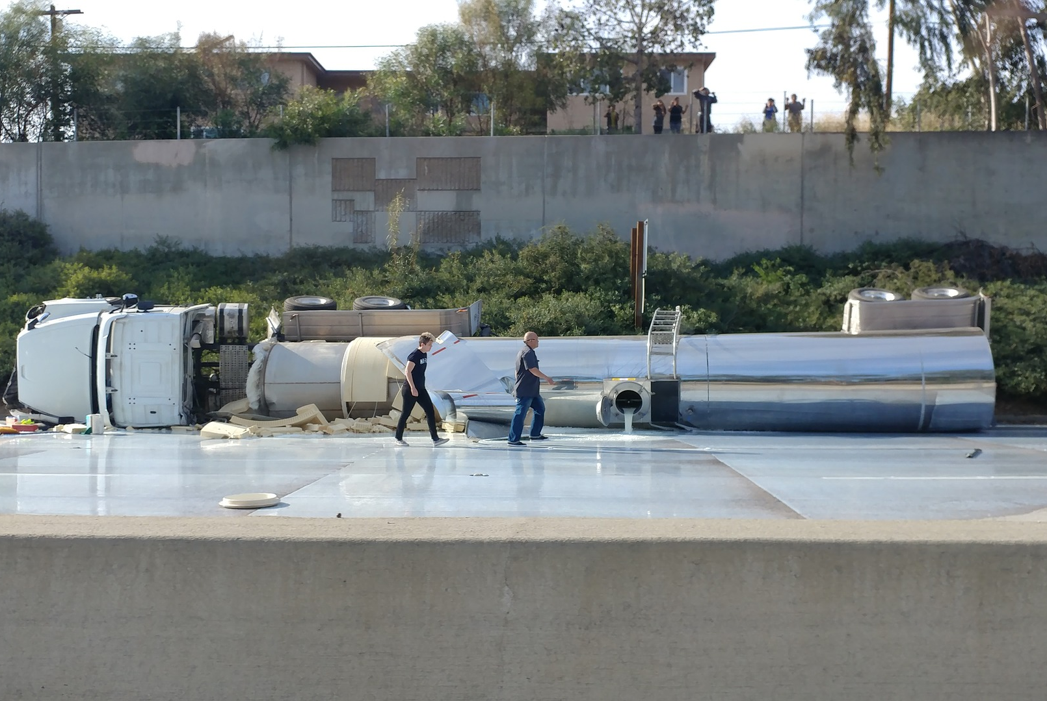
How to Protect Yourself
SPILL FOLLOW-UP
Provide Spill Cleanup Training
Proper Storage of Spill Kits
Keeping Multiple Kits on Hand
Improve Safety with Spill Cleanup Kits
Notes:
How to Protect Yourself
Spill Follow-up
Provide Spill Cleanup Training
Another important tip to keep in mind is that you should always provide good training to anyone in the facility so they know how to use the cleanup kits. While the maintenance or safety team should ideally be the people to clean up any hazardous spill, it may be necessary for other people to do it in certain situations.
Proper Storage of Spill Kits
Spill kits should be kept as close to the area where the things they are made to clean up are kept. For example, if you are operating a medical facility, the blood born spill kits should be kept in the blood lab. Letting everyone know where each kit is stored will allow them to grab it as quickly as possible. It may even be a good idea to use labels or floor signs near where the kits are kept to make them easier to find.
Keeping Multiple Kits on Hand
If it is at all possible, your facility should have at least two of each of the needed spill kits on hand at all times. This is because spill kits are made to be used just once and then disposed of. After a kit is used you will need to order a new one to replace it. If you don’t keep a spare on site you will be left without one until the replacement arrives.
Improve Safety with Spill Cleanup Kits
The bottom line whenever thinking about spill kits is that they should always be used to eliminate hazards and improve the overall safety of a facility. Keeping them properly stocked and ready to use at all times will not only keep your facility in compliance but also improve the safety of the entire facility.

Slide 8

Final Word
Every facility should have an effective spill response plan to prevent accidents from becoming disasters. Stocking the appropriate spill response equipment and providing the proper training for all employees is important before a spill response plan can be implemented.
Notes:
Final word
Every facility should have an effective spill response plan to prevent accidents from becoming disasters. Stocking the appropriate spill response equipment and providing the proper training for all employees is important before a spill response plan can be implemented.

