Slide 1

Click anywhere to get started…

Slide 2
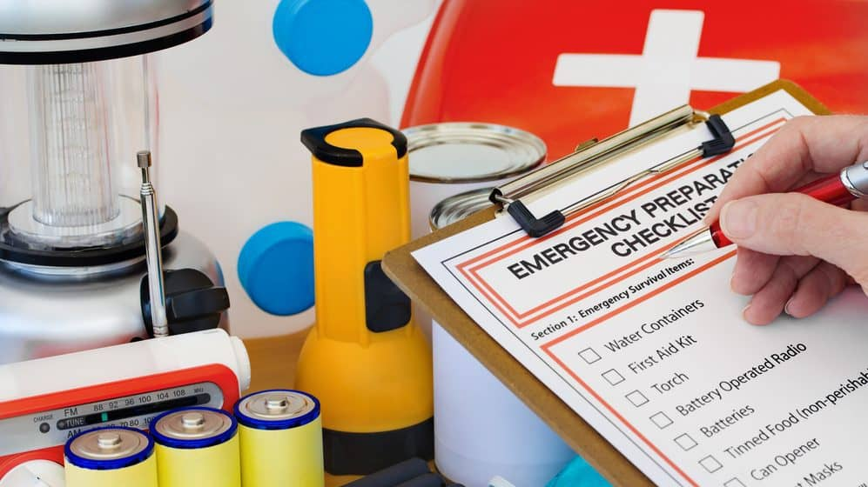

EMERGENCY PREPAREDNESS - DO YOU KNOW TO DO
Notes:
EMERGENCY PREPAREDNESS - DO YOU KNOW TO DO

Slide 3
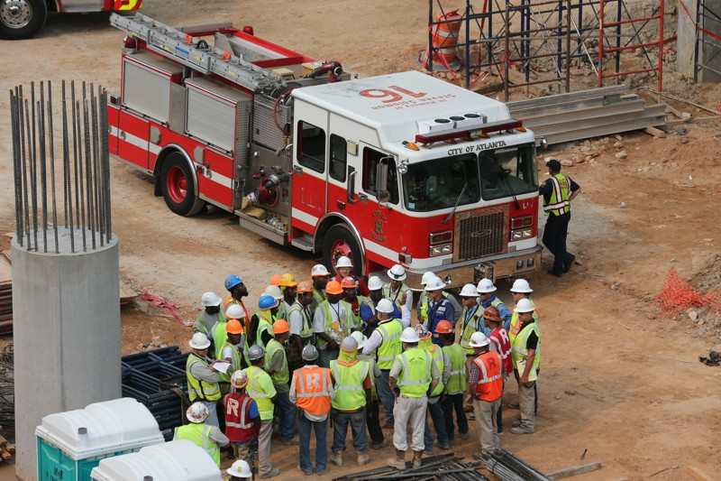
What’s at Stake?
Unexpected emergencies occur every day in many facilities, including laboratories, offices, plants, manufacturing, construction sites and residential buildings. If you don’t know what to do during an emergency the odds increase that you or others around you will be injured or killed.
Notes:
What’s at Stake?
Unexpected emergencies occur every day in many facilities, including laboratories, offices, plants, manufacturing, construction sites and residential buildings. If you don’t know what to do during an emergency the odds increase that you or others around you will be injured or killed.

Slide 4
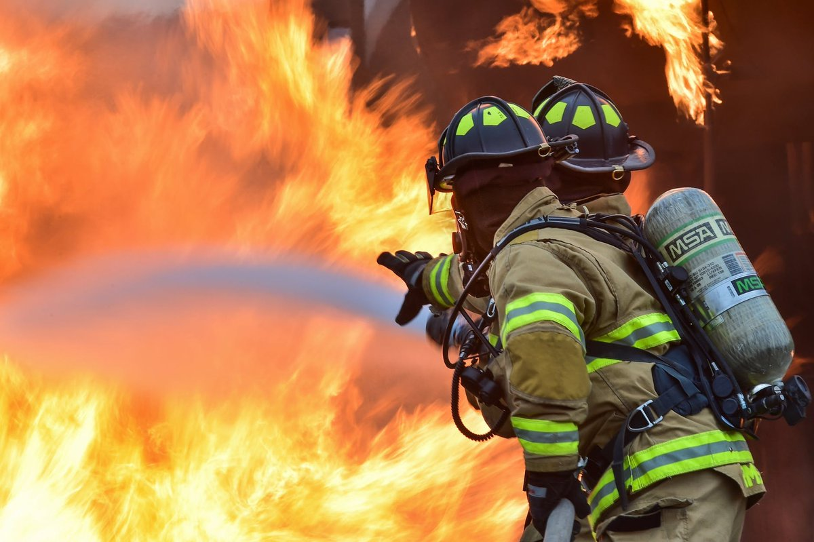
What’s the Danger?
Emergencies include severe weather, such as heavy wind, flooding, tornados, or hurricanes
Utility outages
Fires
Explosions
Notes:
What’s the Danger?
Emergencies include severe weather, such as heavy wind, flooding, tornados, or hurricanes
Utility outages
Fires
Explosions

Slide 5
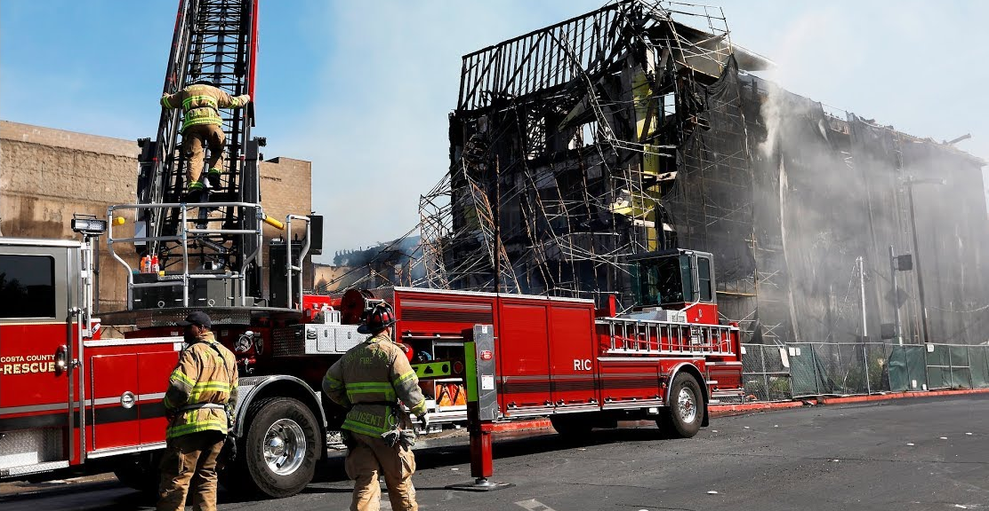
What’s the Danger?
Widespread infection
Hazardous materials
Earthquakes
Workplace violence
Terrorism
Notes:
What’s the Danger?
Widespread infection
Hazardous materials
Earthquakes
Workplace violence
Terrorism

Slide 6
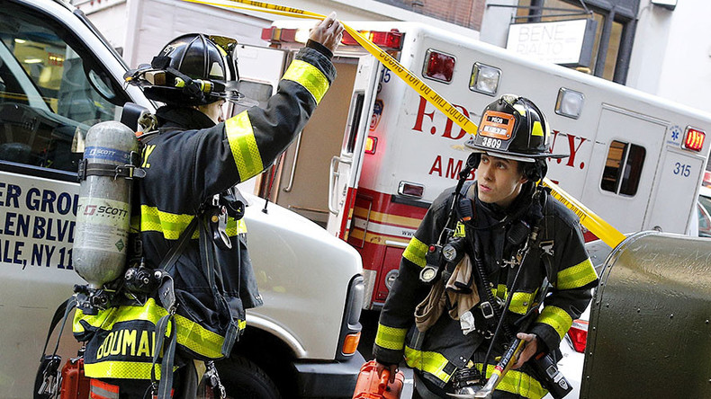
How to Protect Yourself
Knowing and practicing what to do before an emergency occurs is a key step to protecting yourself and others around you.
WHO
Who are the qualified first aid personnel for your facility?
Who on your crew knows CPR?
Who in your area is trained to clean up a chemical spill?
Notes:
How to Protect Yourself
Knowing and practicing what to do before an emergency occurs is a key step to protecting yourself and others around you.
WHO
Who are the qualified first aid personnel for your facility?
Who on your crew knows CPR?
Who in your area is trained to clean up a chemical spill?

Slide 7
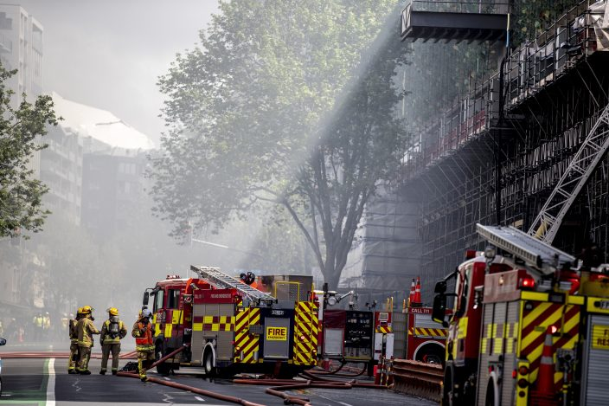
How to Protect Yourself
WHAT
What factors determine when you evacuate and when you shelter-in-place? You may be told to shelter-in-place during an earthquake, severe weather, or radiological, biological, or chemical release.
What are the emergency exit routes from your work area? There must be at least two – and more than two are required if the circumstances warrant it.
What phone numbers do you call for various emergency agencies?
What is the physical address of your work location?
What are your duties in an emergency?
What should an emergency kit contain?
Notes:
How to Protect Yourself
WHAT
What factors determine when you evacuate and when you shelter-in-place? You may be told to shelter-in-place during an earthquake, severe weather, or radiological, biological, or chemical release.
What are the emergency exit routes from your work area? There must be at least two – and more than two are required if the circumstances warrant it.
What phone numbers do you call for various emergency agencies?
What is the physical address of your work location?
What are your duties in an emergency?
What should an emergency kit contain?

Slide 8
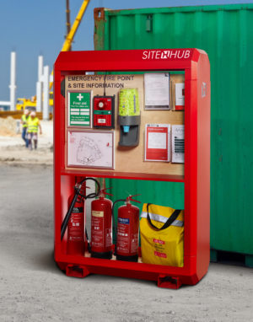
How to Protect Yourself
WHERE
Where should you assemble outdoors if you must evacuate?
Where should you shelter-in-place if necessary?
Where is the first aid equipment located?
Where are the nearest telephones in your work area?
Where is the fire extinguisher located?
Where are the safety showers and eyewash stations in this work area?
Where are the SDSs (Safety Data Sheets) for the chemicals used in your work area?
Notes:
How to Protect Yourself
WHERE
Where should you assemble outdoors if you must evacuate?
Where should you shelter-in-place if necessary?
Where is the first aid equipment located?
Where are the nearest telephones in your work area?
Where is the fire extinguisher located?
Where are the safety showers and eyewash stations in this work area?
Where are the SDSs (Safety Data Sheets) for the chemicals used in your work area?

Slide 9
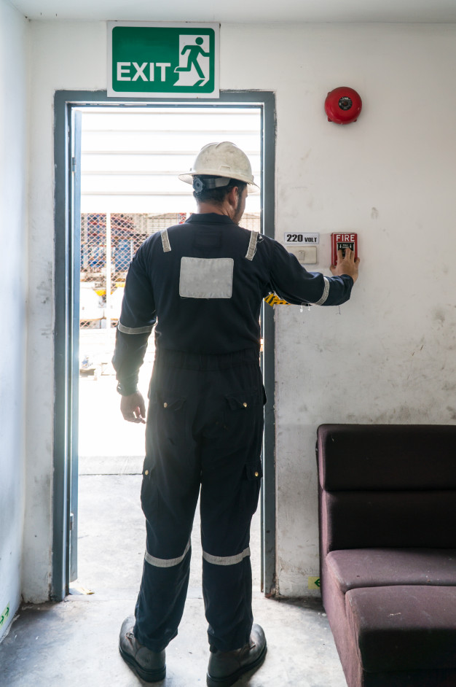
How to Protect Yourself
HOW
How do you activate the alarm for a fire?
How do you contact the fire department?
How would you give directions to an ambulance?
Notes:
How to Protect Yourself
HOW
How do you activate the alarm for a fire?
How do you contact the fire department?
How would you give directions to an ambulance?

Slide 10
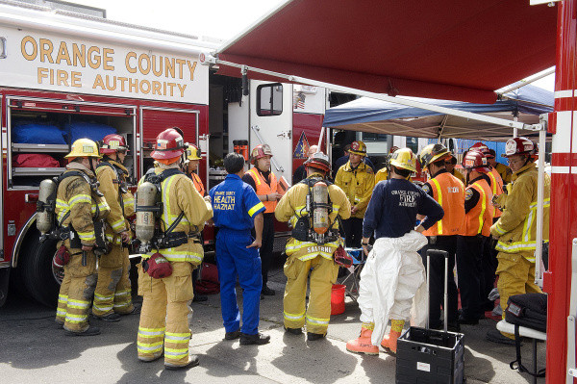
Final Word
How did you do? Do you feel you’re ready for an emergency? If not, talk with your supervisor, safety contact, or floor warden to clear up any questions you have. Remember, if you wait for an emergency to learn how to protect yourself, it’s likely already too late.
Notes:
Final Word
How did you do? Do you feel you’re ready for an emergency? If not, talk with your supervisor, safety contact, or floor warden to clear up any questions you have. Remember, if you wait for an emergency to learn how to protect yourself, it’s likely already too late.

